Slide 1
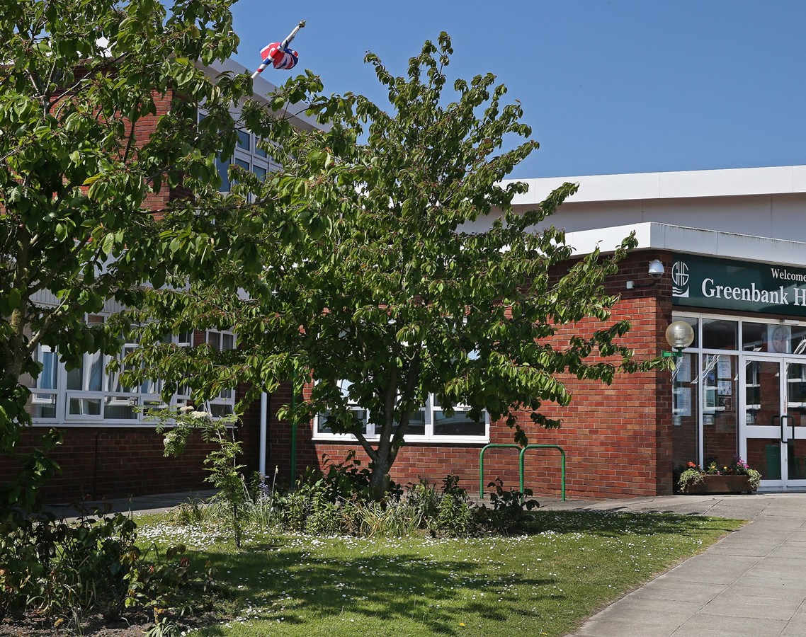

Welcome to Greenbank High School
Ms Aspinall - Headteacher
Inspire, Care, Achieve

Slide 2
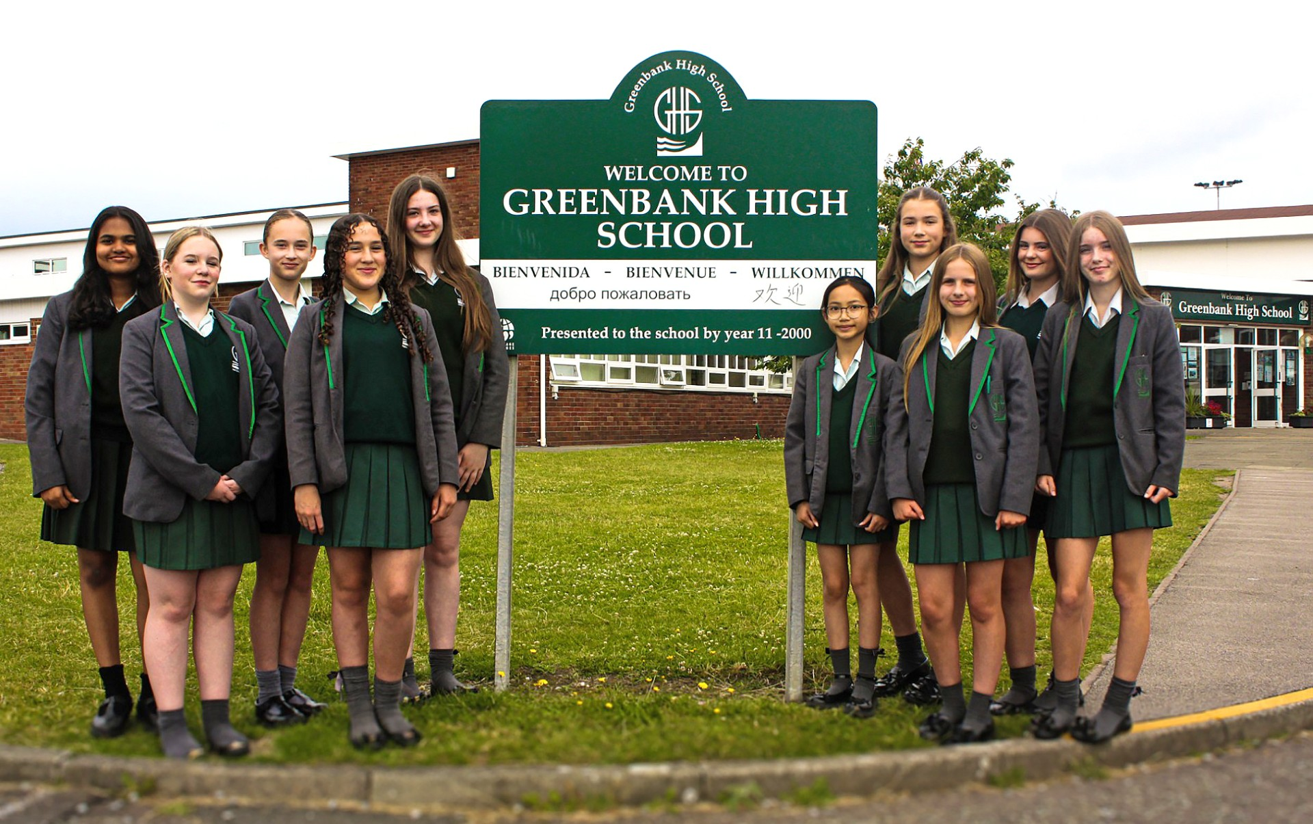
Inspire, Care, Achieve
Notes:
DANCE PERFORMANCE
What a wonderful welcome to Greenbank – thank you girls!
Good evening and very warm welcome to Greenbank High School.
It’s a great privilege to be able to welcome you to our school this evening. I would like to share with you how immensely proud I am, to be leading such a talented and committed team of staff, in a school filled with superb students. It is the school that many staff, myself included, choose to send their own children to, which I believe is further testament to how good Greenbank is.
So whether your child is in Y6 or Y5 you are on the cusp of making a big decision about their next stage and given that, we want to make sure that you get a really good feel for what we are all about here at GHS. Myself, senior leaders, teaching and support staff and most importantly our students will be around this evening to answer any questions.
Transition to secondary school is an exciting one! … looking to spend 5 years with us… I just want to take about 20 minutes or so to give you a flavour of some of the special features of our school and say a little about the admissions process … But first what is it like starting at Greenbank High School from a pupil’s point of view? Like to welcome Violet from Year 8 and our Head Girl Ellie from Year 11.

Slide 3
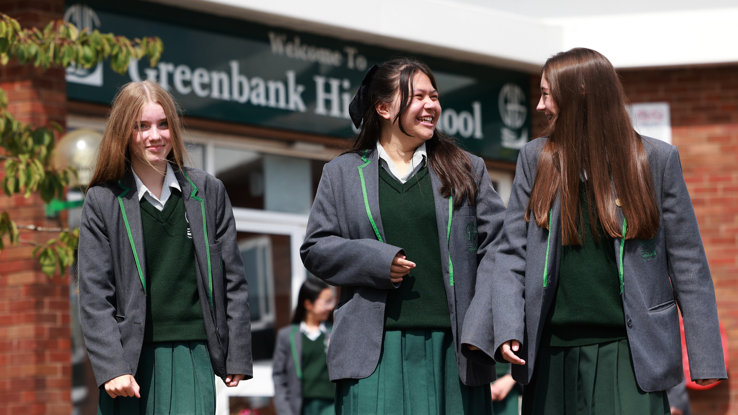
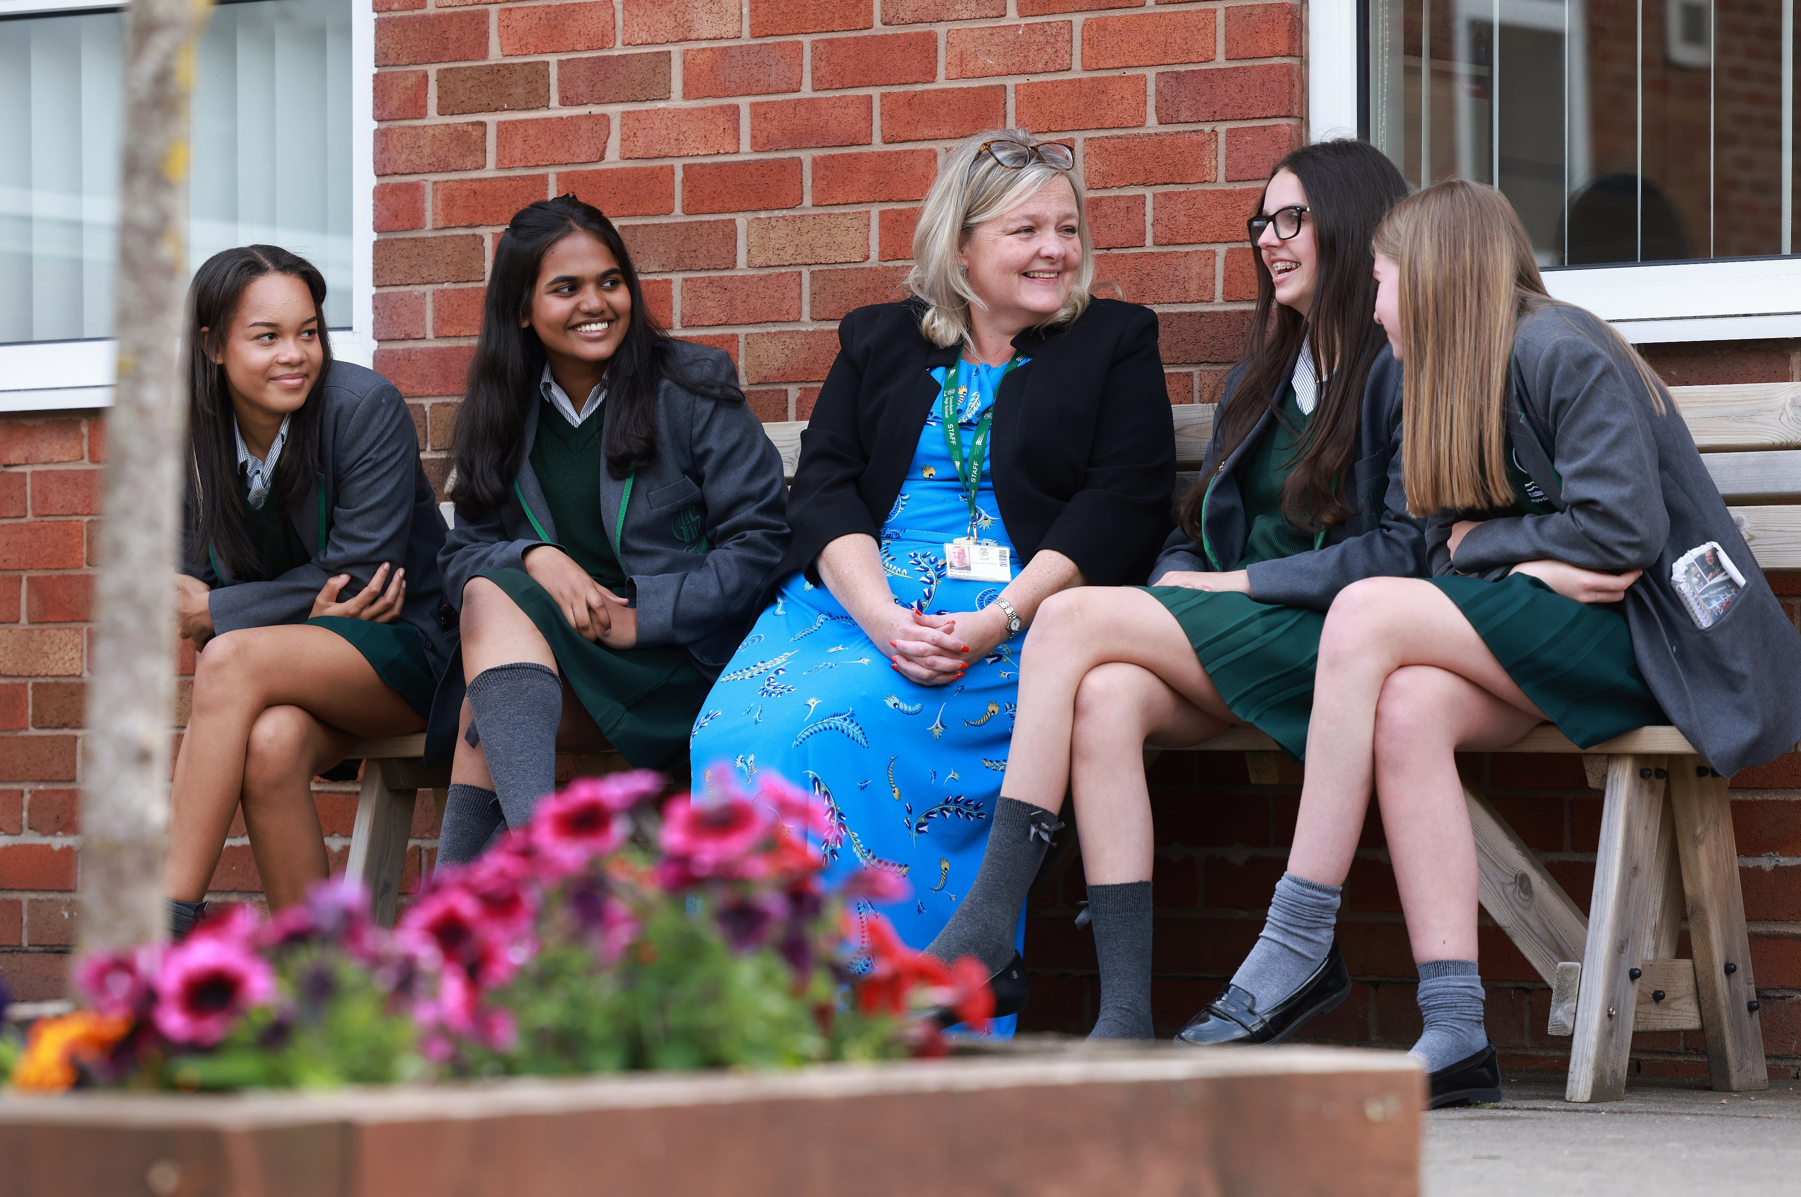
Welcome
Violet Brettel - Year 8 and
Ellie-Ann Thomas Blackledge - Head Girl Year 11
Inspire, Care, Achieve
Notes:
Thank you Violet and Ellie
Wow! What a duo to follow!

Slide 4
Our Vision
Our Vision
Excellence for all: to be an exceptional school of choice for girls in the heart of Southport’s diverse community.
A school community where we all belong.
The delivery of an inclusive and dynamic learning experience, will empower all Greenbank pupils to achieve academic success, and go on to be courageous global citizens that will continue to show the world their brilliance.
Our diverse and inclusive school community provides an exceptional education that nurtures, enriches and empowers all our pupils to thrive.
Inspire, Care, Achieve
Notes:
Our vision is to provide a truly exceptional education - three key components to this:
High quality curriculum, delivered by expert teachers – teaching children everything they need to learn and know. This will be with them for life – our drive is to ensure there are no limits for pupils that they can compete and access all the opportunities they need to.
Excellent standards of behaviour – highest expectations so that the focus is rightly on learning. This is because first and foremost we care about every child in our school, we have high expectations because we believe in each and every one of them.
A positive, nurturing learning environment – children need to feel afe and secure in order to take risks with learning and access all the opportunities on offer. I know that when you walk round this evening this is what you will find. We have excellent relationships with children, a great environment and everyone is committed to ensuring the very best for our pupils.
Importantly a school community where we all belong and feel valued.

Slide 5
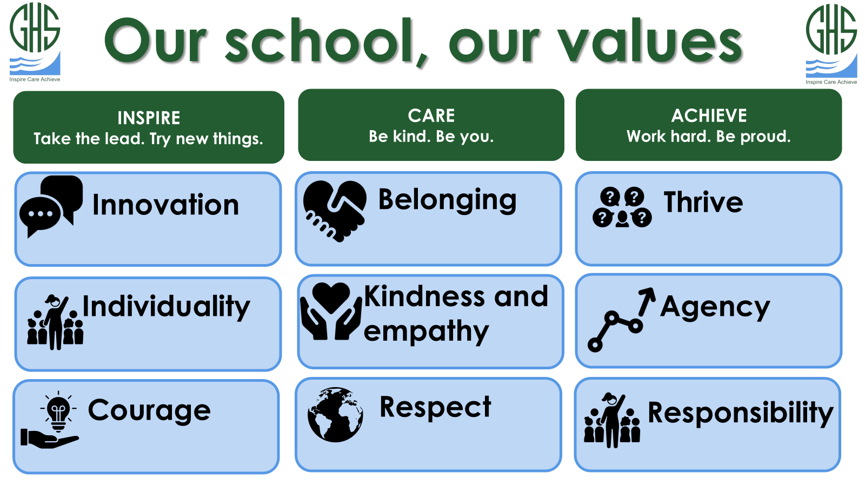
Notes:
Our school values centre around our school motto of INSPIRE CARE ACHIEVE. Actively teach and role model these values across the school, within curriculum and personal development time – theme them against subject areas.
We operate a warm and strict approach so that children learn to be organised, respectful and have a great attitude to learning. When they get these things right routinely they are rewarded in many different ways, earning achievement points for getting things right, going above and beyond, modelling our school values.
When mistakes are made then we help pupils to learn and reflect on this through our centralised restorative behaviour system, this is clear and consistent which we know are so important for children.
We teach our pupils how to behave… don’t assume they just know how to… its part of growing up and a safe, calm and structured environment.
Principally if they are the right uniform, got their pencil cases and books for the day they will be just fine!

Slide 6
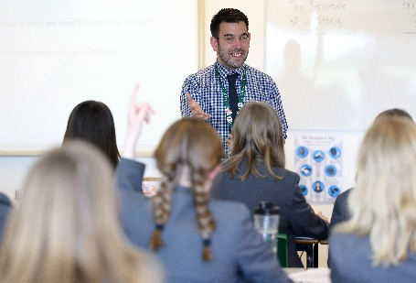
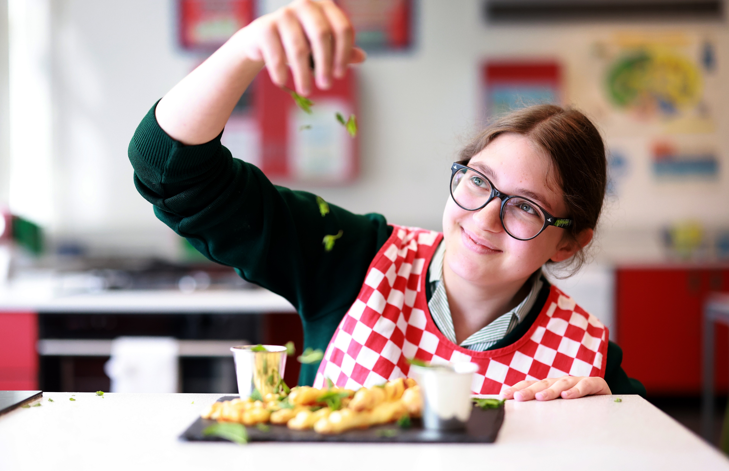
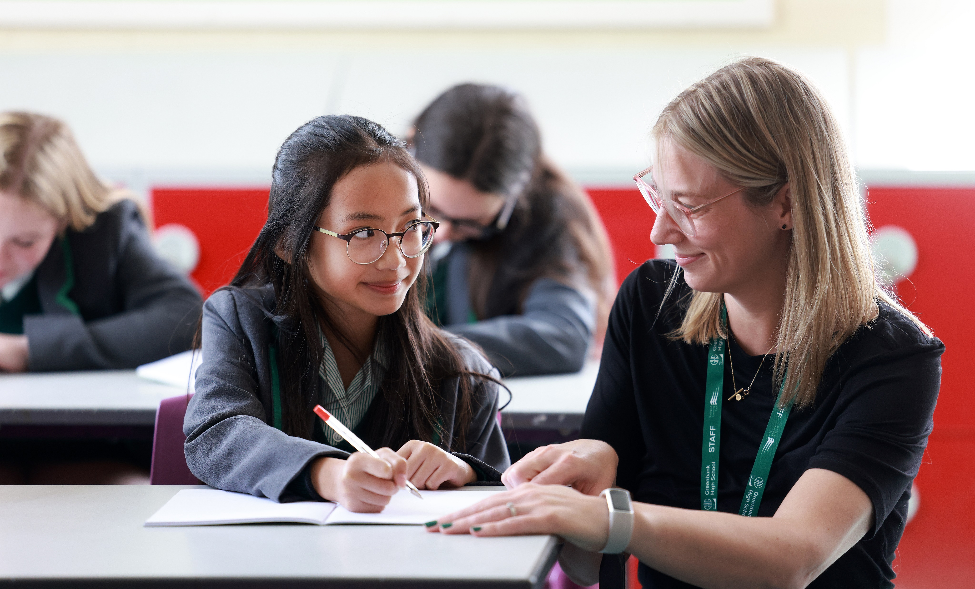
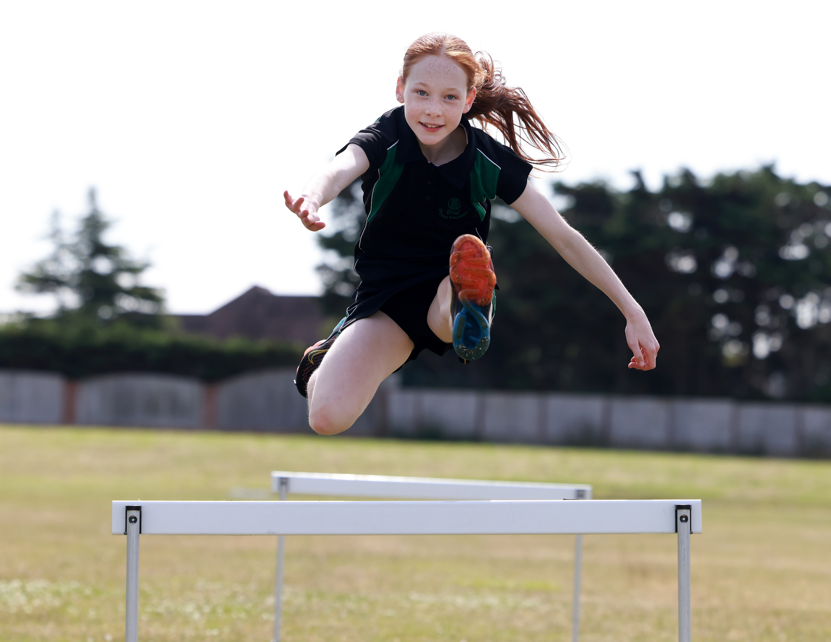
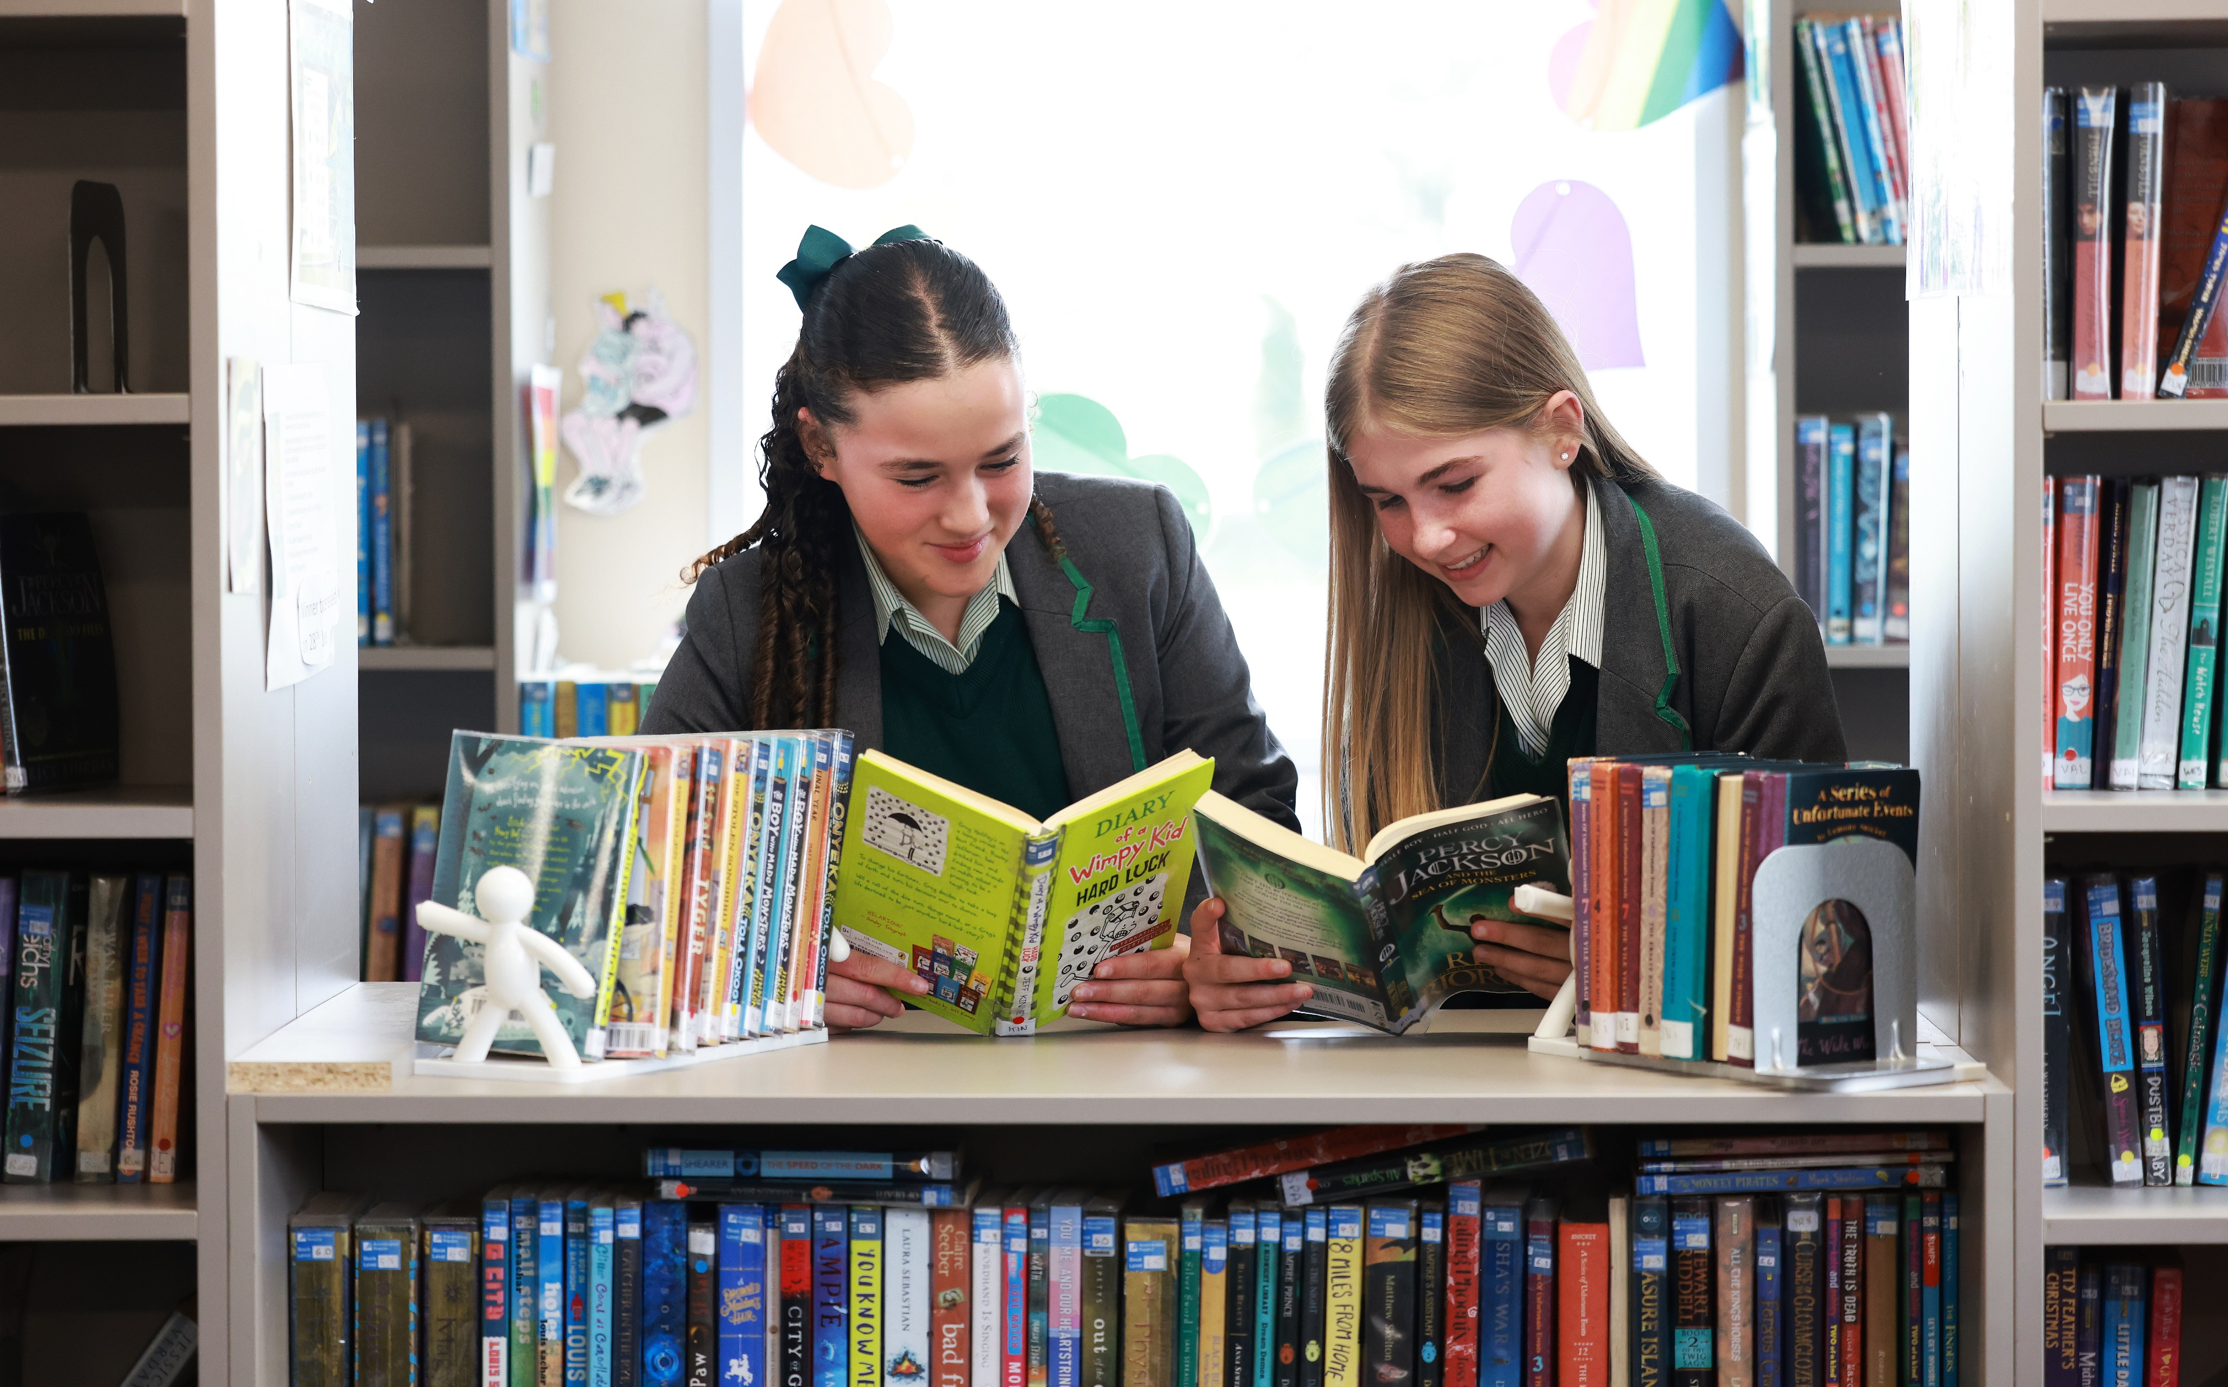
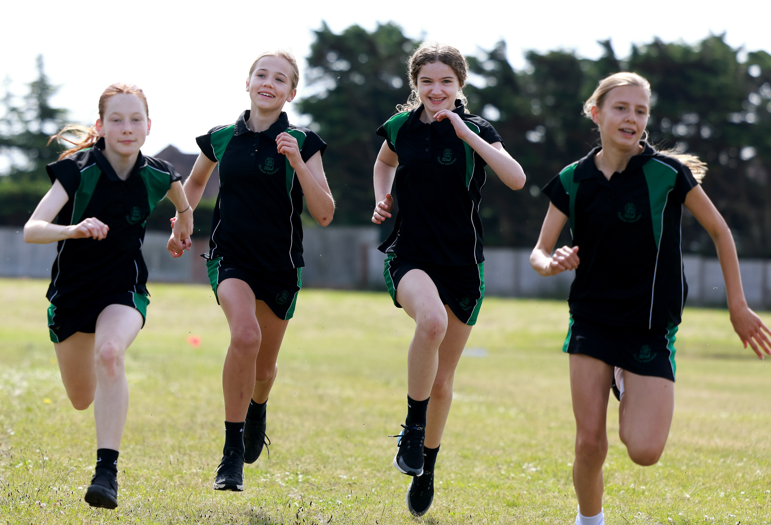
Why choose an all-girls education at Greenbank?
Learning and Succeeding
Research has consistently shown that girls achieve more in single-sex schools. They make better decisions about their future and are not afraid to be seen to be working hard.
Learning to Lead
Girls’ schools help their pupils to develop broad horizons, offering strong female role models and providing high expectations. We provide greater leadership opportunities.
Learning with Confidence
Girls acquire higher self-esteem and greater self-confidence. Girls’ schools create opportunities for appropriate educational risk-taking and challenge stereotypes.
Inspire, Care, Achieve
Notes:
So why choose an All Girls education?
There are a number of reasons why this works well for so many pupils and having worked in both mixed and in single sex schools there are a few things that are noticeable.
In the classroom children are confident to get involved and answer and ask questions – if you join us for one of our tours you will see the safe, calm and purposeful way in which our pupils work.
We also know that on average girls make better progress in single sex schools compared with co-ed. This is predominantly down to the environment and the opportunities which can be tailored for girls to ensure that we are supporting them, to challenge stereotypes, to have sky high aspirations and to access all of the opportunities.
What is also of note is the confidence and concentration that pupils have without the distraction of boys allowing the focus to be on accessing all of the opportunities on offer as well as the full curriculum.

Slide 7
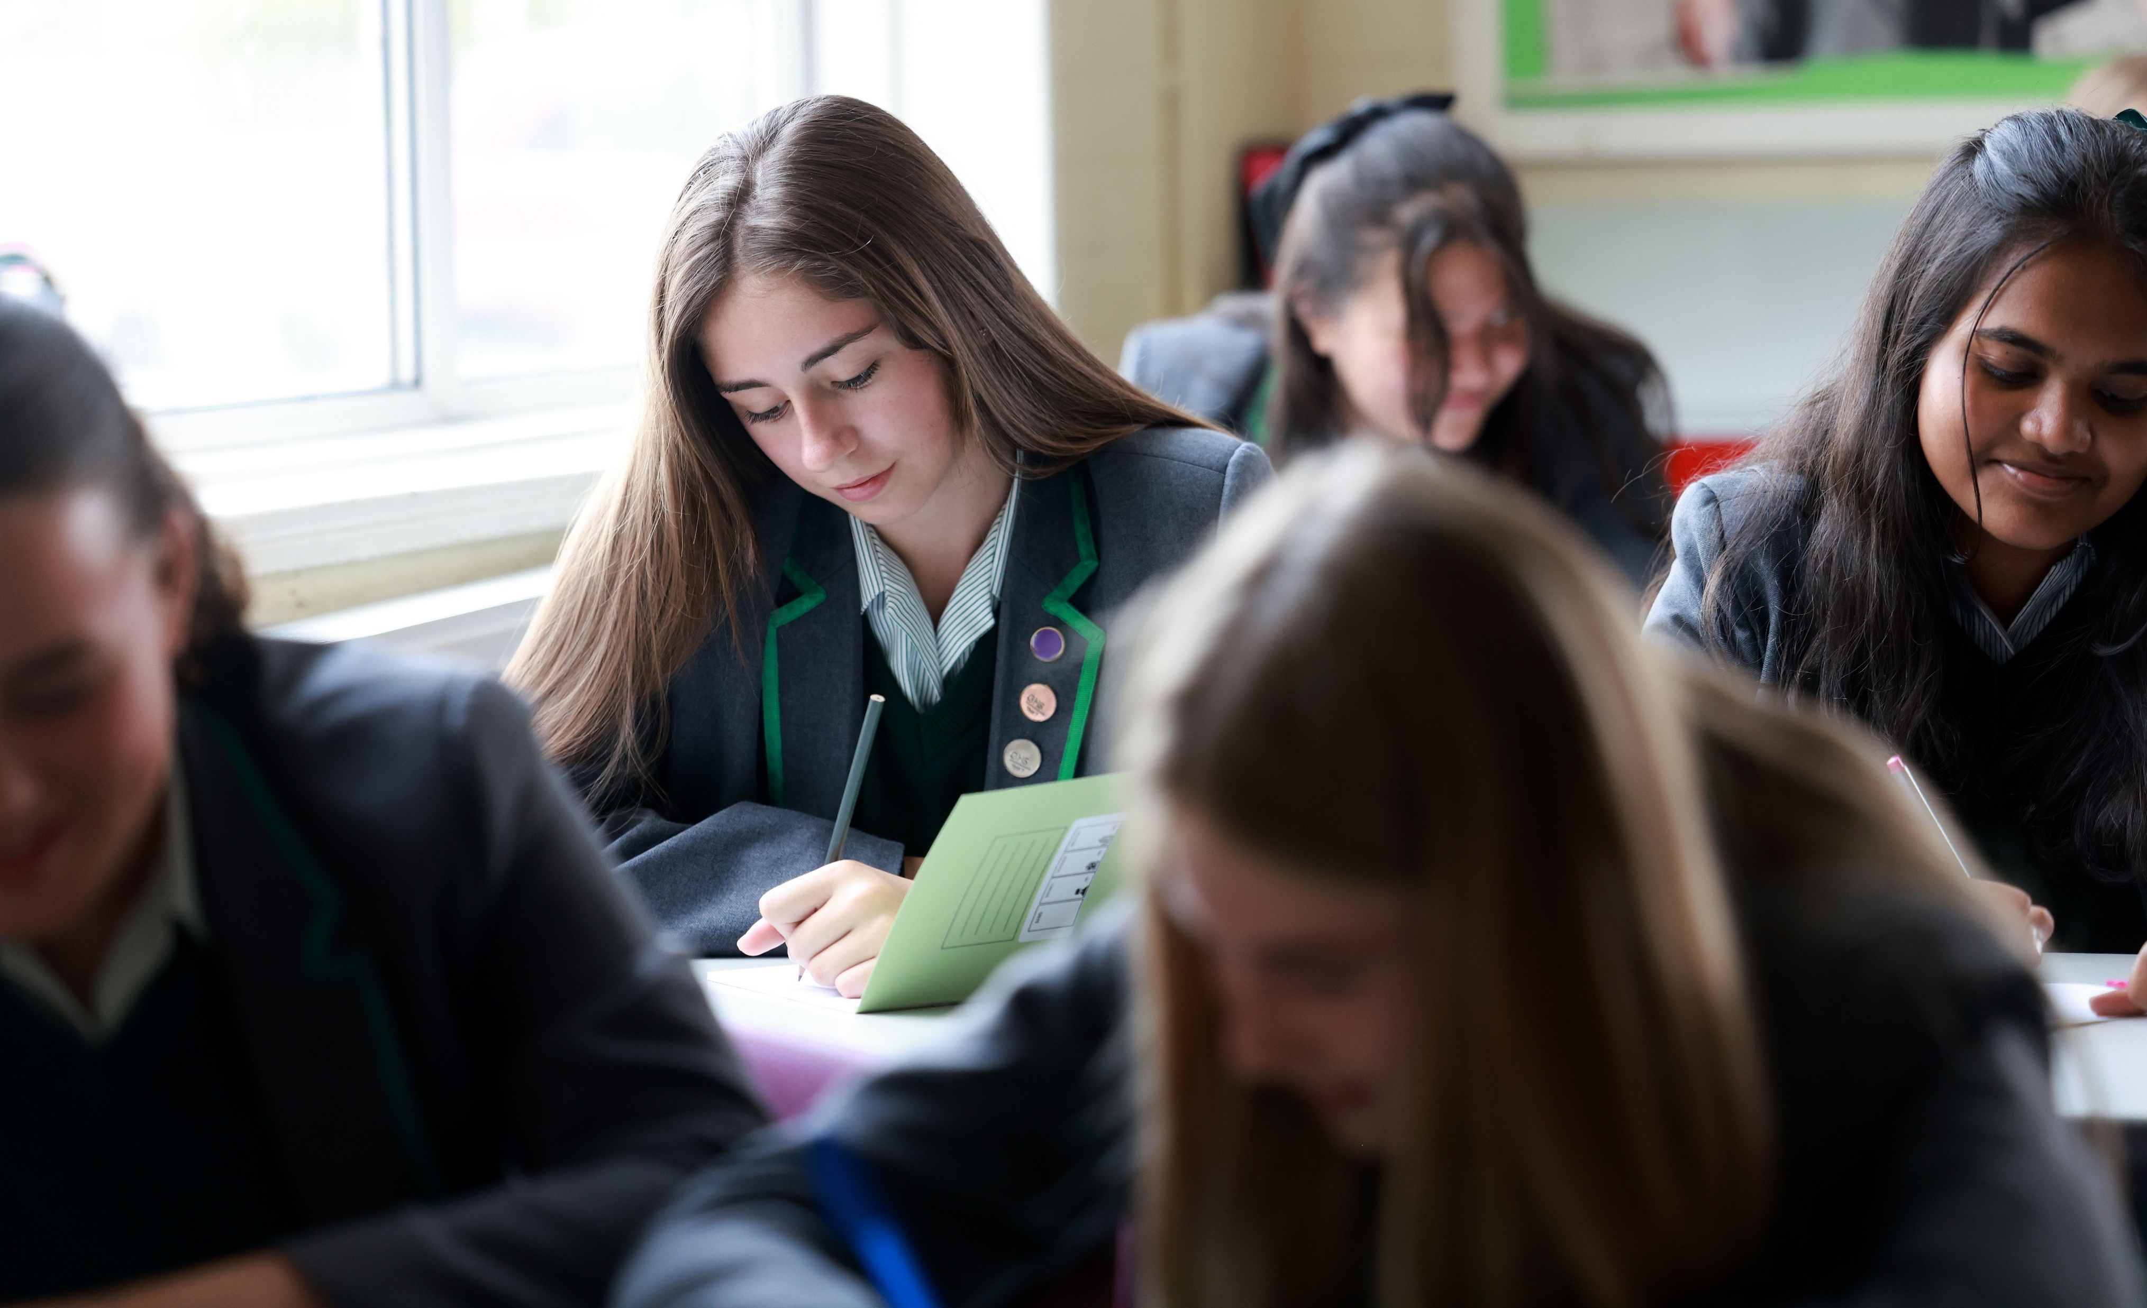
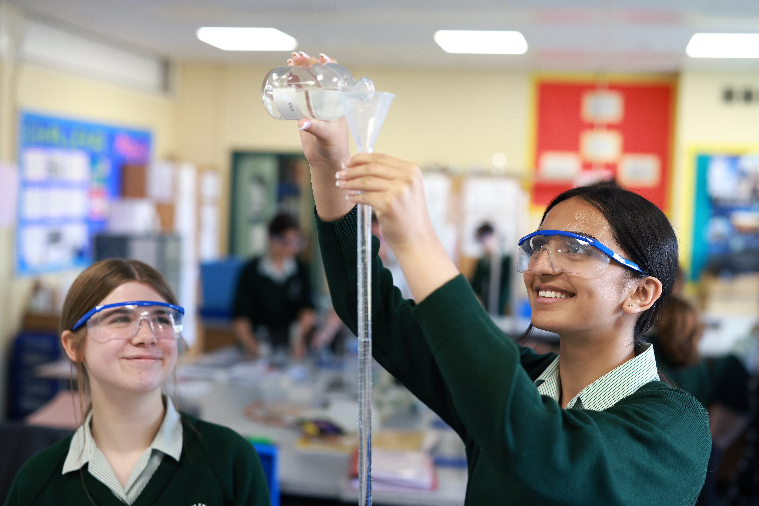
How do we inspire our learners?
A sky’s the limit approach with no pre-determined targets for pupils
Specialist teachers in all subject areas
A broad and balanced curriculum taught predominantly in mixed ability classes
Bringing the curriculum to life with:
  Exceptional teaching
  Extra-curricular clubs
  Curriculum based visits
  Links with careers and further and higher
  educational establishments
Enhancing learning through leadership and enrichment opportunities
Developing literacy throughout the curriculum
Inspire, Care, Achieve
Notes:
We inspire our learners every day with a broad curriculum giving children the core knowledge they need to go on and study whatever they choose to do.
We have a sky's the limit approach with no pre-determined targets for pupils.
We have specialists in all subject areas which may sound obvious but actually is not always the case at secondary. Subject knowledge and how this is taught are the 2 most important aspects in how well children learn and so excellent subject knowledge is an incredibly important aspect of their learning. We have examiners in every faculty of the school as well as professional development to support staff being at the top of their game in terms of pedagogy.
We believe and know from research that pupils on average do better in mixed ability classes. Most of our curriculum is delivered in this way and we ensure that all children learn across a broad curriculum - (exception of maths which is setted)
Learning is brought to life with world class teaching, extra-curricular clubs, curriculum based visits and links to careers and FE/HE. These are all important as they help children to understand why their learning matters in a real context but it also develops pupil to pupil and pupil to staff relationships. Learning is often assessed based on what pupils remember and again, extra curricular activities and visits will help children to create memories in a way that will allow them to learn and recall knowledge and skills even better.
We also support pupils to develop their leadership skills so that by Y9 they all have an area that they lead on, supporting younger pupils.
Finally, and almost most importantly, children need to read frequently and widely to access the curriculum, we focus on this routinely and encourage parents and carers to do the same.
Students who join us that have not yet reached age expected results - we respond, and plan additional support to ensure that children understand the basics before we move on, as well as ensuring those that are ready are sufficiently challenged and are making progress.

Slide 8
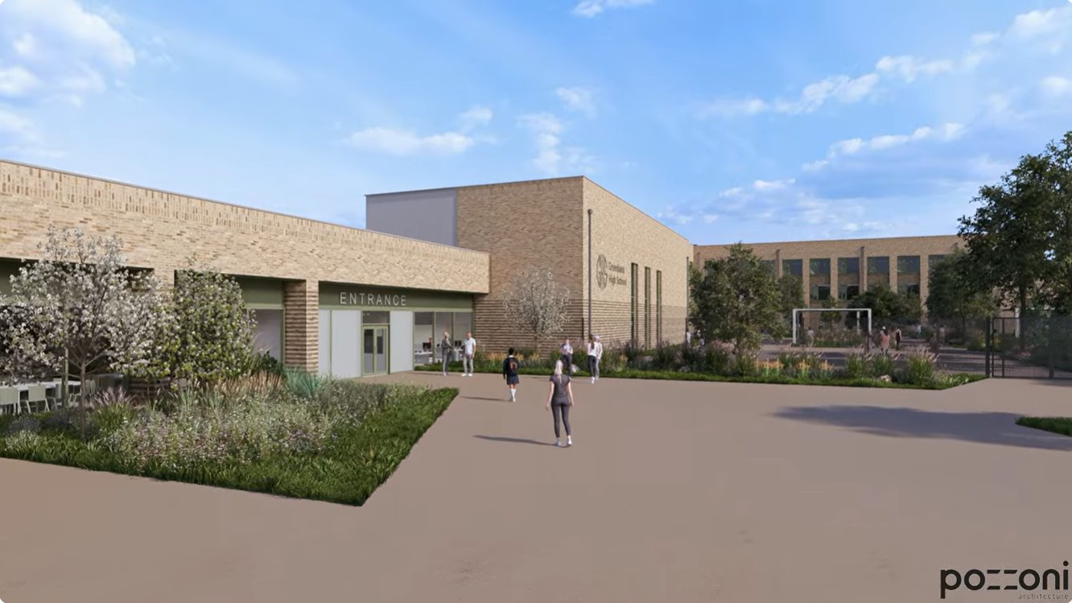
DfE School Rebuilding Programme
Phase 1 – Provide temporary accommodation
Phase 2 – Partial demolition
Phase 3 – Build new building
Phase 4 – Demolish all existing buildings and provide new soft and hard landscape areas and sports facilities
link: https://youtu.be/LCGw7d3Lkao
Inspire, Care, Achieve
Notes:
Super excited to be selected by the DfE for a brand new school – significant multimillion pound investment. Planning was agreed unanimously only last night at Planning Committee meeting.
Expecting work to start on site end of this year (2026) – finished end of 2028/early 2029 – most of their school career in a fantastic new school building with incredible facilities. Majority of school building will remain in operation during the build programme. Disruption minimised, some temp accommodation – better than existing spaces! Onlylast night planning permission was unanimously granted by Sefton Planning Committee
​Ppt will be published on our school website so please do have a look at You Tube link – fly through the new building.
Hand over to HH who will share more information on our curriculum offer and transition process.
​

Slide 9

Ms Hinde
Deputy Headteacher
Inspire, Care, Achieve

Slide 10
Key Stage 3 Curriculum
Science
French
Spanish
History
RE
PE
English
Personal Development
Music
Design Technology
Drama
Maths
Geography
Computer Science
Art
Latin
Dance
Inspire, Care, Achieve
Notes:
At Greenbank High School, our curriculum is built around our vision of Educational Excellence for All and our commitment to the Greenbank values. We want every student to be ambitious, resilient, respectful and ready to make a positive contribution to the world around them.
From September 2026, students will benefit from a full three-year Key Stage 3 curriculum. This means more time to explore a broad range of subjects, build secure knowledge and develop the confidence and curiosity that underpin lifelong learning. Rather than rushing students towards examinations, we believe in giving them the time to think deeply, develop mastery and truly understand what they are learning.
Our curriculum is carefully sequenced so that knowledge is revisited and strengthened over time, helping students become confident learners, critical thinkers and effective communicators. Alongside academic success, we place great importance on enrichment, leadership opportunities, creativity and personal development, ensuring students grow in character as well as achievement.

Slide 11
Key Stage 4 Curriculum
GCSE Science
GCSE English language
GCSE Maths
Personal Development
IT throughout the curriculum
GCSE English literature
GCSE History / Geography
Option 1
Option 2
Option 3
Inspire, Care, Achieve
Notes:
Students will study nine GCSEs, allowing greater depth of learning without reducing ambition. This approach enables students to achieve strong outcomes, whilst also developing the literacy, numeracy, digital skills and wider experiences they will need for future success.
Above all, our curriculum reflects our belief that every child should feel known, valued and supported. We maintain high expectations for all students, including those with additional needs, while providing the opportunities and encouragement that help every young person thrive.
At Greenbank, we don't believe that success comes from doing more. We believe it comes from learning more deeply, thinking more critically and embracing every opportunity to grow. That is how we live our values and how we prepare our students for successful futures.

Slide 12
Options Choices
GCSE PE
GCSE French / Spanish / Latin
GCSE separate sciences
GCSE food and nutrition
GCSE RE
GCSE dance
GCSE design technology: textiles
GCSE Child development
GCSE music
GCSE art and design
GCSE fine art
GCSE photography
GCSE graphics
GCSE computing
GCSE film studies
GCSE drama
Inspire, Care, Achieve
Notes:
One of the highlights of this evening is the opportunity to explore the wide range of GCSE subjects available at Greenbank. Staff and students are on hand to share information about the courses, the skills students develop, examples of work and the opportunities each subject can offer.
We encourage you to ask questions, explore the displays and discover the breadth of opportunities available. While GCSE choices are still some years away, tonight offers a valuable insight into how our ambitious curriculum helps students develop their interests, talents and future aspirations.

Slide 13
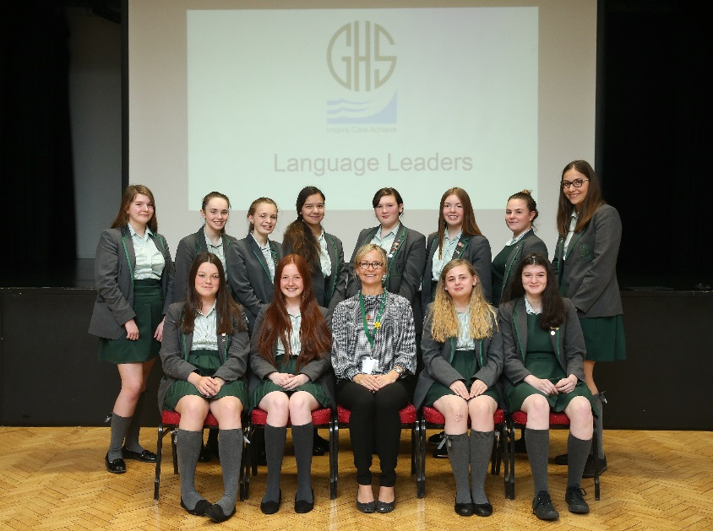
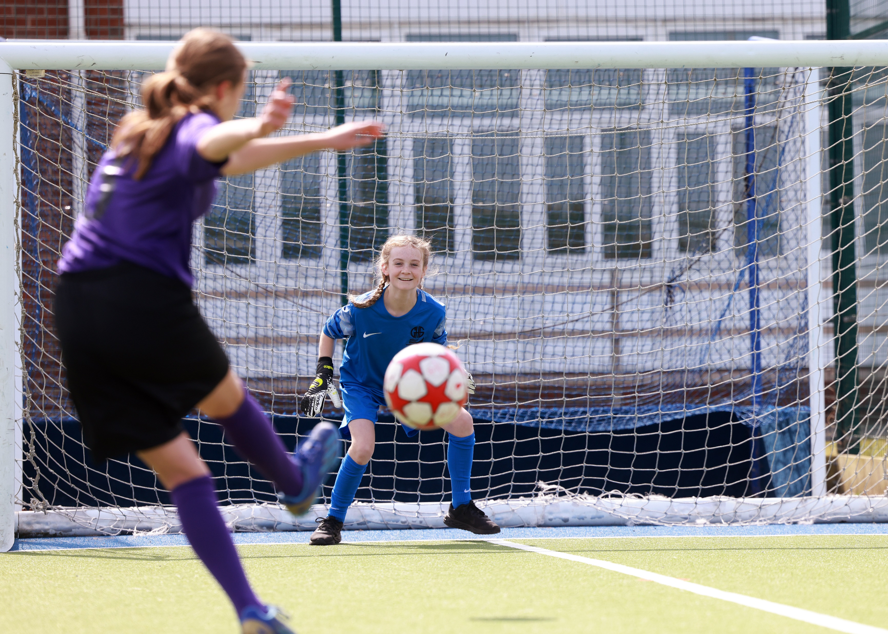
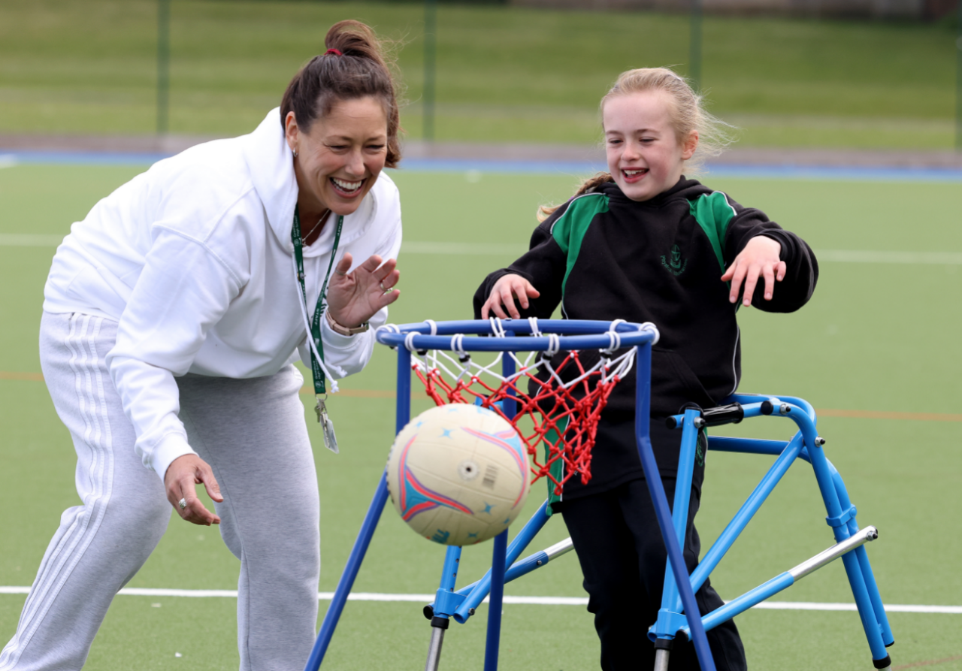
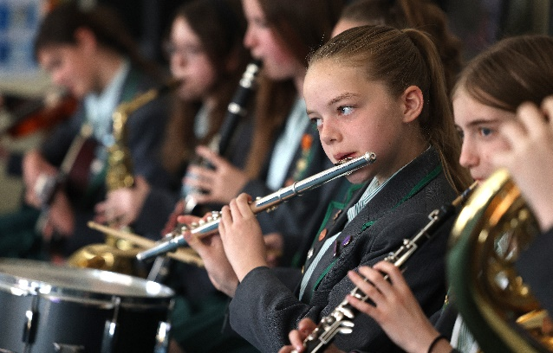
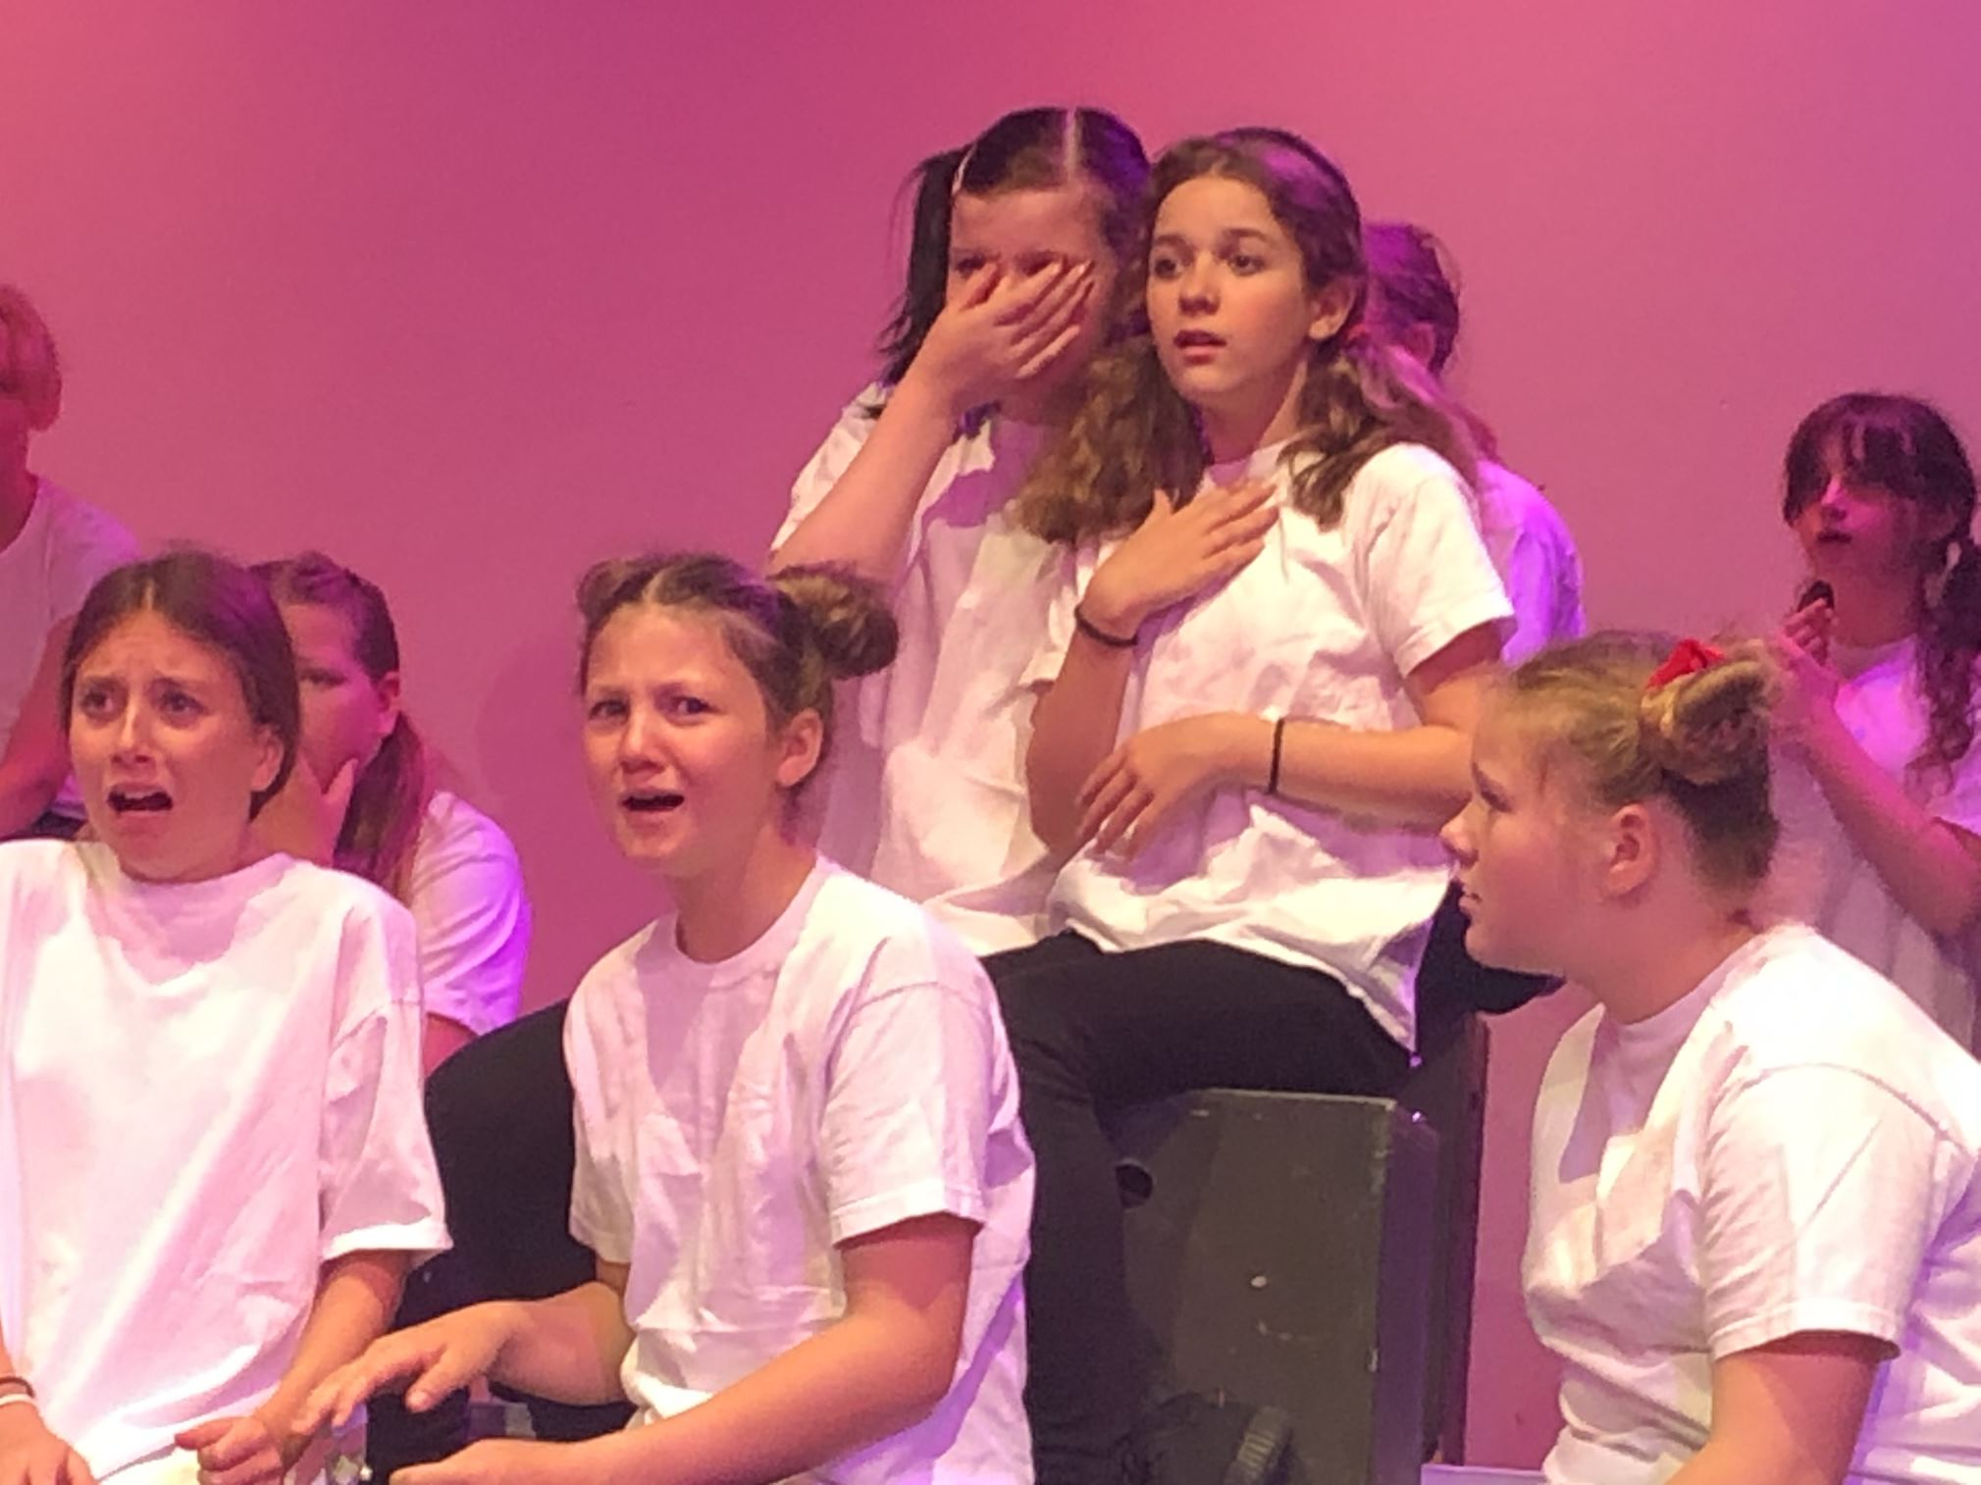
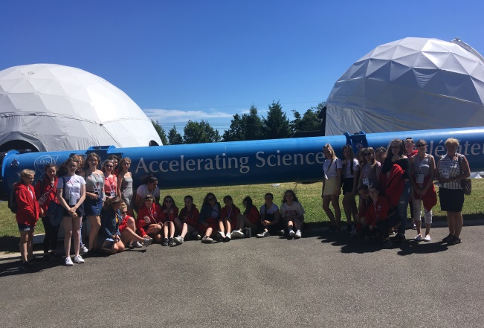
To Inspire…
Inspiring excellence in Pupil Leadership
Inspiring Sport for All
Inspiring Arts
Inspiring Trips and Residential Experiences
Inspire, Care, Achieve
Notes:
To inspire…
Here are some of our leaders, whether your child loves sport, music, reading there will be an opportunity for them here and you will see the full range in our leadership booklet in the prospectus. Some will develop and become part of the Pupil Leadership Team and our new Head Girl, Ellie, who spoke briefly this evening.
Children are all part of one of our 7 houses whose patrons are all inspirational women. Students work across year groups to raise money for local, national and international charities of their choice, through a variety of activities throughout the year… quite literally raising thousands of pounds!
We inspire our pupils with Sports for all as well as competing regularly both locally and nationally. The facilities you will see this evening are super.
We believe that all children should learn to perform and appreciate the arts. We regularly have music concerts, drama and dance performances. All of our pupils learn a musical instrument in year 7 – what brilliant skills to take with them.
Curriculum trips, visits and residentials provide pupils with so many opportunities and we want all pupils to experience this at some point during their time at GHS. We know that the memories this creates will be with them for ever and that this really bring the curriculum to life whether that's visiting Anne Frank's house, seeing Vesuvius, climbing a mountain for DfE or spending the day in a French school
At Greenbank we strive for every child to have an inspiring residential experience. We have a vibrant extra-curricular life, only through all subject areas, Performing Arts, extensive sports programme and a wide variety of cultural experiences.

Slide 14
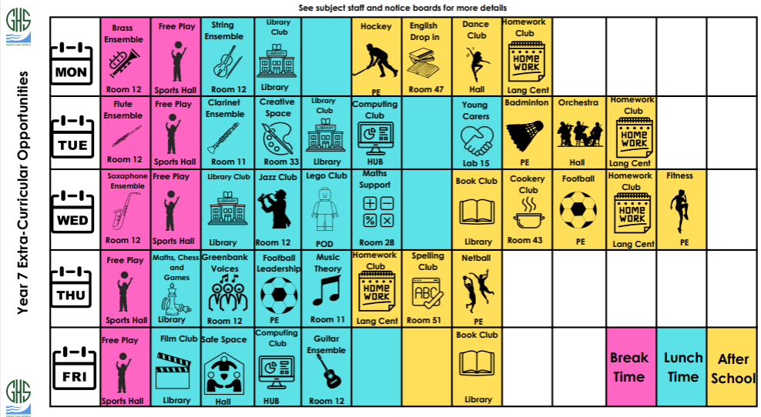
Inspiring your child inside and outside the curriculum
Inspire, Care, Achieve
Notes:
One of the most special features of our school is the breadth of opportunity.
Here you can see an example of the wide range of activities on offer. Again, you will find a full run down in the prospectus pack… but clubs include Nature Club, Harry Potter club, Athletics, Debating club – something for everyone!

Slide 15

Caring About Transition
Through Transition:
In Year 7:
Primary school visits
New Intake Day - July 2027
First day in September
Summer School
Enhanced Transition Days
Year 10 ANGELS & Prefects
School Website
Form Tutor
Head of Year
Inclusive Support & Pastoral Team
Teaching & Support Staff
Young Carers Coordinator
Year 10 ANGELS & Prefects
RP Reps
Parents and Carers
Ms Hinde - Deputy Head
&
Senior Leaders
Mrs Collins-Murphy
Head of Year 7
Inspire, Care, Achieve
Notes:
Caring for our Students in a SAFE school environment.
We continue to invest more in supporting our students … this slide seeks to illustrate my point:
Through transition … not one but at least three members of staff visiting every primary school even if only one child transferring … then visiting the school on Year 6 induction day, follow up induction sessions if needed and our hugely popular, summer school … which over 140 students benefited from this year.
Small things are important such as our new Year 7s have their own form tutor base – relax with their friends at break and lunchtimes, lockers to store school bag, personal items
Due to growth in student numbers over the last 3 years. We have seven forms of entry… each with its own Form Tutor and other attached pastoral members of staff… Head of Year 7 Mrs Collins-Murphy, mentors, trained counsellors, school nurse, professional counsellor and experienced Inclusive specialist support team. AND our we have a system of ANGELS – A New Girl’s Easy Listening Service and Restorative Practice Reps to support pupils on transition. We have a very strong pastoral team …
Here I do want to talk about BULLYING … any school who presents on an evening like this and tells you that there is no bullying in their school is quite frankly a liar. So we do have instances of bullying but we do not have a serious problem with bullying because we do not allow there to be one …
When it does happen it’s far more likely to be name calling, social media and exclusion from friendship groups rather than physical bullying … again the strong relationships that exist and the positive ethos ensures that our students don’t suffer in silence. … they have the confidence to talk about it because they trust and know that staff and pupils will respond professionally and appropriately.
Hand back to DAS

Slide 16
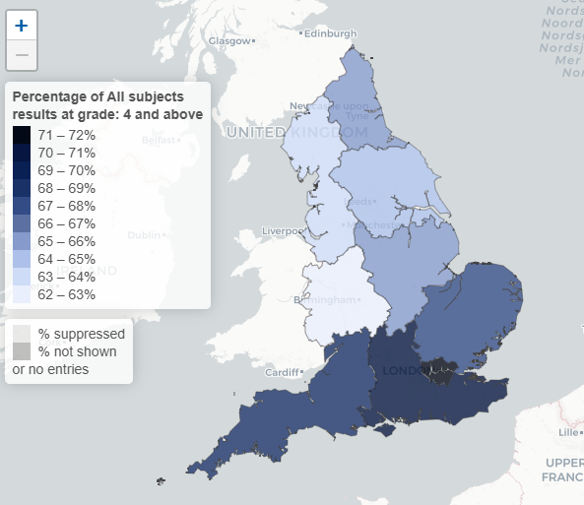
Achieving Success
Greenbank Outcomes 2026
Grade 4+ 76% (NW 63.9%
Nat 67.3%
London 71.6%)
Grade 7+ 24% (NW 18.9%
Nat 21.8%)
Source: Ofqual Analytics – Summer 2026
Notes:
Back to DAS
So this notion of excellence for all is important; I find this infographic provided by Ofqual particularly worrying as it shows a great disparity between the different regions.
Here you have one indicator as to how children are doing at Grade 4+/old C grade equivalent – across England you can see huge variation in the grades pupils achieve across different regions.
Students at Greenbank achieve exceptionally well. In the prospectus pack there is summary of student achievement and outcomes, including by subject. One of the highest performing schools in the local authority.
Here this slide illustrates that GHS performance in 4+/C and above is 76% above national 67.3% and our 9-7/A*/A performance is 24% (National 21.8%) - shows just how well our pupils do here at Greenbank.
This is the same for children of all abilities – we look at the progress that they make and we know that pupils of all different abilities make better than average progress.

Slide 17
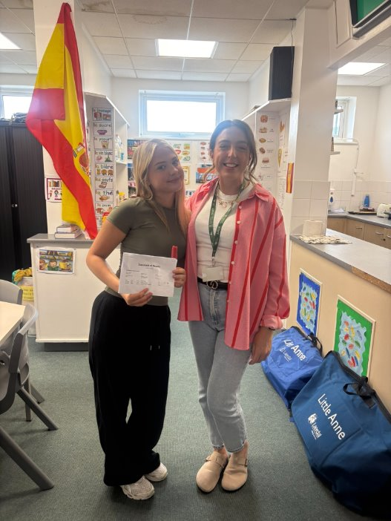
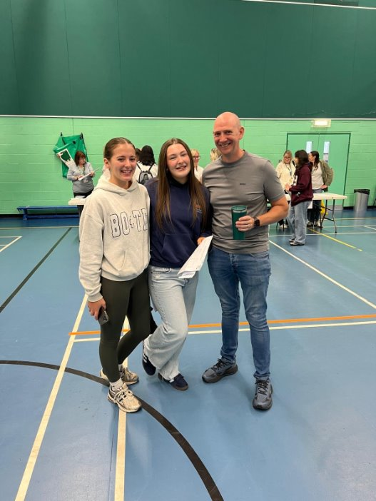
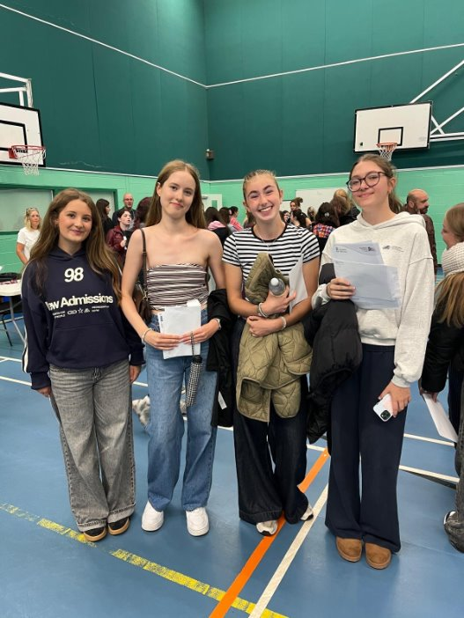
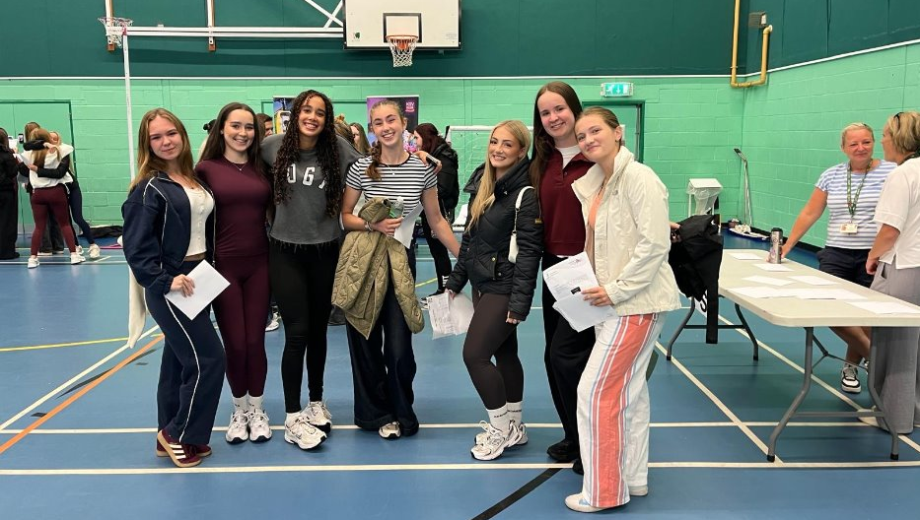
Achieving Success
Inspire, Care, Achieve
Notes:
We are super proud of all of our pupils right across the board… the majority of pupils making better than average progress – this is when we compare their starting points from primary school to how they do at the end of Year 11.
The government compare these each year with all the other pupils who had the same starting point and here at GHS, our pupils typically achieve 0.5 grade above the national average. Pupils make great progress here irrespective of starting points.

Slide 18
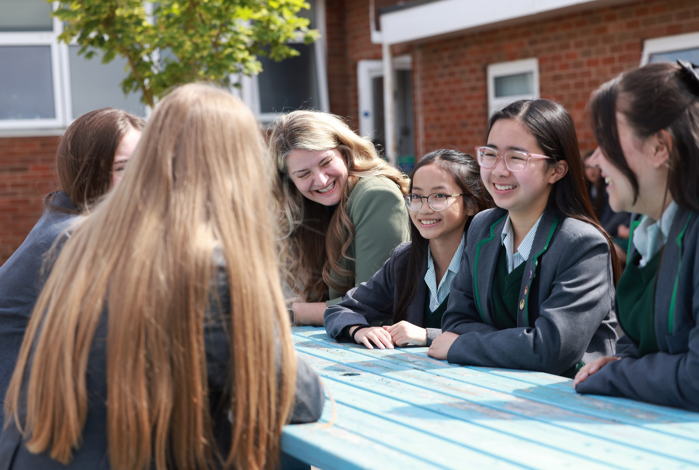
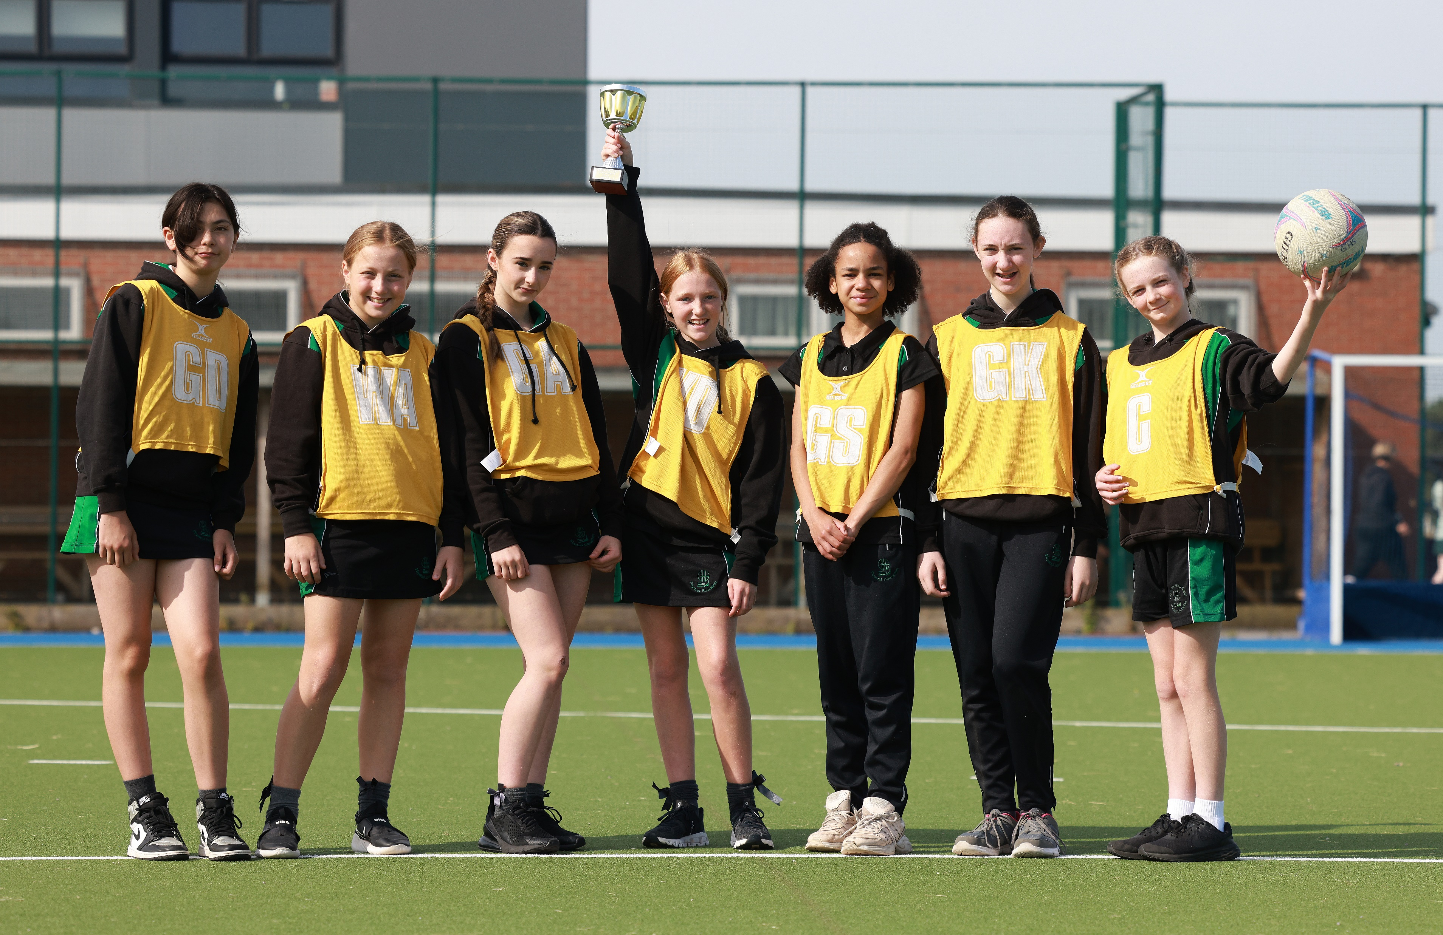
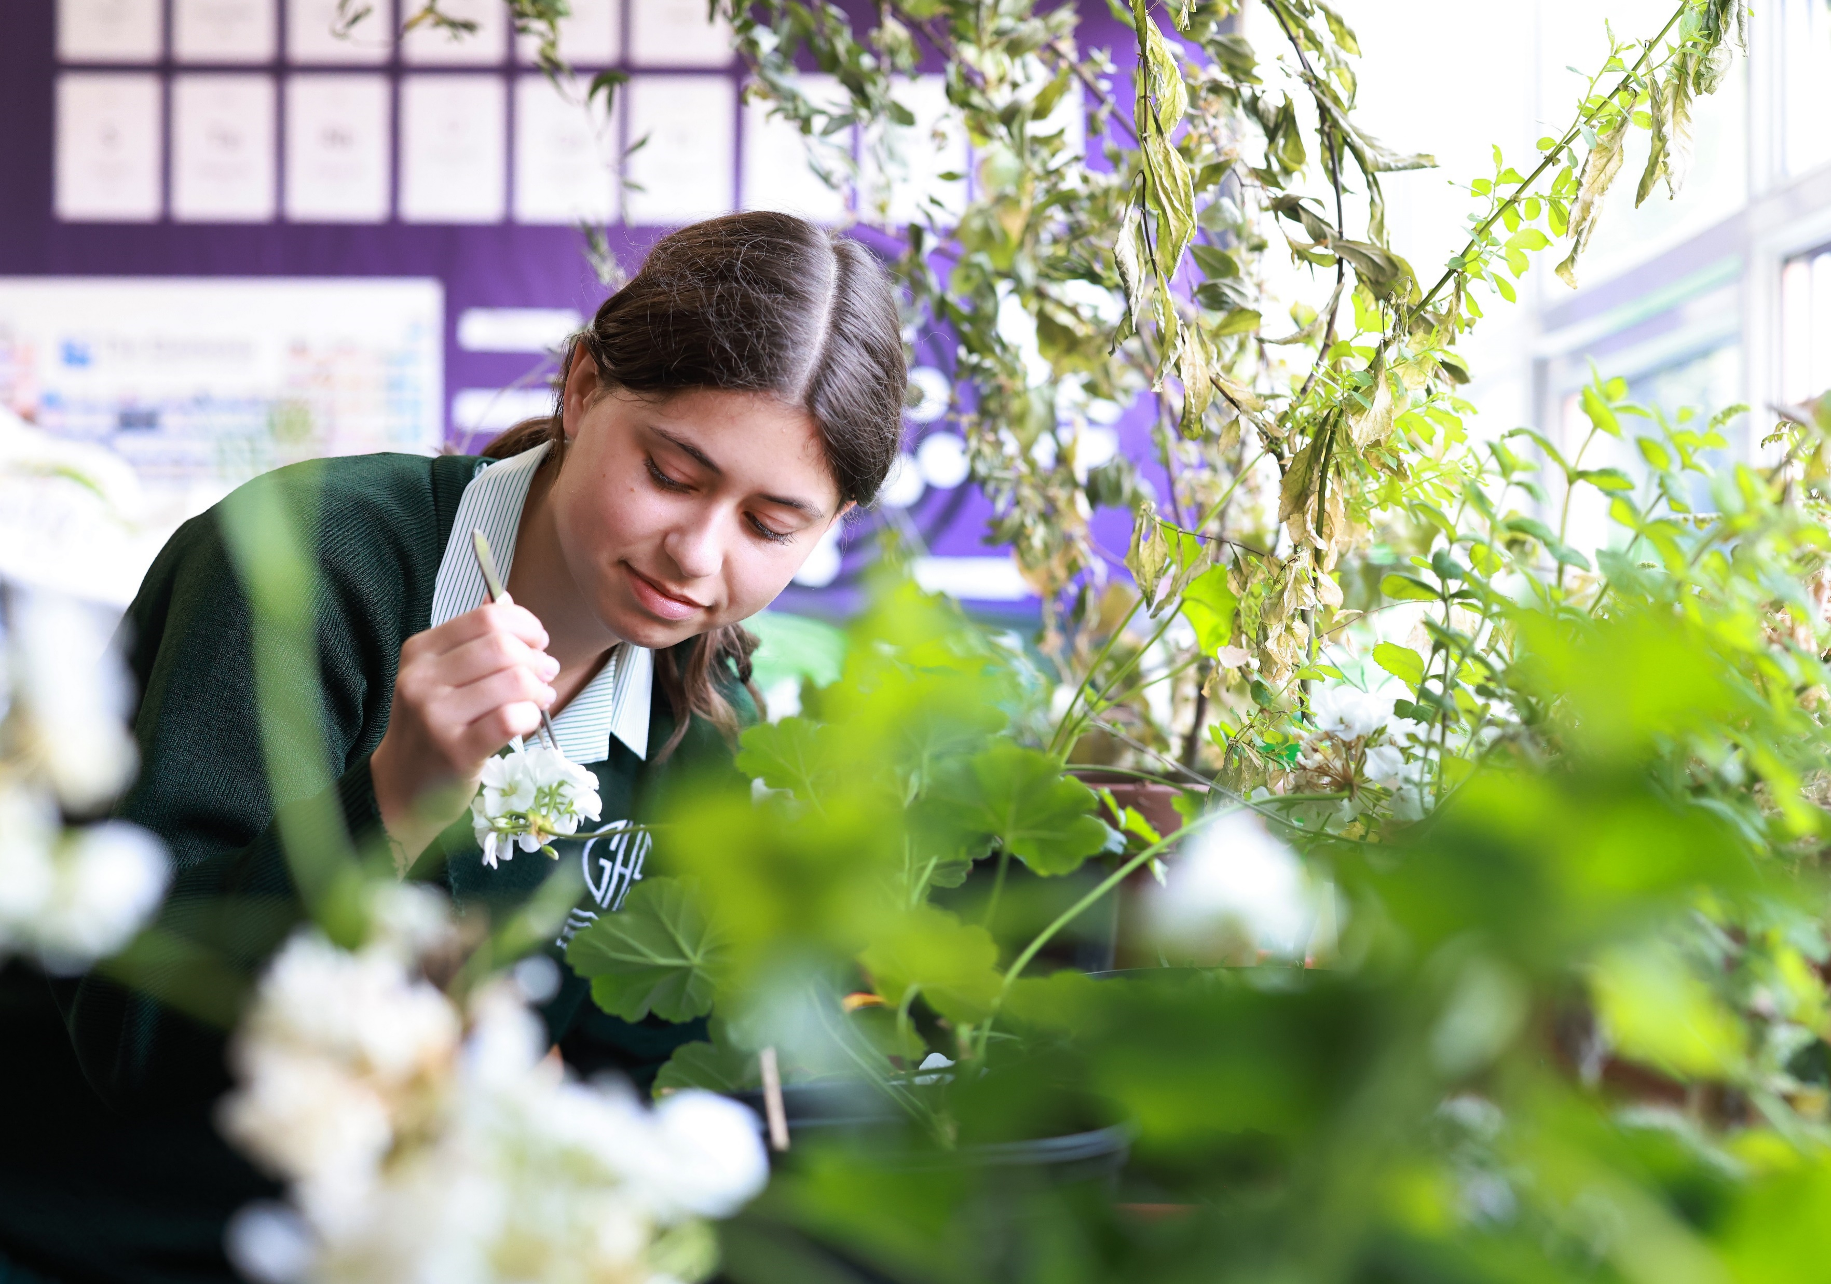
Admissions
…“Will we get a place?”
Apply through LA: Sefton, Lancashire
PAN 206 into Year 7
Oversubscribed school
School Day Tour: telephone the school to book
Inspire, Care, Achieve
Notes:
So you are making a decision for the next 5 years… GCSEs in 2031!
Greenbank is part of the Southport Learning Trust but it is Sefton that administer our admissions … whichever authority you live in the admissions rules have to be applied as fairly as possible to try and match the choices which you as parents and carers make
Admissions to Greenbank are through the online forms from the Borough where you live: Sefton, Lancashire County on the Citizen Portal. You should all have received a letter via primary school.
The school’s PAN is 206, we are an oversubscribed school with high demand for pupil places. We are an inclusive school and want to continue to ensure that every Year 7 pupil who wants to come to this school can. We have seen a significant increase in first choice preferences over the last 3 years, demand for places at Greenbank is exceptionally high. Due to the increase in the number of first choice preferences, we cannot guarantee you a place next September.
If you want your child to come to Greenbank, you most certainly need to indicate us as your first preference. We are a very popular and oversubscribed school! I can see live applications and lovely to see so many of you have already submitted your application, with GHS being your first choice preference, thank you!
Please take note of the application deadline Saturday 31st October 2026
The prospectus and school website is a wealth of information but please do not hesitate to telephone to arrange a visit to the school. We welcome parents to come and see our school in action on a ‘working day’…
Many thanks for your time this evening.

Slide 19
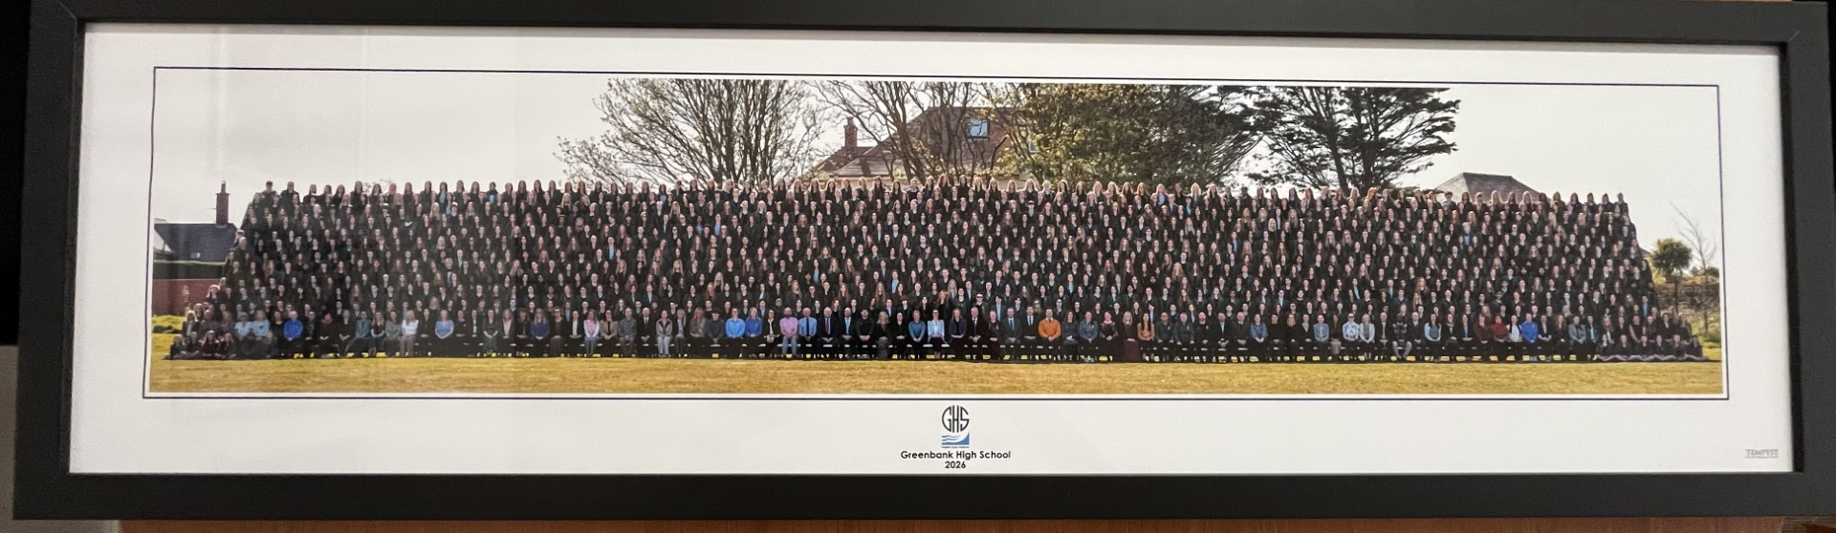
Inspire, Care, Achieve

