Slide 1


YEAR 7
PERSONAL DEVELOPMENT
2. ONLINE SAFETY AND BULLYING
NAME:
FORM:
TEACHER:

Slide 2
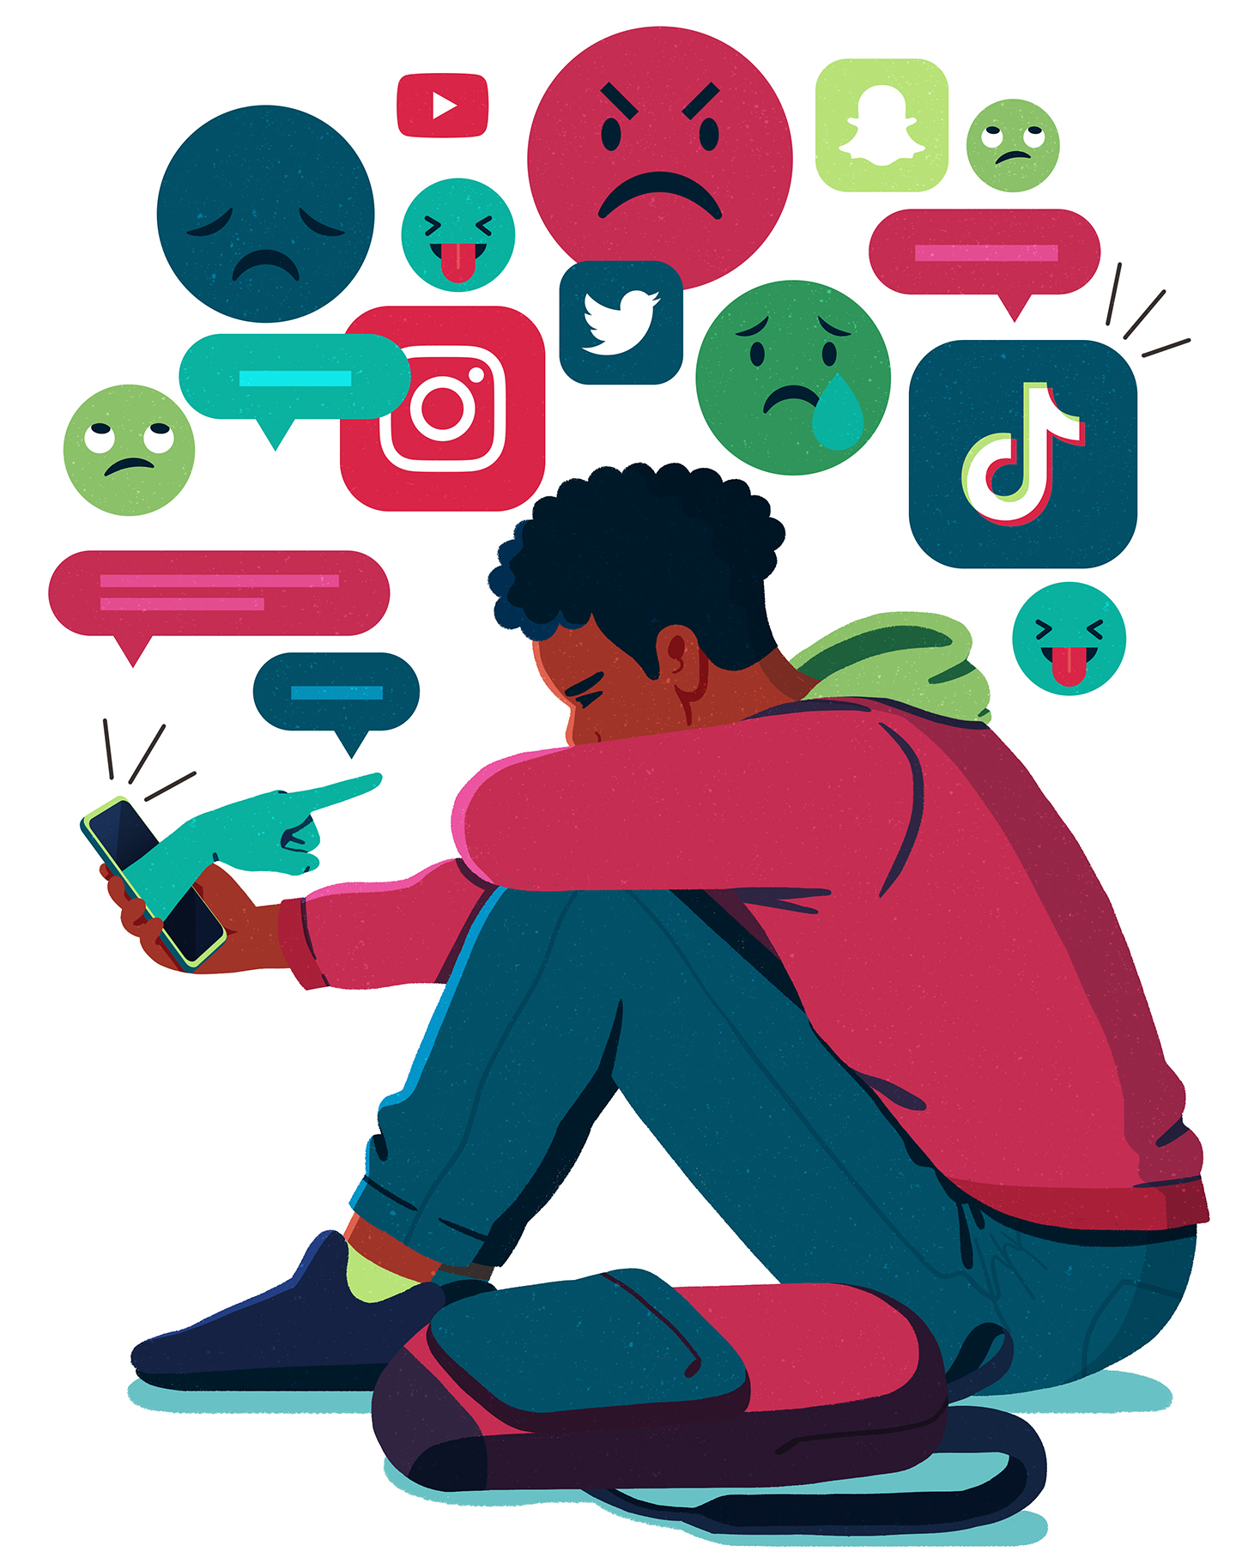
Self Assessment
At the start of this topic: add what you know about online safety and bullying around the picture
At the end of the topic: add any other points in a different coloured pen

Slide 3

Bullying
What is bullying ?
____________________________________________________________________________________________________________________________________________________________________________________________________________________________________________________________________________________________________
My 5 things likely to be 'joked about'
_____________________________________________________________________________________________________________________________________________________________________________________________________________________________________________________________________________________________________________________________________________________________________________
Video:
Was Sarah OK with some of the jokes?
__________________________________________________________________________________________________________________________________________________
At what point did the banter turn to bullying for Sarah?
___________________________________________________________________________________________________________________________________________________________________________________________________________________________
How could Sarah have approached those who are saying hurtful things to her and asked them to stop?
____________________________________________________________________________________________________________________________________________________________________________________________________________________________________________________________________________________________________
Age restrictions ?

Slide 4
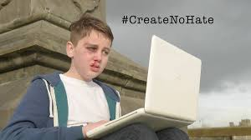
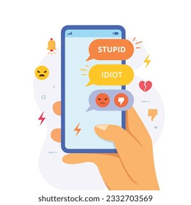
What is the message of the video ?
There are risks of using social media platforms. These can include:​
Oversharing​
Sharing your location​
Talking to people that you don’t know​
Sending or receiving inappropriate content​
Unrealistic sense of body image or reality​
Obsessive focus on likes and comments​
Online bullying and harassment
Think before you post: Consider the potential consequences of your online actions and to avoid sharing hurtful or harmful content.
Set privacy settings: Using privacy settings on social media platforms is important to limit access to personal information and posts.
Block and report: Remember to block or report any individual who engages in online bullying or makes you uncomfortable.
Seek help from adults: It is really important to talk to a trusted adult, such as a parent or teacher, if you encounter online bullying.
Be an ally: You can help others by supporting your friends and standing up against online bullying by reporting incidents and offering help to victims.

Slide 5
Impact of bullying
Why people bully others
How people bully others

Slide 6

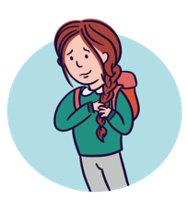
Impact of bullying
Joseph
________________________________________________________________________________________________________________________________________________________________________________________________________________________________________________________________________________________________________________________________________________________
Chelsea
________________________________________________________________________________________________________________________________________________________________________________________________________________________________________________________________________________________________________________________________________________________

Slide 7
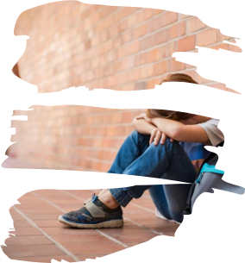
  Quiz
  What's the most common type of bullying - physical, online, verbal?
  A place where bullying happens?
  A word that describes how being bullied feels?
  One thing you can you do to stop bullying from happening?
  A type of verbal bullying that would be breaking the law?
  A type of person who might experience more bullying?
  What name is given to someone who sees bullying but does nothing about it?
  What name is given to someone who encourages bullying but isn't the one directly involved?

Slide 8

Social media: positives and negatives
Benefits of being online
Keeping safe
Always know what your privacy settings are on all your social media accounts.​
Don’t share sensitive information across different platforms.​
Check out your employer’s social media policy.​
When you experience something that angers or upsets you, stop and take 10 deep breaths before deciding whether or not to post.​
Don’t write anything online that you wouldn't say face to face.​
Never post when you're angry or drunk – you’ll only regret it later.​
Always remember anything you post online can be used and shared without your knowledge or consent.​
What is an influencer ?​
________________________________________________________________________________________________________________________________________________________________________________________________________________________________________________________________________________________________________________________________________________________________________

Slide 9
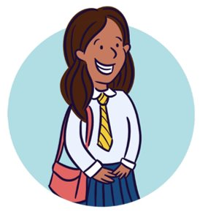
Social Media influencers online identities can severely affect their own;​
Follower's self esteem​
body confidence​
mental health​
These influencers can put undue pressure on young people to look a certain way and to buy certain products.​
Positives of following a social media influencer. | Negatives of following a social media influencer.
Healthy social media use
Aisha

Slide 10
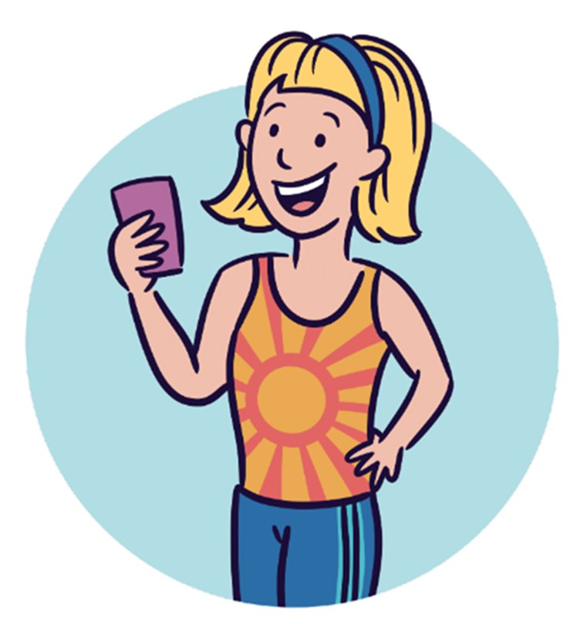
A digital citizen is someone who has an identify on the internet. You are a digital citizen if you have:​
Used any website​
Used an app​
Watched TV online​
When you use the internet, you are part of the global community. You have the responsibility to engage with the online community appropriately and sensibly.​
As a digital citizen, people have rights and responsibilities that are similar to those that we all share offline.
Examples of the rights you have both on and offline include:
The right to privacy.
The right to security.
Zoe
How do we communicate online ?
____________________________________________________________________________________________________________________________________________________________________________________________________________________________________________________________________________________________________________________________________________________________________________________________________________________________________________________________________________________________________________________________________________________________________________________________________________________________________

Slide 11

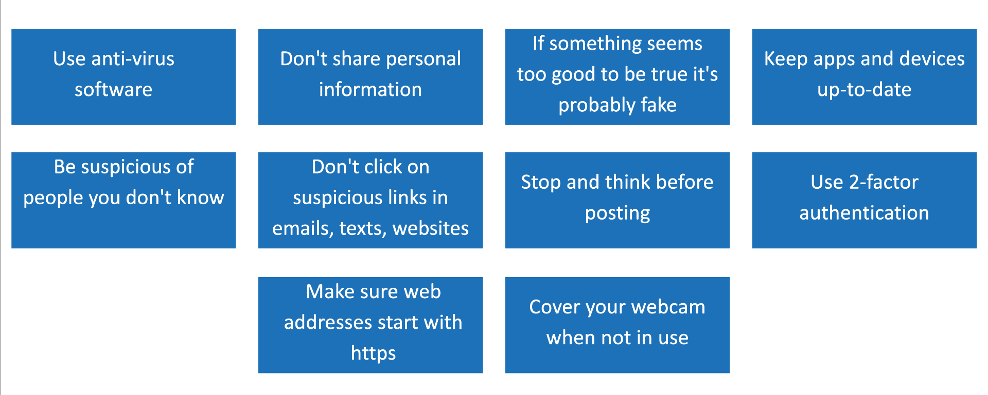
What is a digital footprint ?
__________________________________________________________________________________________________________________________________________________________________________________________________________________________________________________________________________________________________________________________________________________________________________________________
The more you are online, the bigger your digital footprint will be.
Digital footprints are not only used by companies, social media platforms, hackers and people trying to steal your online identity
Being connected is a big part of our lives, but if you’re seeing stuff online which makes you feel angry, sad, worried, stressed, or annoyed, this can build up and start having a negative impact on your life.​
​
If you ever feel overwhelmed by the online world, unable to switch off, or find it difficult to cope, you’re not alone. We all struggle to keep our online world positive sometimes.

Slide 12
Cyberbullying
How do I use the internet?
Acceptable online behaviour
The word acceptable means allowed, suitable or agreed. Socially acceptable behaviours and activities are those that society consider to be normal, or behaviours that they approve of. ​
Therefore, unacceptable behaviours are those that society decide is unreasonable or inappropriate. They may include behaviour and activity that offends others, that are abusive or ones that are inappropriate.
As with all human rights, there are laws to ensure that you are upholding the acceptable behaviours. The laws are there to protect you, and others, from potential risks.
Some of the unacceptable behaviours - e.g. hate speech, abusive and threatening behaviour - are illegal and they may lead someone to be prosecuted in a court of law.

Slide 13

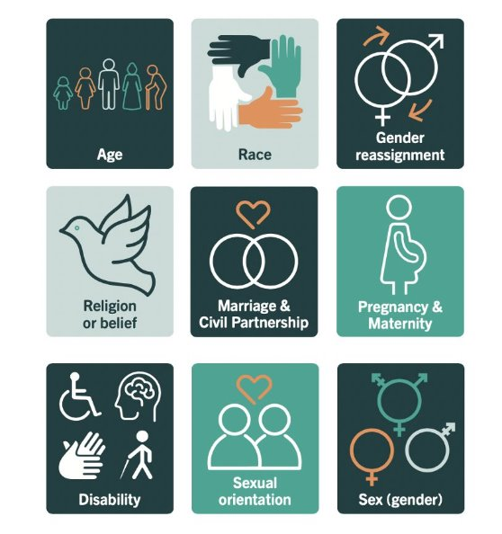
What is cyberbullying ?
___________________________________________________________________________________________________________________________________________________________________________________________________________________________________________________________________________________________________________________________________________________________________________________________________________________________________________________________________
Bullying that breaches the Equality Act 2010 can often be categorised as "Hate Crime" and this is also illegal, for example:​
​
Bullying that is sexist​
Bullying that targets race or religion​
Bullying about someone's sexual orientation​
Bullying related to gender identity​
Bullying that targets learning disability, physical disability or any other type of disability​
Protected characteristics
Would you add any others ?

Slide 14
Cyberbullying ? Explain your answer
1. | 2.
3. | 4.
Video: How did Nadiya feel ?
____________________________________________________________________________________________________________________________________________________________________________________________________________
In the UK we have the right to free speech and sometimes online bullies hide behind this right and think it will protect them from prosecution, however;
"If comments posted online about an individual or group of individuals are threatening or intend to cause distress, this is against the law."
Can you think of any examples of this type of behaviour involving celebrities or people on the news?
____________________________________________________________________________________________________________________________________________________________________________________________________________

Slide 15

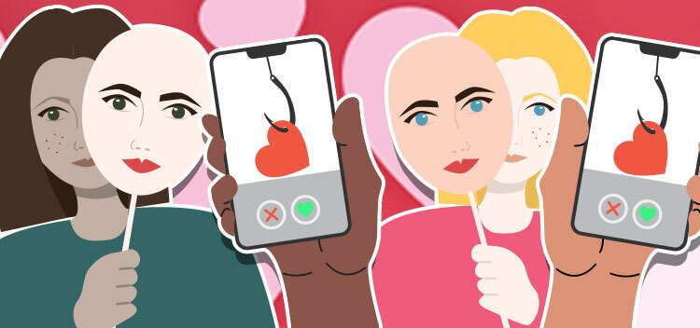
​The law
Those creating or spreading offensive Internet content have also been prosecuted under hate crime laws. ​​
The number of people arrested for ‘online crimes’ has increased dramatically under the Communications Act 2003 and the Malicious Communications Act 1988. ​​
Breaking this law could result in a six-month prison sentence or a fine of up to £5,000.​
​Under current anti-harassment laws, internet ‘trolls’ could face two years in prison ​for ‘online harassment’.
Online grooming
____________________________________________________________________________________________________________________________________________________________________________________________________________________________________________________________________________________
What is catfishing ?
What happens when someone steals your identity?​
__________________________________________________________________________________________________________________________________________
Should catfishing be made a crime?
____________________________________________________________________________________________________________

Slide 16
Grooming
Grooming is when someone builds a relationship with a young person and tricks them or pressures them into doing something abusive, criminal or both.​
Grooming is still rare, but it does happen to some young people.​
Consent
You don't have to do anything that you don't want to do.
If you're being pressured to do something you're not comfortable with, that's called coercion, even if it’s someone you trust.
Consent can change – people change their minds and this is ok.
Who is Andy and how did he know Sarah?
____________________________________________________________________________________________________________________________________________________________________________________________________________________________________________________________________________________________________
How did Andy gain the trust of Sarah?
____________________________________________________________________________________________________________________________________________________________________________________________________________________________________________________________________________________________________
Why does Andy want photos of Sarah?
____________________________________________________________________________________________________________________________________________________________________________________________________________________________________________________________________________________________________
What should Sarah have done in this situation?
___________________________________________________________________________________________________________________________________________________________________________________________________________________________
_________________________________________________________________________
What help is available to Sarah?
____________________________________________________________________________________________________________________________________________________________________________________________________________________________________________________________________________________________________

Slide 17
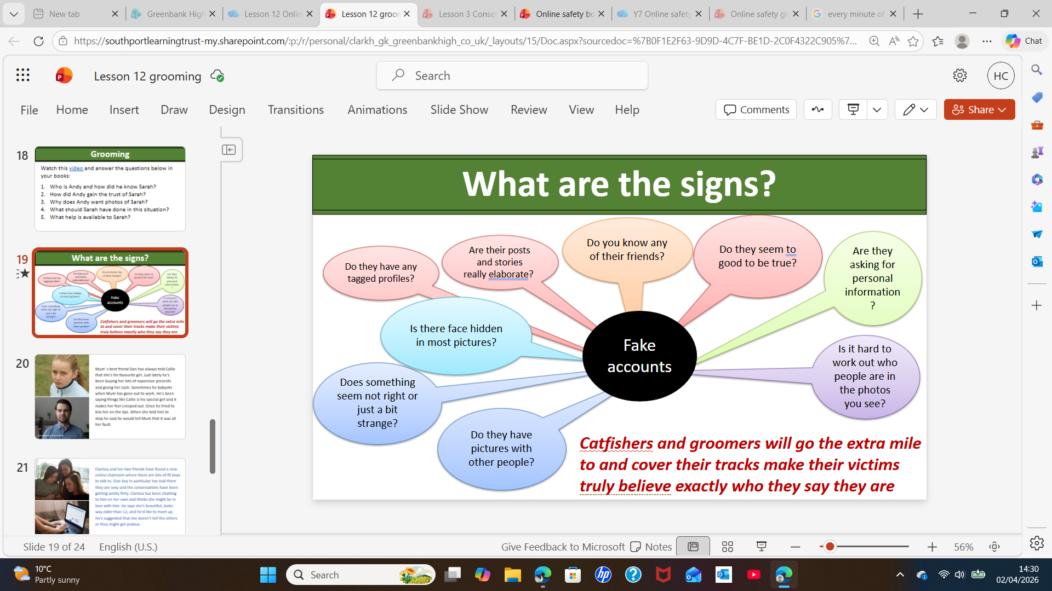
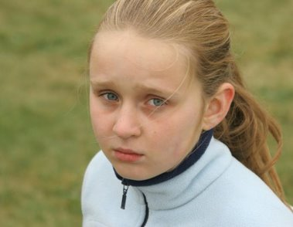
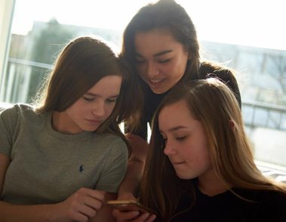
Callie
__________________________________________________________________________________________________________________________________________________________________________________________________________________________________________________________________________
Clarissa
________________________________________________________________________________________________________________________________________________________________________________________________________________________________________________________________________________________________________________

Slide 18












Help and advice on this topic

Slide 19
Spare pages:
____________________________________________________________________________________________________________________________________________________________________________________________________________________________________________________________________________________________________________________________________________________________________________________________________________________________________________________________________________________________________________________________________________________________________________________________________________________________________________________________________________________________________________________________________________________________________________________________________________________________________________________________________________________________________________________________________________________________________________________________________________________________________________________________________________________________________________________________________________________________________________________________________________________________________________________________________________________________________________________________________________________________________________________________________________________________________________________________________________________________________________________________________________________________________________________________________________________________________________________________________________________________________________________________________________________________________________________________________________________________________________________________________________________________________________________________________________________________________________________________________________________________________________________________________________________________________________________________________________________________________________________________________________________________________________________________________________________________________________________________________________________________________________________________________________________________________________________________________________________________________________________________________________________________________________________________________________________________________________________________________________________________________________________________________________________________________________________________________________________________________________________________________________________________________________________________

Slide 20
Spare pages:
____________________________________________________________________________________________________________________________________________________________________________________________________________________________________________________________________________________________________________________________________________________________________________________________________________________________________________________________________________________________________________________________________________________________________________________________________________________________________________________________________________________________________________________________________________________________________________________________________________________________________________________________________________________________________________________________________________________________________________________________________________________________________________________________________________________________________________________________________________________________________________________________________________________________________________________________________________________________________________________________________________________________________________________________________________________________________________________________________________________________________________________________________________________________________________________________________________________________________________________________________________________________________________________________________________________________________________________________________________________________________________________________________________________________________________________________________________________________________________________________________________________________________________________________________________________________________________________________________________________________________________________________________________________________________________________________________________________________________________________________________________________________________________________________________________________________________________________________________________________________________________________________________________________________________________________________________________________________________________________________________________________________________________________________________________________________________________________________________________________________________________________________________________________________________________________________

