Slide 1

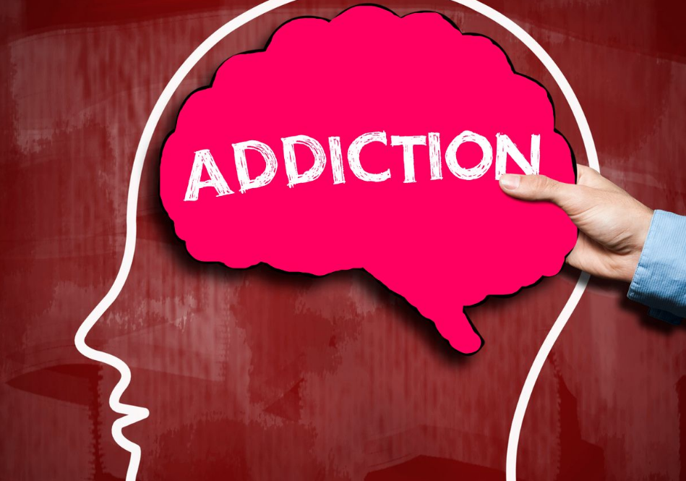

Year 9 Personal Development
Keeping safe
Rights and responsibilities
Addiction
British Values:
Mutual respect,
Individual Liberty,
Rule of Law

Slide 2

The Greenbank safeguarding team are here to help you if you are worried about anyone in school or are concerned about any of the issues raised in class.

Slide 3





Classroom Rights and Responsibilities
Only join in discussions if you feel comfortable
Rights: Principles that everyone is entitled to
Responsibilities: Actions that you are expected to carry out
Be listened to and listen to others
Be respected and not judged
Have my discussions kept confidential unless there is cause for concern
Use the correct vocabulary
Ask for help, support and advice

Slide 4

Title: What is Addiction?
Whiteboards, Do now:
What can people become addicted to? Make a list

Slide 5
Feedback: Examples of addiction
Chemical Addiction
Behavioural Addiction
Alcohol
Nicotine
Opioids
Prescription drugs
Cocaine
Cannabis/weed
Amphetamines
Hallucinogens
Inhalants
PCP
Food Addiction
Internet Addiction
Pornography Addiction
Video Game Addiction
Work Addiction
Exercise Addiction
Cutting/self harm
Shopping Addiction
Exercise
Gambling Addiction

Slide 6

What are we learning today?
Lesson Objective: Today we are learning about addiction.
Learning Outcomes:
What is addiction.
What types of addiction are more common.
What are the chemical and behavioural effects of addiction.

Slide 7

Today's Key Terms
Addiction
Chemical
Behavioural
Legal and illegal drugs
Self esteem
Trauma
Withdrawal
MDMA/Ecstasy
Start of the lesson
Can you explain these words ?

Slide 8

Whiteboards
What does addiction mean ?

Slide 9

What is addiction ?
Addiction - the fact or condition of being addicted to a particular substance or activity.
It is not having control over doing, taking or using something to the point where it could be harmful to you.
Copy this definition into your booklets

Slide 10

Types of addiction?
Addiction is most commonly associated with gambling, drugs, alcohol and nicotine, but it's possible to be addicted to just about anything, including:
The internet
Work
Solvents
Shopping

Slide 11
Types of addiction
There are two main types of addiction: chemical and behavioural.
Chemical | Behavioural
Chemical addiction is, in simplest terms, a biological reaction to an addictive chemical. | Behavioural addictions (also called process addictions) follow the same pattern as substance-based addictions, and they result in problems in many areas of the individual's life.

Slide 12
Most common types of addiction
Put these addictions in order from most common (1) to least common (9)
Painkillers | Cocaine | Alcohol
Internet | Nicotine | Heroin
Sex | Gambling | Cannabis

Slide 13
Feedback
How many did you get correct?
4. Painkillers | 5. Cocaine | 2. Alcohol
8. Internet | 1. Nicotine | 6. Heroin
9. Sex | 7. Gambling | 3. Cannabis
https://thedawnrehab.com/blog/most-common-addictions/

Slide 14
Legal and Illegal
Cocaine | Cannabis (Weed) | Caffeine
Heroin | (Amphetamine) Speed | Tobacco
Tranquilisers (prescription) | Ketamine | Alcohol
Magic Mushrooms | Ecstasy and MDMA (pills and powder) | Nos/Laughing gas (balloons)
Crack Cocaine | Methadone (M-Kat) | Aspirin
Diazepam | LSD/Acid | Anabolic Steroids
Spice | Tramadol | Glue, gases and aerosols
The highlighted drugs are completely illegal. There is never any excuse that will stop these from being illegal to posses or supply. You will face charges if you are caught with these on you.

Slide 15
Legal and Illegal
Tranquilisers (prescription) Okay if you are the one with a doctor prescription. | Tobacco Okay if you are over 18.
Diazepam Okay if you are the one with a doctor prescription. | Alcohol Okay if you are over 18.
Methadone (M-Kat) Okay if you have a prescription and are recovering from heroin addiction | Nos/Laughing gas (balloons) Okay if you are baking a cake. Illegal to inhale.
Ketamine (Animal tranquiliser) Okay to have if you are a vet and have a reason to possess. | Anabolic Steroids Legal when prescribed by doctor. Legal for personal use. Illegal to give to someone else.
Tramadol Okay if you are the one with a doctor prescription. | Glue, gases and aerosols Okay if you are not inhaling them and are using them for the purpose intended.
These drugs are illegal depending on circumstance.
All of these drugs are illegal to supply to someone else. This can even be giving your mate a bit to try. You could face a prison sentence of 7 years +.

Slide 16
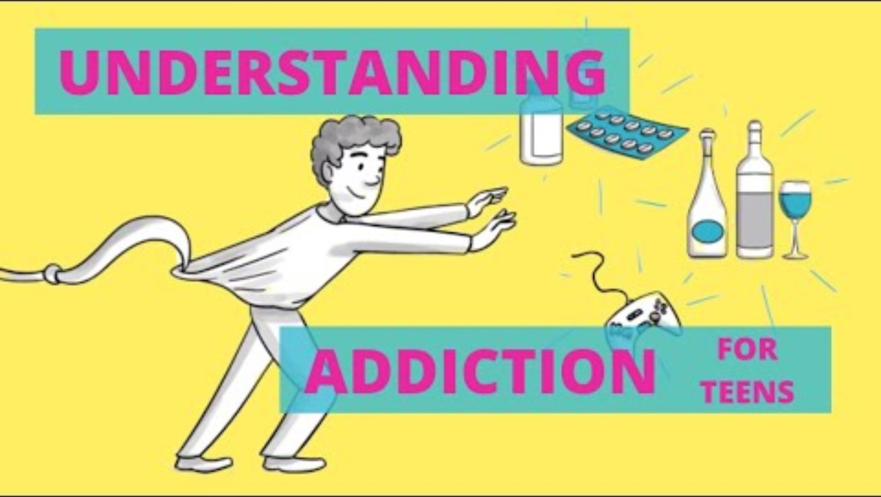
What is addiction ?
Watch the clip on the next slide and write down some reasons for addiction
Be ready to discuss

Slide 17
What is addiction ?

Slide 18
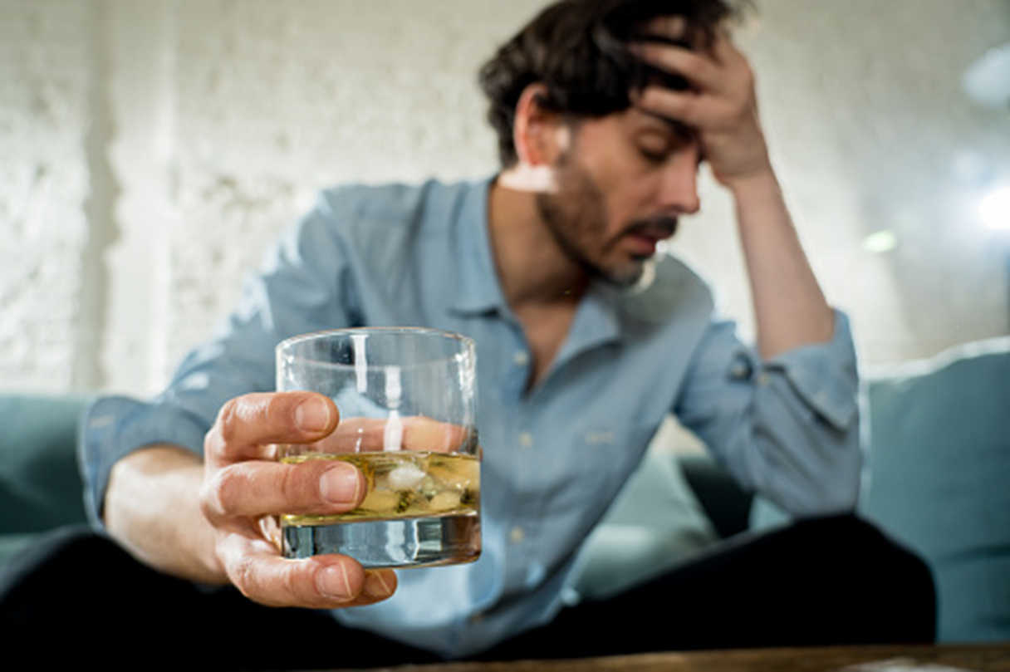
What causes addiction?
There are lots of reasons why addictions begin. In the case of drugs, alcohol and nicotine, these substances affect the way you feel, both physically and mentally.
These feelings can create a powerful urge to use the substances again.

Slide 19
Contributing factors
Low self-esteem: A person suffering from low self-esteem is much more likely to engage in destructive behaviours, which can become addictive.
Trauma, loss and guilt: If you have gone through a traumatic experience, have lost someone dear to you, or have feelings of intense guilt (justified or otherwise) you are more likely than the average to engage in and display addictive behaviour, as a way of escaping painful memories or difficult circumstances.
Poor social and communication skills: If you have poor social and/or communication skills you may be more likely than average to participate in certain activities – such as types of video gaming – which can create a feeling of community without the normal emphasis on such skills.

Slide 20
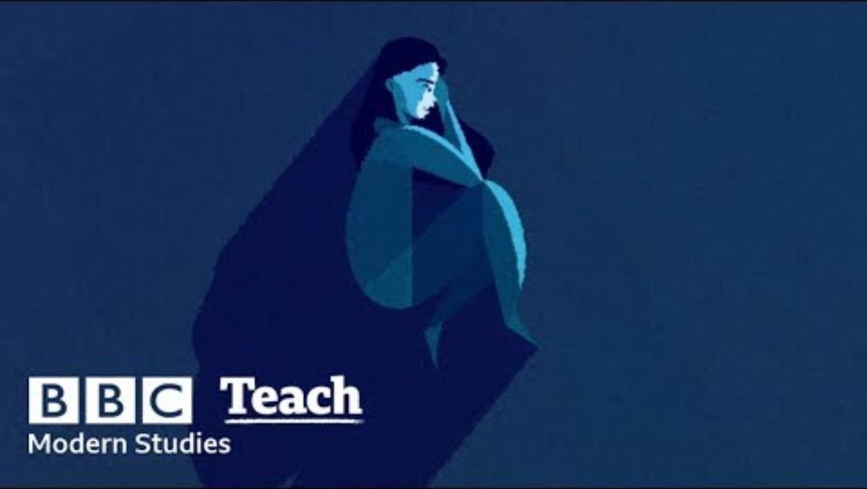
Addiction story TW suicidal thoughts

Slide 21
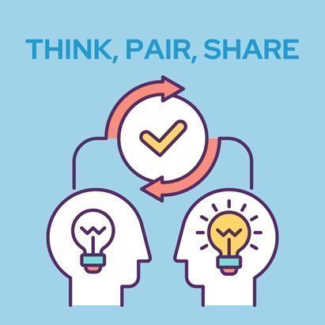
Signs of addiction​
Can you tell if someone has an addiction ?
Does their appearance change ?
Does their behaviour change ?
Make some notes in your books

Slide 22
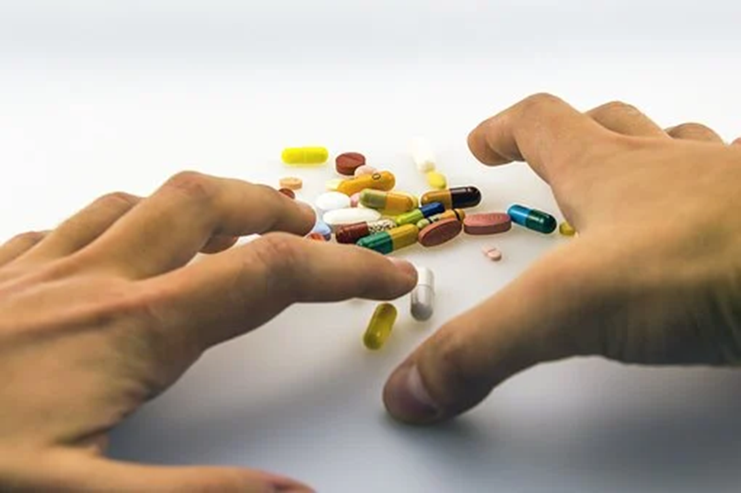
Signs of addiction
Loss of interest – apathy – complacency.
Physical signs – weight, hygiene etc.
Change in physical appearance.
Discovering drug paraphernalia.
Rapid mood swings.
Reclusive and private behaviour.
Rapid change in what is considered “normal” for the individual.
Erratic behaviours.
Additional behaviours.
Change in sleep habits.

Slide 23
Psychological effects
Mood swings.
Having a negative outlook on life.
Loss of motivation.
Having episodes of drug-induced psychosis.
Drugs can cause mental health problems as a results some people are more likely to try and harm themselves or take their own life. Research has shown that cannabis can increase your chances of developing schizophrenia.

Slide 24
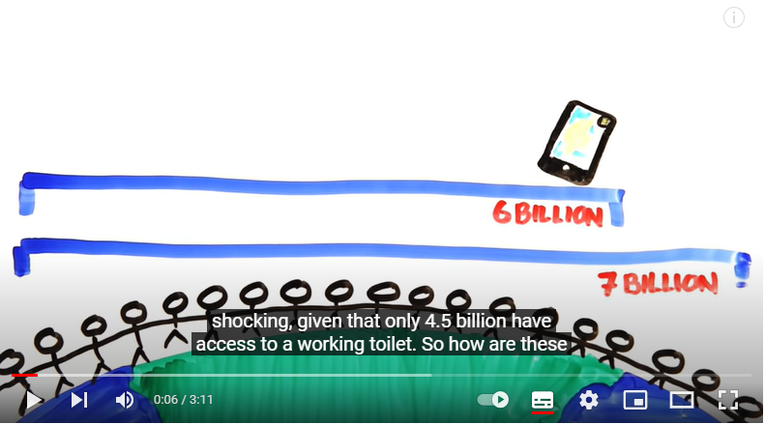
Screen Addiction
Why are screens so addictive ?
Watch the clip and write down 5 facts about screen addiction

Slide 25
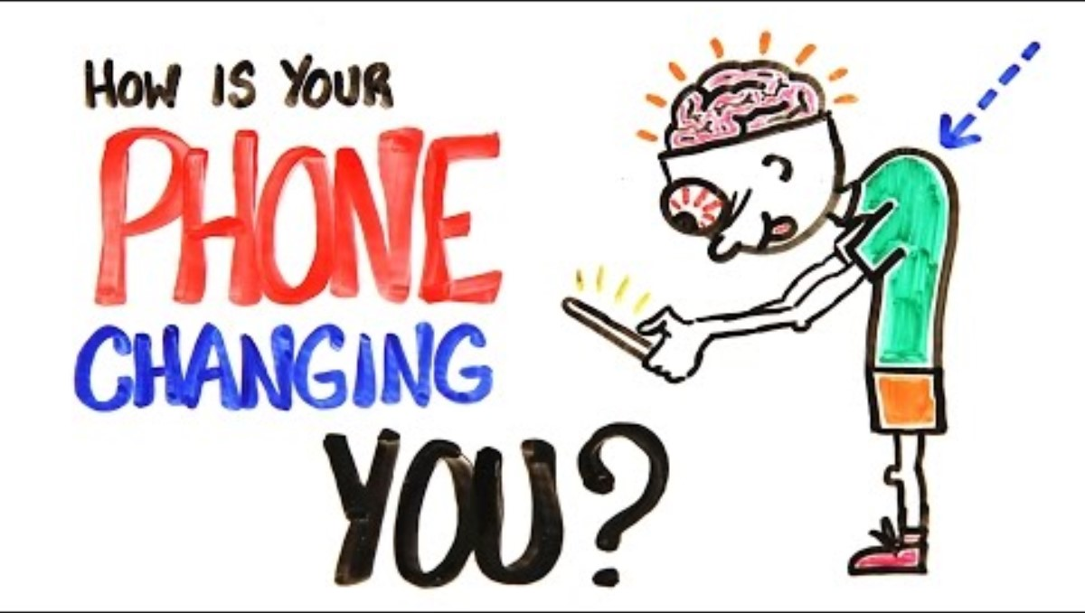
Screen Addiction​

Slide 26
Cause of Withdrawal
The body and brain work to maintain a state of balance known as homeostasis. Taking a substance changes that balance, so your body has to take steps to adjust including changing the levels of certain neurotransmitters. These substances act on your brain's reward system, triggering the release of chemicals.

Slide 27

Cannabis Addiction

Slide 28
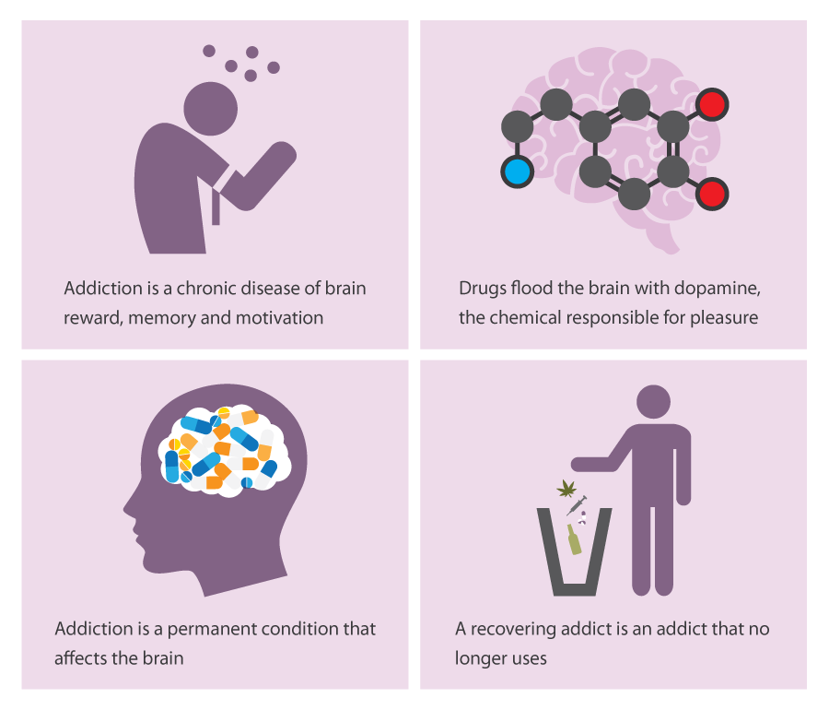
Addiction phases

Slide 29
How to Beat Addiction
Which of these tips can help you beat an addiction?
1.Reflect on your life | 2.Hang around with the same people | 3.Help others
4.Don’t think about consequences | 5.Exercise regularly | 6.Don’t talk to you friends
7.Refuse help | 8.Distract yourself | 9.Stay away from people who encourage addiction

Slide 30
Feedback
Which of these tips can help you beat an addiction?
1.Reflect on your life | 2.Hang around with the same people | 3.Help others
4,Don’t think about consequences | 5.Exercise regularly | 6.Don’t talk to you friends
7.Refuse help | 8.Distract yourself | 9.Stay away from people who encourage addiction

Slide 31
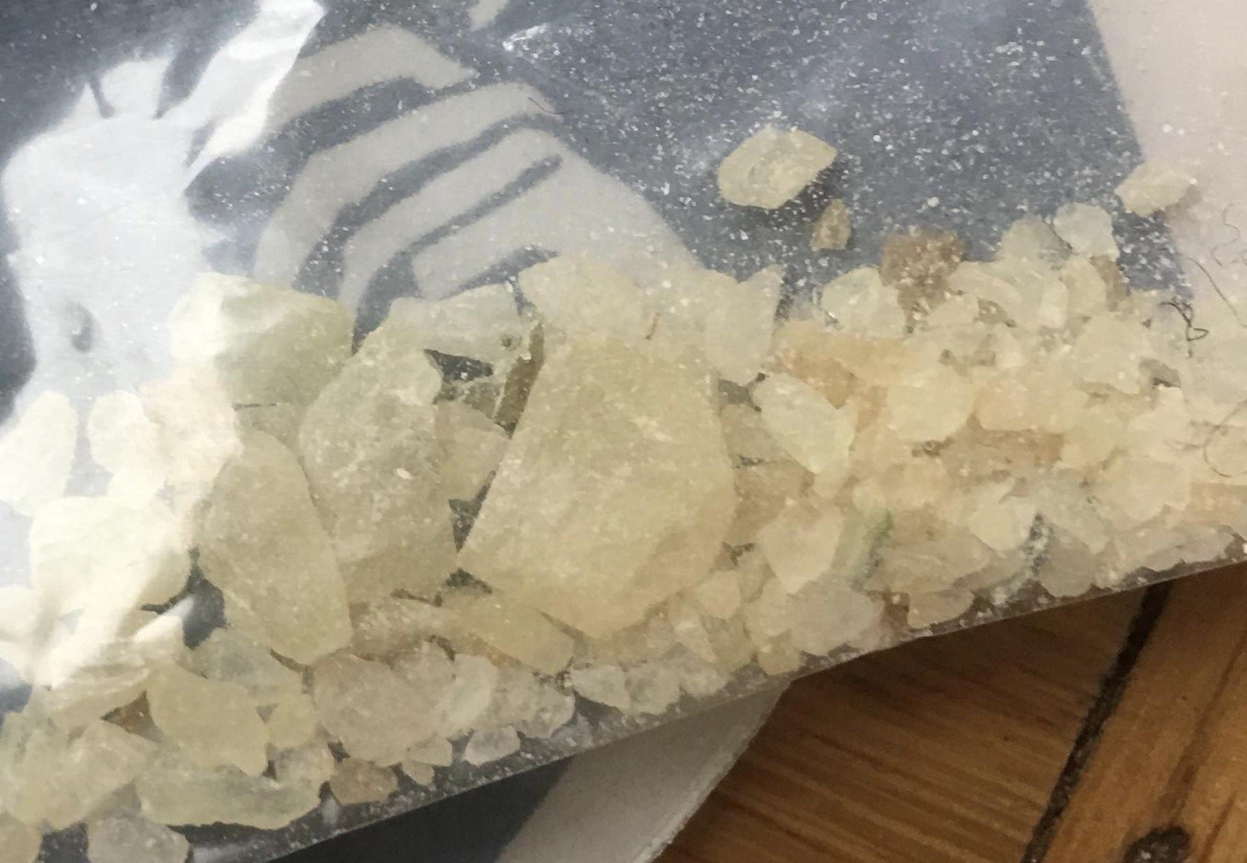
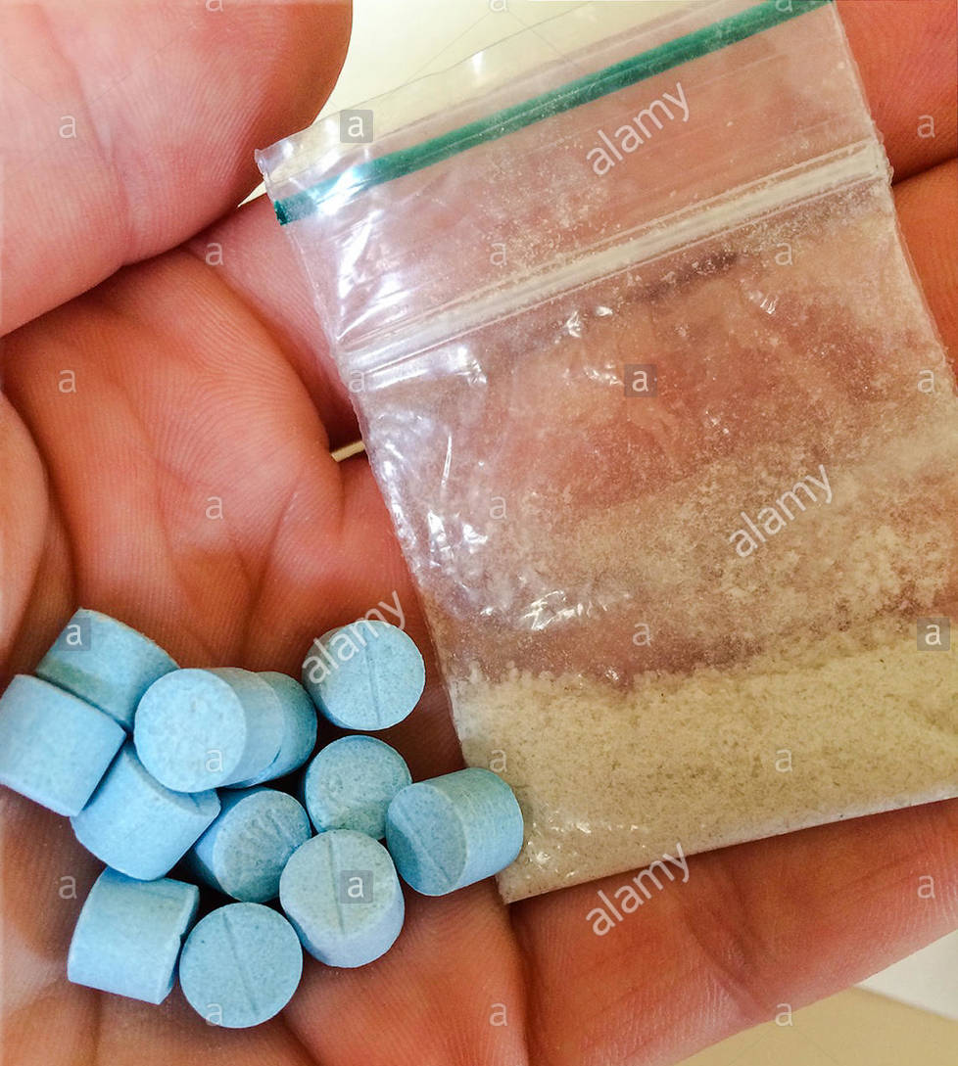
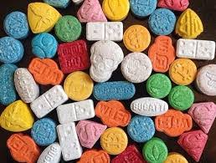
Case Study: MDMA
One of the most common drugs young people in England are exposed to is MDMA (Pills/Mandy/Molly/Beans/Ecstasy)

Slide 32
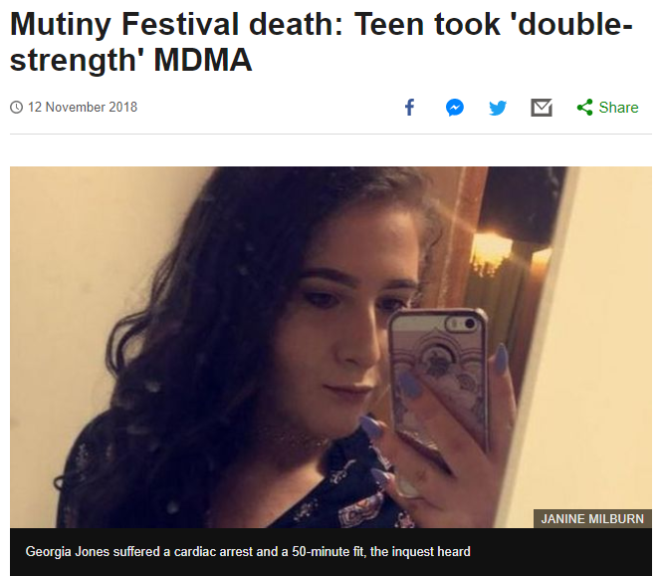
MDMA: The Facts
MDMA pills cost as little as five pounds. MDMA will cause you to feel happy, energised and make you feel like you want to dance. It is incredibly popular amongst young people and clubbers. It is also one of the most dangerous drugs you can take, and it can kill you within one hour of taking it.
Watch the videos
From the video, write in your books what is a major risk with taking MDMA pills?
https://www.youtube.com/watch?v=2yNoHqndq-U

Slide 33

How not to die from Ecstasy
Task: Watch the video and complete the questions on the following slide.
TW Overdose
Death

Slide 34

How not to die from Ecstasy

Slide 35
How not to die from Ecstasy
How many 16-24 year olds have taken ecstasy in the last year?
What form of MDMA did he take?
How many did the dealer advice he took?
How long does it take for a pill to kick in?
What does ecstasy do to your body?
Why shouldn’t you drink too much water?
What should you do if something doesn’t feel right?

Slide 36
Feedback
How many 16-24 year olds have taken ecstasy in the last year?
  350,000
What form of MDMA did he take?
  Pills
How many did the dealer advice he took?
  No more than 2 (you shouldn’t ever take more than 2 in a 6 hour period)
How long does it take for a pill to kick in?
  Between 0.5hours and 1.5 hours. It may be different between you and your mates. Never take another pill until you feel the first.
What does ecstasy do to your body?
  It heats it up. If your brain gets too hot you will black out.
Why shouldn’t you drink too much water?
  You could ‘drown’. You will want to drink LOADS on MDMA – you should be careful with this.
What should you do if something doesn’t feel right?
  Cool off – fresh air, sit down. Call an ambulance

Slide 37

How to beat addiction
https://www.youtube.com/watch?v=vBwToltbJTM
https://www.nhs.uk/live-well/addiction-support/drug-addiction-getting-help/

Slide 38

Today's Key Terms
Addiction
Chemical
Behavioural
Legal and illegal drugs
Self esteem
Trauma
Withdrawal
MDMA/Ecstasy
End of the lesson
Can you explain these words ?
Fill in your booklet
Is there anything you
are not sure about ?

Slide 39

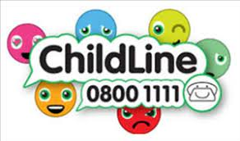






Where to go for help

