Slide 1

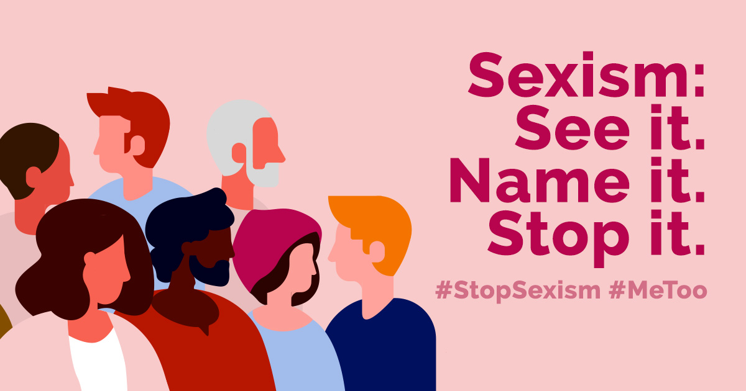

Year 11 Personal Development
Relationships
Values, rights and responsibilities
Keeping safe
Sexism and Misogyny
British Values:
Mutual respect,
Individual Liberty,
Rule of Law

Slide 2
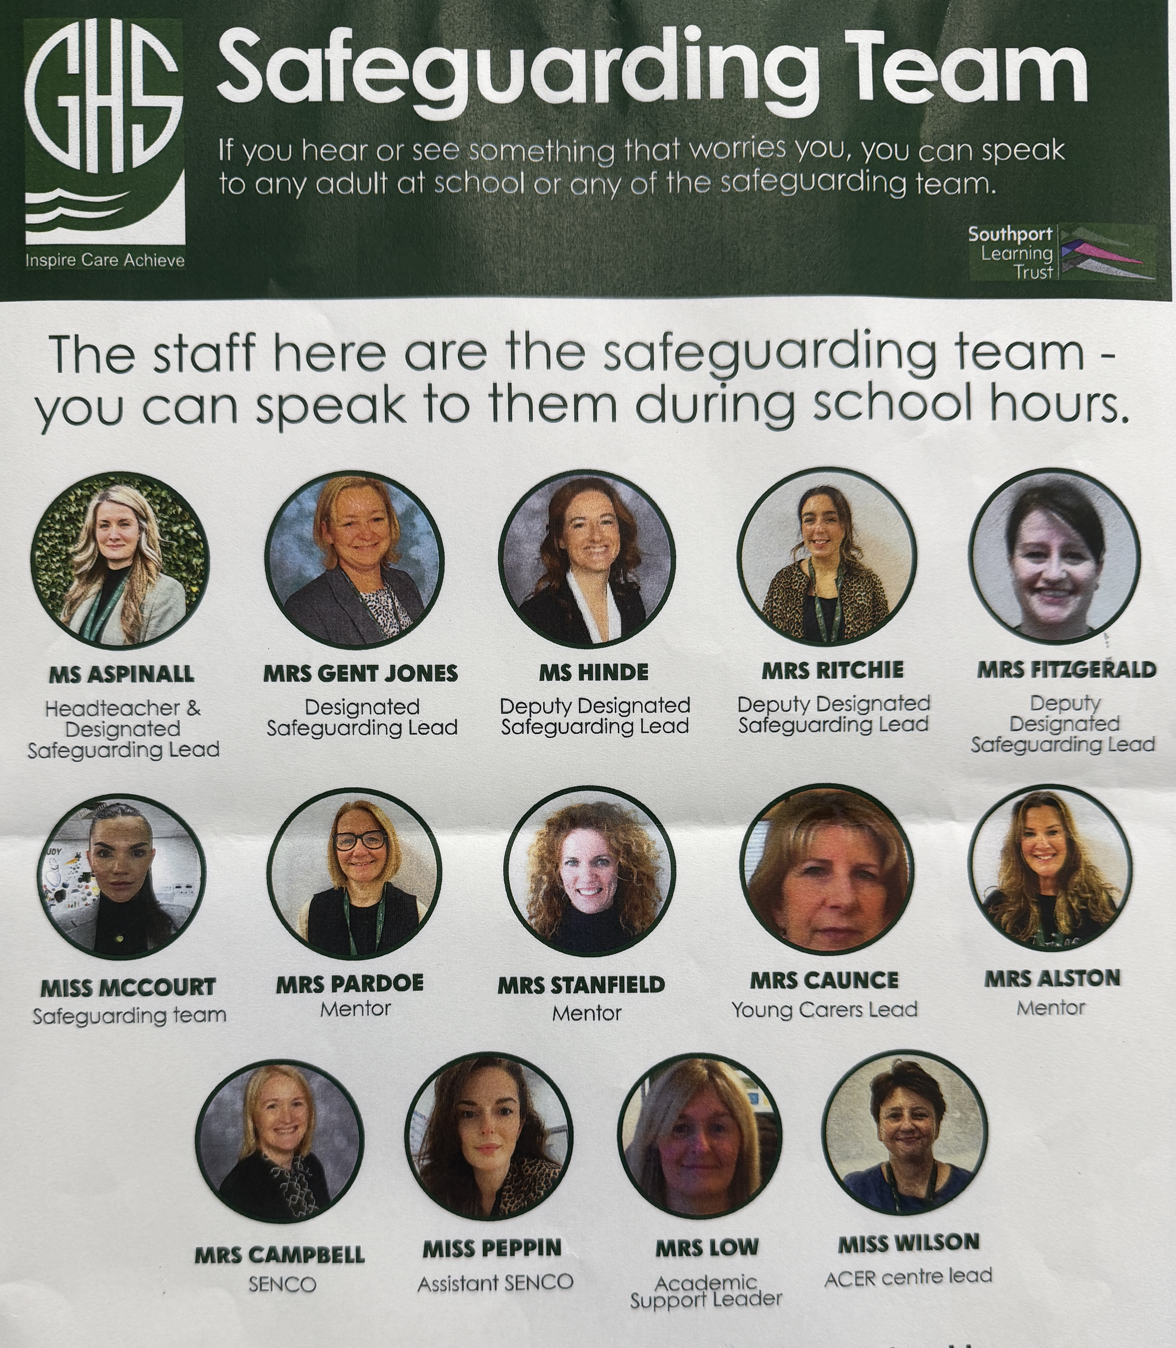
The Greenbank safeguarding team are here to help you if you are worried about anyone in school or are concerned about any of the issues raised in class.

Slide 3



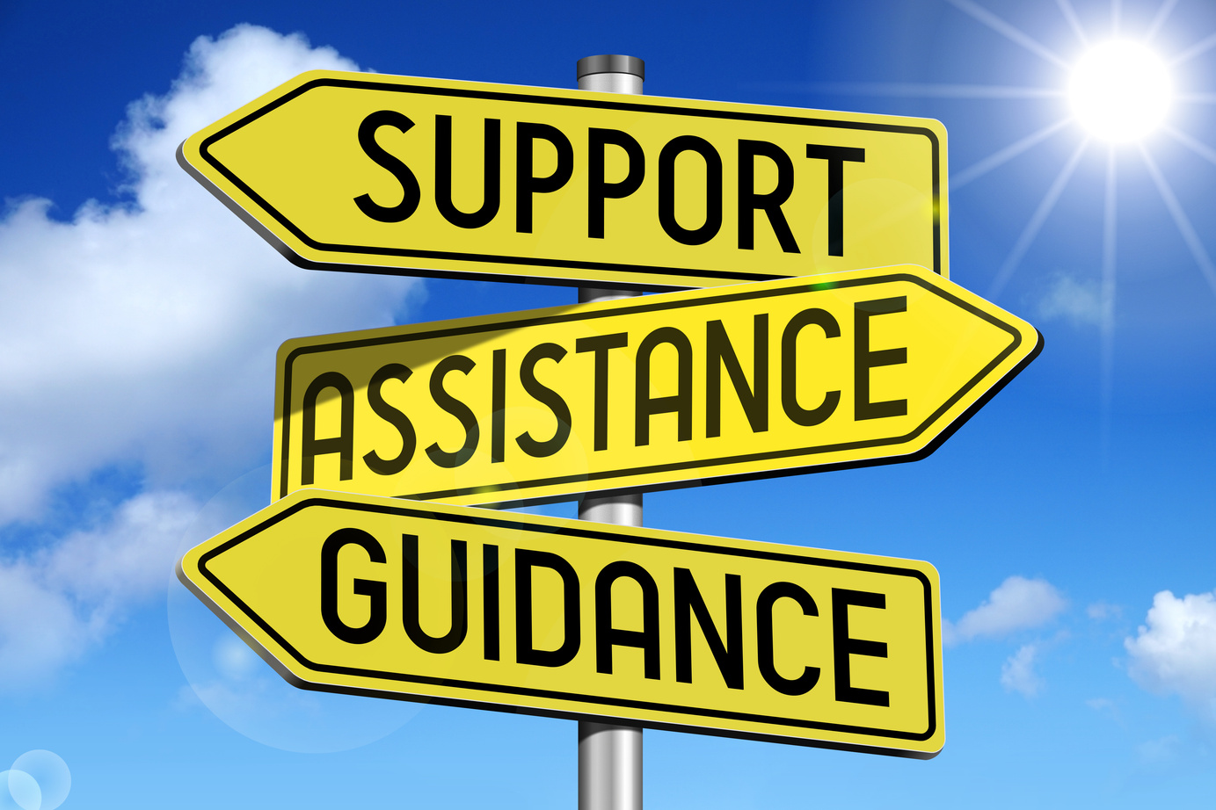

Classroom Rights and Responsibilities
Only join in discussions if you feel comfortable
Rights: Principles that everyone is entitled to
Responsibilities: Actions that you are expected to carry out
Be listened to and listen to others
Be respected and not judged
Have my discussions kept confidential unless there is cause for concern
Use the correct vocabulary
Ask for help, support and advice

Slide 4


Title: Respect, Equality, Action: Challenging Sexism and Misogyny
Do now: whiteboards
Write down what you think sexism means.
Notes:
“Good morning everyone. Today is our Values Day, and we’ll be talking about an important topic: how we treat each other with respect – especially when it comes to gender.”
“Our focus is on understanding sexism and misogyny – what they are, how they affect people, and what we can do about them. This session isn’t about blaming anyone – it’s about learning and thinking critically.”
“Let’s start with this question: What do you think sexism means? Write your answers on your MWBs.
[After 2 mins]
“Who would like to share their definition or example?”
Take 2–3 contributions. Then explain:
“Sexism is when someone is treated unfairly or differently because of their sex or gender. It can be based on stereotypes, assumptions, or disrespect – often against women and girls, but it can affect anyone.”
“It’s not just about ‘big’ incidents – it can include ‘jokes’, dress codes, who is listened to or believed, and more.”

Slide 5

What is sexism ?
Sexism is when someone is treated unfairly or differently because of their sex or gender.
Copy this definition into your booklets

Slide 6

Today's Key Terms
Sexism
Misogyny
Misandry
Incel
Impact
Emotional suppression
Pressure to conform
Stereotypes
Start of the lesson
Can you explain these words ?

Slide 7
Key words
Sexism: Discrimination or prejudice based on a person's sex or gender, often against women.
Misogyny: Hatred, dislike, or mistrust of women, often expressed through harmful attitudes, behaviours, or systemic practices.
Misandry: dislike of, contempt for, or ingrained prejudice against men (i.e. the male sex).

Slide 8
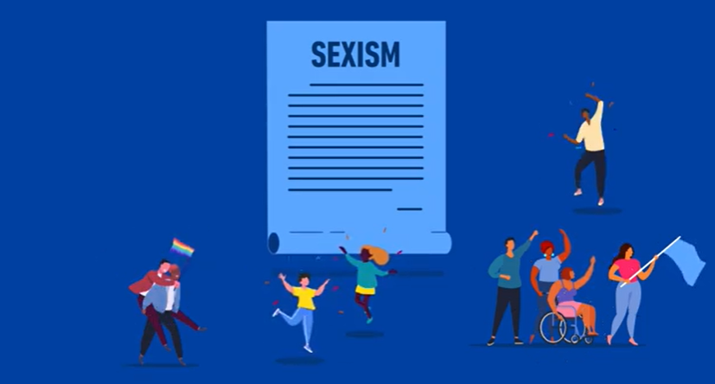
What is sexism?
Task: While we watch the video on the next slide, take note of three examples that it shares about sexism.

Slide 9
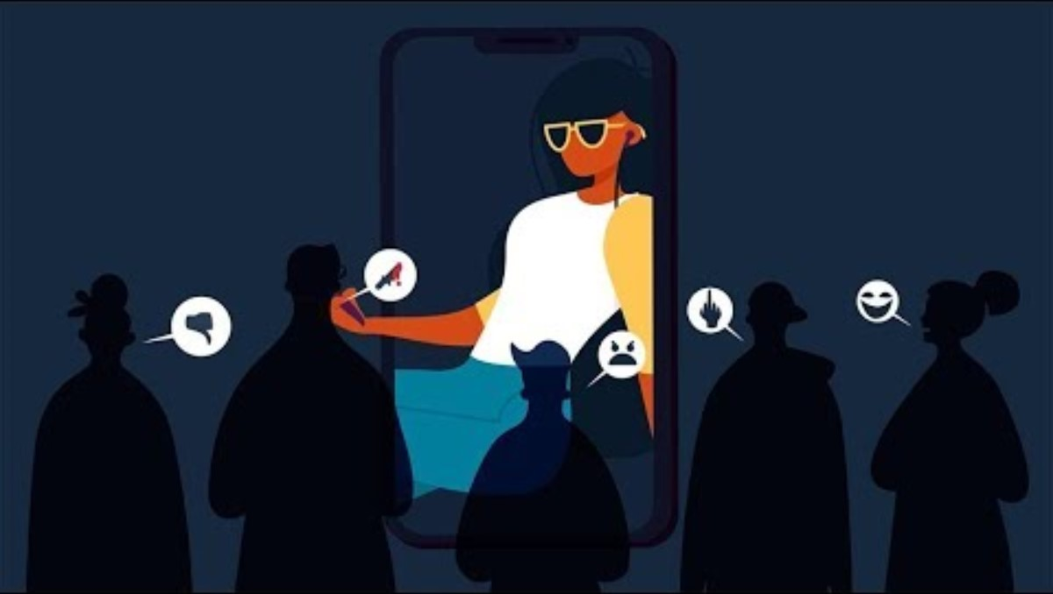
What is sexism?

Slide 10
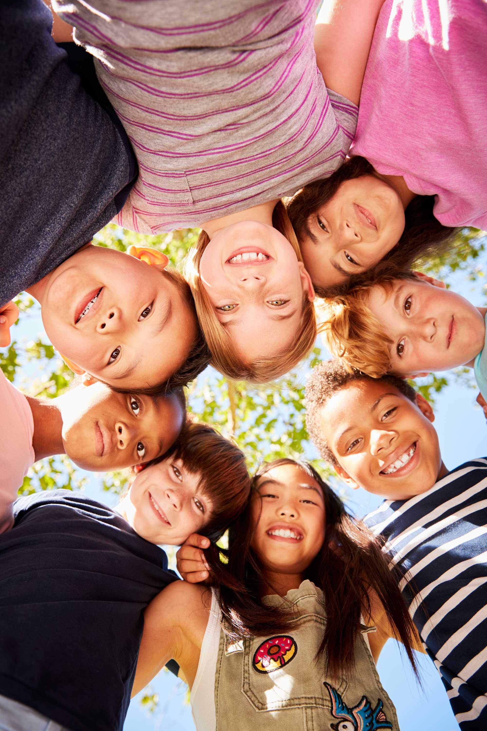
Sexism in childhood
Over the next few slides, you are going to look at examples of sexism in society that young children might experience.
In your books, tally up any that you have noticed as you have grown up.

Slide 11
Sexism in childhood
🏠 At Home
“Boys don’t cry.” Emotion is discouraged in boys, reinforcing the idea that being sensitive is “weak” or “unmanly.” | “Let your brother carry that – it’s too heavy for you.” Girls are assumed to be weaker and less capable of physical tasks. | Chores divided by gender. Girls are asked to help cook or clean, while boys take out the bins or fix things.

Slide 12
Sexism in childhood
🧑‍🏫 At School
Teachers calling on boys more in maths or science. Boys are sometimes assumed to be naturally better at STEM subjects. | Girls being told to “dress appropriately” more than boys. Places more responsibility on girls for others' behaviour or attention. | Boys being allowed to be loud or disruptive; girls are expected to be quiet and polite. Reinforces double standards in behaviour expectations.

Slide 13
Sexism in childhood
🛍️ In Shops and Advertising
Toys divided by gender. “Girls’ toys” are pink and domestic (dolls, kitchen sets); “boys’ toys” are blue and action-oriented (cars, construction, superheroes). | Clothing slogans. Boys' shirts say things like “Brave” or “Explorer,” while girls’ say “Princess” or “Cute.” | Books and media portraying mostly male heroes. Girls often see themselves in supporting roles or passive characters.

Slide 14
Sexism in childhood
🧑‍🤝‍🧑 Among Peers and Friends
Boys teasing other boys for liking "girl things." Reinforces that feminine interests are less valuable. | Girls being told they “shouldn’t get dirty” or “shouldn’t play football.” Limits girls' access to sports and physical play. | Children laughing if a boy wears pink or dresses up as a princess. Sends the message that femininity is shameful for boys.

Slide 15
Sexism in childhood
📱 On Social Media and TV
YouTube videos or cartoons showing girls as obsessed with appearance. Promotes the idea that girls should care most about looking pretty. | Parents posting “jokes” about protecting their daughters from boys. Reinforces the idea that girls are passive and boys are aggressors.

Slide 16
Sexism in childhood
How many tally marks did you get? Why does this matter?
Sexist messages in childhood can:
Shape what careers or hobbies children feel confident pursuing
Influence self-worth and emotional expression
Limit friendships, play, and opportunities

Slide 17
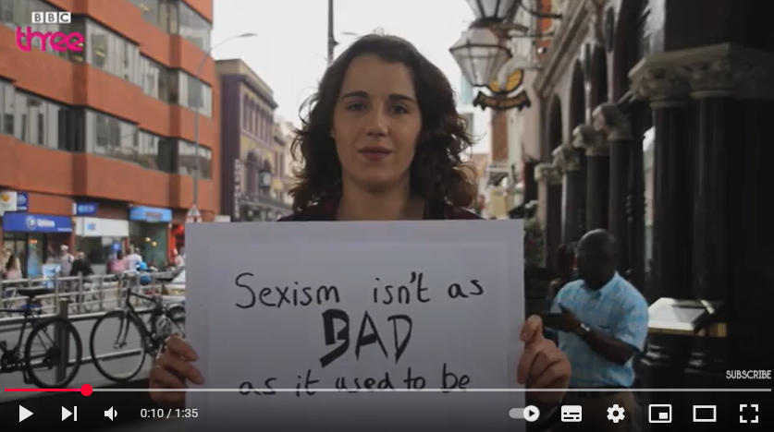
What can sexism sound like?
Task: While we watch the video, take note of two ways in which sexist behaviours can impact a person.

Slide 18
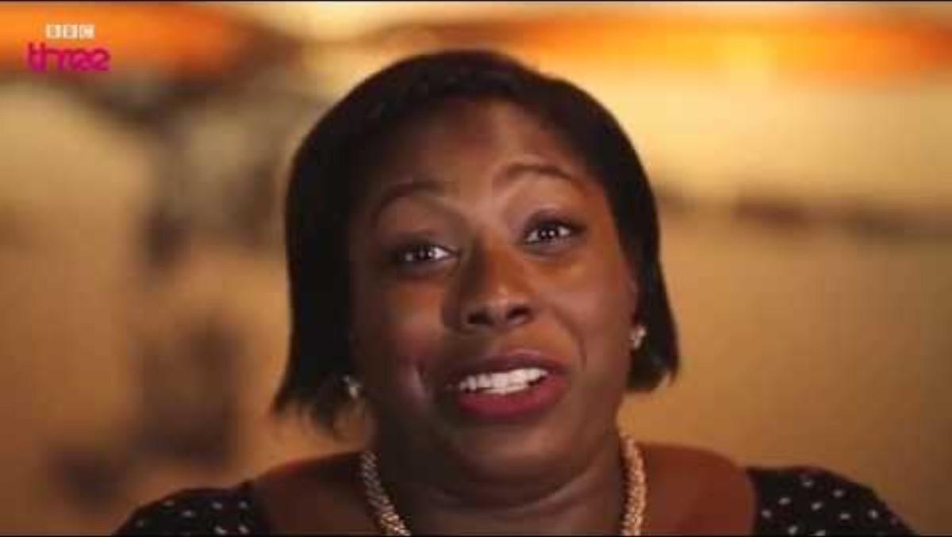
What can sexism sound like?

Slide 19
What impact can sexism have?
Sexism harms everyone — not just women and girls. It creates unfair expectations, limits opportunities, and encourages disrespectful or harmful behaviour across society.
Look at the following information and decide what you think are the most important impacts and why.

Slide 20
Impact on women and girls
Mental health and confidence: Repeated sexist comments or behaviour can lower self-esteem. Girls may feel like their voices or achievements aren't taken seriously. Fear of harassment can lead to anxiety, stress, or depression.
Safety and freedom: Many women change how they dress, travel, or act in public to avoid unwanted attention. This limits their freedom and can make them feel unsafe in everyday situations.

Slide 21
Impact on women and girls
3. Education and career choices: Girls may be discouraged from pursuing STEM subjects or leadership roles due to stereotypes. They may face discrimination or bias in school, university, or work.
4. Normalising abuse: When sexism is tolerated, it becomes easier for harassment and violence to be ignored or excused. Victims may feel ashamed or blamed instead of supported.

Slide 22
Impact on men and boys
Emotional suppression: Boys are often told not to cry or express emotion: “man up,” “don’t be soft.” This leads to bottled-up feelings, poor mental health, and higher rates of suicide in men.
Pressure to conform: Boys may feel pressure to act “tough,” dominate others, or be sexually aggressive to prove masculinity. They may struggle with identity if they don’t fit into those gender expectations.

Slide 23
Impact on men and boys
3. Fear of being judged: Boys who like “non-masculine” things — e.g. dancing, art, or pink — may be mocked. This limits self-expression and confidence.
4. Strained relationships: Sexist attitudes can lead to disrespect in relationships, poor communication, and misunderstandings. It can stop men from being seen as gentle, caring or vulnerable, even when they want to be.

Slide 24
What is misogyny?
Misogyny means dislike, contempt, or hatred of women. It can look like sexist comments, but also violence, harassment, or making women feel unsafe.
Copy this definition into your booklets

Slide 25
What is misogyny?
Misogyny is a stronger term – it means dislike, contempt, or hatred of women. It can look like sexist comments, but also violence, harassment, or making women feel unsafe.
Some people think misogyny is just extreme behaviour, but it can also show up in everyday language or attitudes.
“She’s too high maintenance.”
“She’s such a drama queen.”
“Man up/ grow a pair!”
“She’s asking for it.”

Slide 26
Quick whiteboard quiz
Question 1 - A boy says, “Girls are too emotional to be good leaders.”
Not misogynistic – just an opinion
Misogynistic – it stereotypes and devalues girls
Depends who he says it to
Notes:
✅ Correct Answer: b – Misogynistic. It generalises and discredits women based on gender.

Slide 27

Quick whiteboard quiz
Question 2 - A girl is ignored during group work, even when she offers ideas.
Misogynistic if it’s a pattern of exclusion
Not misogynistic – maybe her ideas weren’t good
That’s just normal in a big group
Notes:
✅ Correct Answer: a – Could be misogynistic if girls are consistently dismissed or devalued.

Slide 28
Quick whiteboard quiz
Question 3 - A student shares a meme that jokes about “women belonging in the kitchen.”
It’s just a joke
Misogynistic – promotes outdated and sexist roles
Depends if anyone laughed
Not misogynistic if a girl shared it
Notes:
✅ Correct Answer: b – Misogynistic. Even if intended as humour, it reinforces harmful gender stereotypes.

Slide 29
Quick whiteboard quiz
Question 4 - A group of boys rates girls’ appearances out loud in school.
Misogynistic – objectifies and reduces girls to their looks
Immature, but not misogynistic
It’s a bit of harmless fun
Notes:
✅ Correct Answer: a – Misogynistic. It reduces girls to their appearance and promotes objectification.

Slide 30
Quick whiteboard quiz
Question 5 - A boy says, “Men have it harder these days – everyone only cares about women’s issues.”
Misogynistic – dismisses real issues women face
It’s a balanced viewpoint
They’re just expressing frustration
Notes:
✅ Correct Answer: a – Misogynistic. This deflects from conversations about inequality and undermines the experiences of women.

Slide 31
What does the law say?
Equality Act 2010 | Sexual Offences Act 2003 | Public Order Act 1986
It is illegal to discriminate against someone based on their sex or gender. Schools must take steps to prevent sexist behaviour and promote equality. | Makes sexual harassment, assault, and rape criminal offences. Consent must be freely given, and someone under 16 cannot legally give consent to sexual activity. | It is illegal to use abusive, threatening or insulting language or behaviour in public, including sexist hate speech

Slide 32
What does the law say?
Protection from Harassment Act 1997 | Online Safety Act 2023 | Domestic Abuse Act 2021
Makes harassment, stalking, and repeated unwanted contact illegal. This includes behaviour online or in person. | Websites and social media must protect users from abuse and harmful content Online sexual harassment, threats or sharing private images are criminal offences. | Defines domestic abuse as not just physical, but also emotional, sexual, and controlling behaviour in relationships or families. Applies from age 16+ but younger teens can still report abuse.

Slide 33
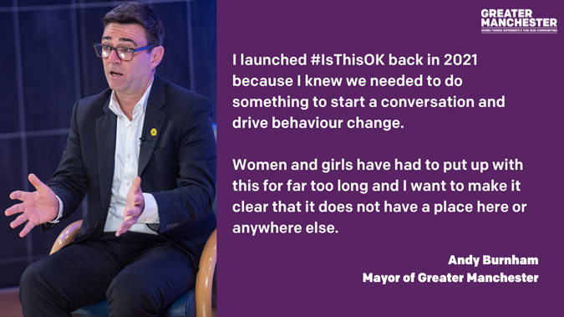
#IsThisOK? campaign

Slide 34
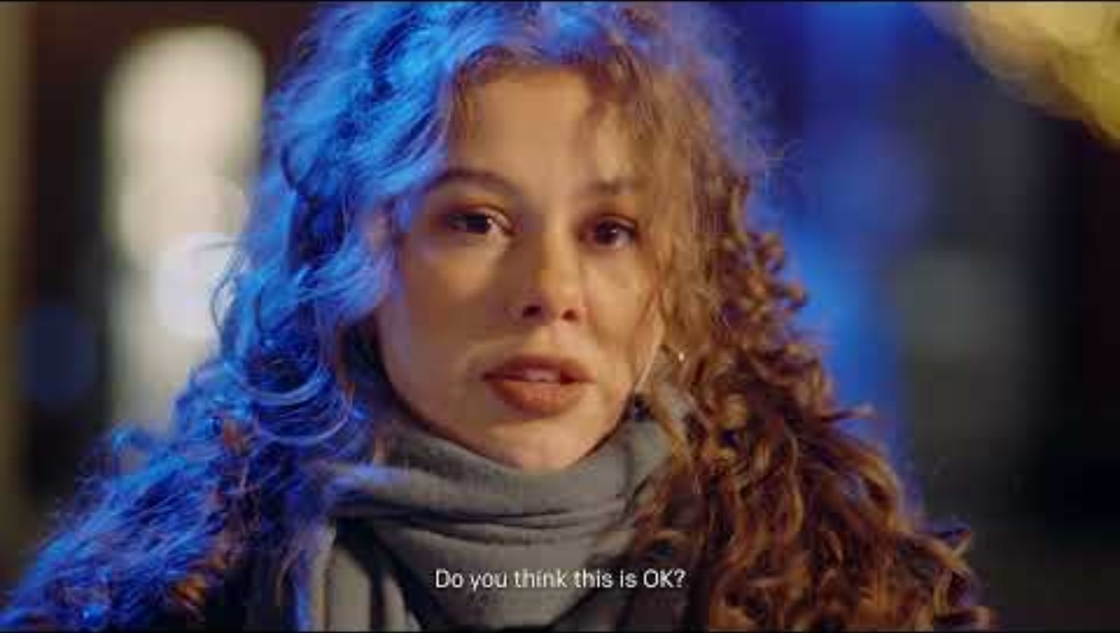
#IsThisOK? campaign

Slide 35
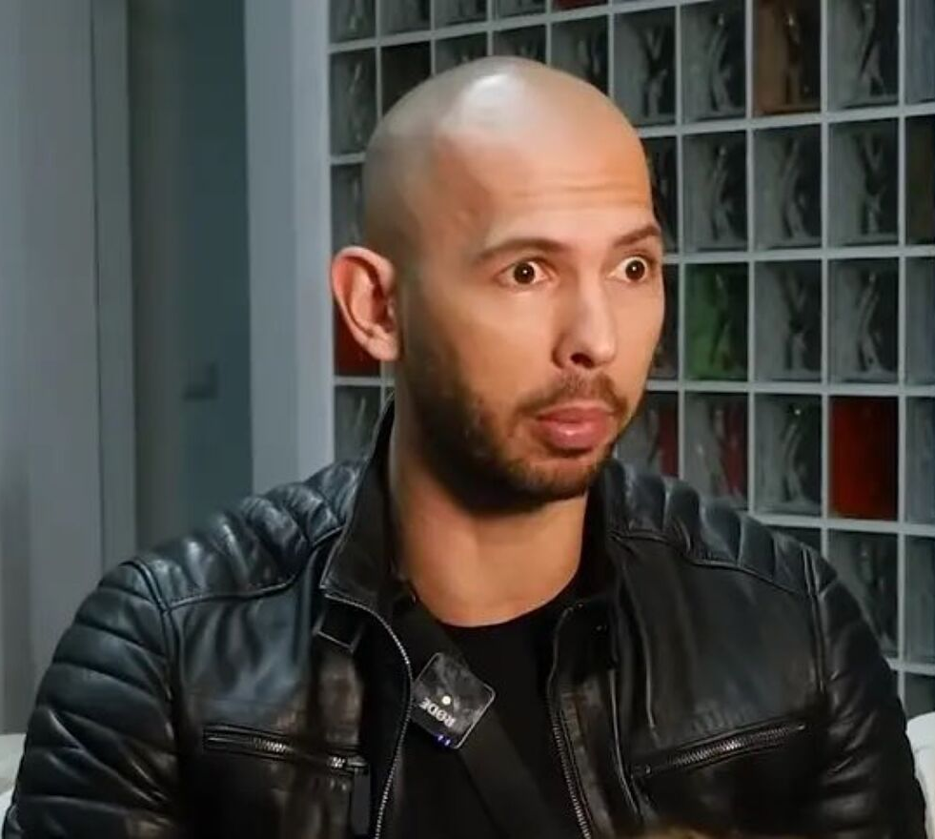
Influence of social media
Andrew Tate became well known on TikTok thanks to his terrifyingly misogynistic beliefs. He has been connected to the dark corner of the internet in which young boys are being radicalised from the certain viewpoint. Tate markets himself as an alpha male lifestyle coach, and preaches misogyny to his followers. ‘Females are barely sentient,’ he once claimed. ‘Females don’t have independent thought. They don’t come up with anything. They’re just empty vessels, waiting for someone to install the programming.’

Slide 36

What is an Incel ?
'Involuntary celibate: a member of an online community of men who consider themselves unable to attract women sexually, associated with views that are hostile towards women.
Elliot Rodger killed 6 people and injured 14 others in the US in a mass shooting. Before starting his attack, Rodger uploaded a video to Youtube announcing his intention to "punish" women—as well as the men to whom they were attracted—for their lack of interest in him.

Slide 37

What is an Incel ?

Slide 38

What is an Incel ?
There is a growing concern that young men and boys are being radicalised online into incel culture. An incel describes someone, usually a male, who is frustrated by their lack of sexual experiences. An incel is defined as 'heterosexual men who blame women and society for their lack of romantic success,'

Slide 39
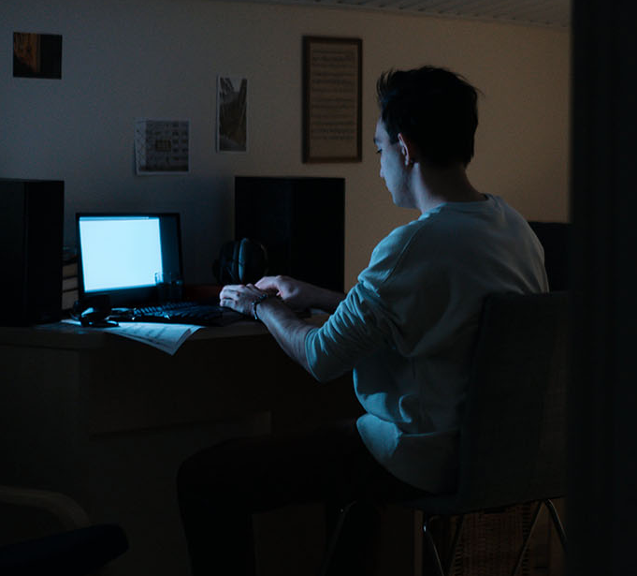
What is an Incel ?
The term manosphere is closely tied to incel culture. The manosphere is a network of online men’s communities against the empowerment of women and who promote anti-feminist and sexist beliefs. These groups place the blame on women and feminists for many problems in society, and many encourage resentment, or even hatred, towards women and girls.

Slide 40
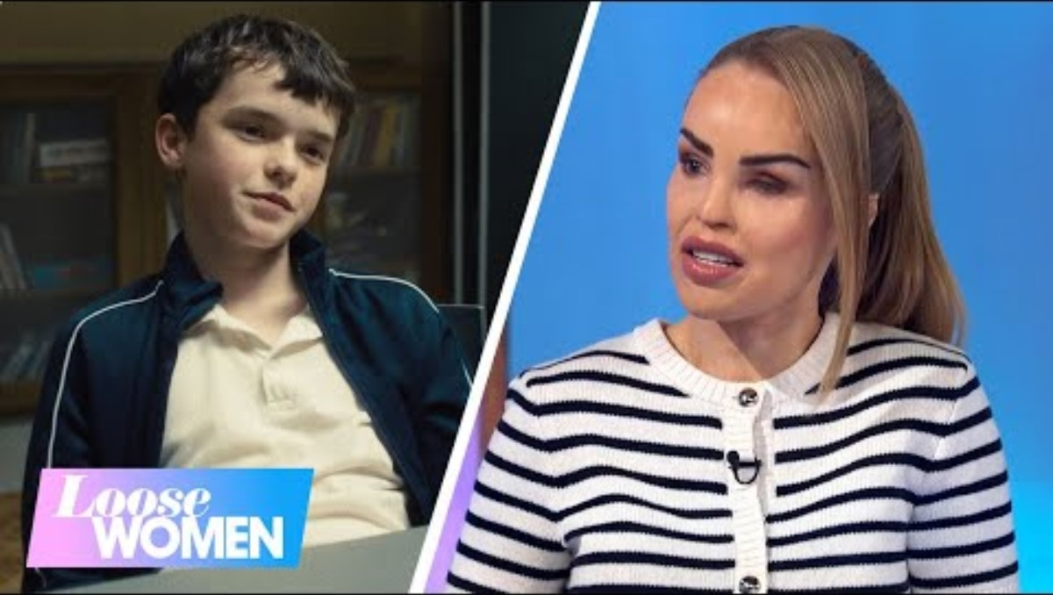
Incel culture and the internet

Slide 41
What can you do?
1. Use Calm, Clear Language
“That’s not okay to say.”
“I don’t think that’s funny.”
“That comment is actually quite sexist.”
4. Support the Target
Stand beside the person being targeted.
Check in with them afterwards: “Are you okay? That wasn’t right.”
2. Ask Questions to Prompt Reflection
“What do you mean by that?”
“Would you say that if it was about your sister or mum?”
5. Change the Subject or Redirect
If it feels unsafe to confront directly, steer the conversation away.
“Let’s talk about something else.”
3. Use “I” Statements
“I feel uncomfortable when you say things like that.”
“I don’t agree with that kind of joke.”

Slide 42
What can you do?
6. Use Humour (Carefully)
“Wow, straight out of the 1950s, that one.”
“Did you really just say that in 2025?”
9. Use Group Influence
If others in the group also disagree, speak up together.
“We don’t talk like that here.”
7. Speak to a Trusted Adult
If the behaviour continues or feels serious, talk to a teacher, form tutor, or safeguarding lead.
10. Educate Gently
Share what you’ve learned: “We talked about this in Values Day—those kinds of comments can really hurt people.”
8. Be a Role Model
Avoid using sexist language or laughing at sexist jokes.
Show respect in your own words and actions.

Slide 43
Key messages
Sexism is not just “banter” – it can be unlawful.
Everyone has the right to feel safe, respected, and heard.
If you or someone you know is experiencing abuse or harassment, speak to a trusted adult or safeguarding lead.

Slide 44

Today's Key Terms
Sexism
Misogyny
Misandry
Incel
Impact
Emotional suppression
Pressure to conform
Stereotypes
End of the lesson
Can you explain these words ?
Fill in your booklet
Is there anything you
are not sure about ?

Slide 45
Reflections
In your books:
What did I learn today?
What surprised me?
What might I do differently?

Slide 46

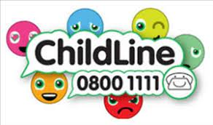







Where to go for help

