Slide 1
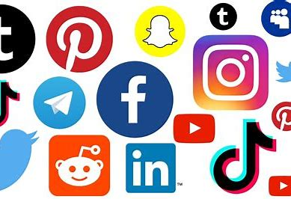

Year 8 Personal Development
Online Life and Media
Mental and emotional health
Social Media and Mental health

Slide 2
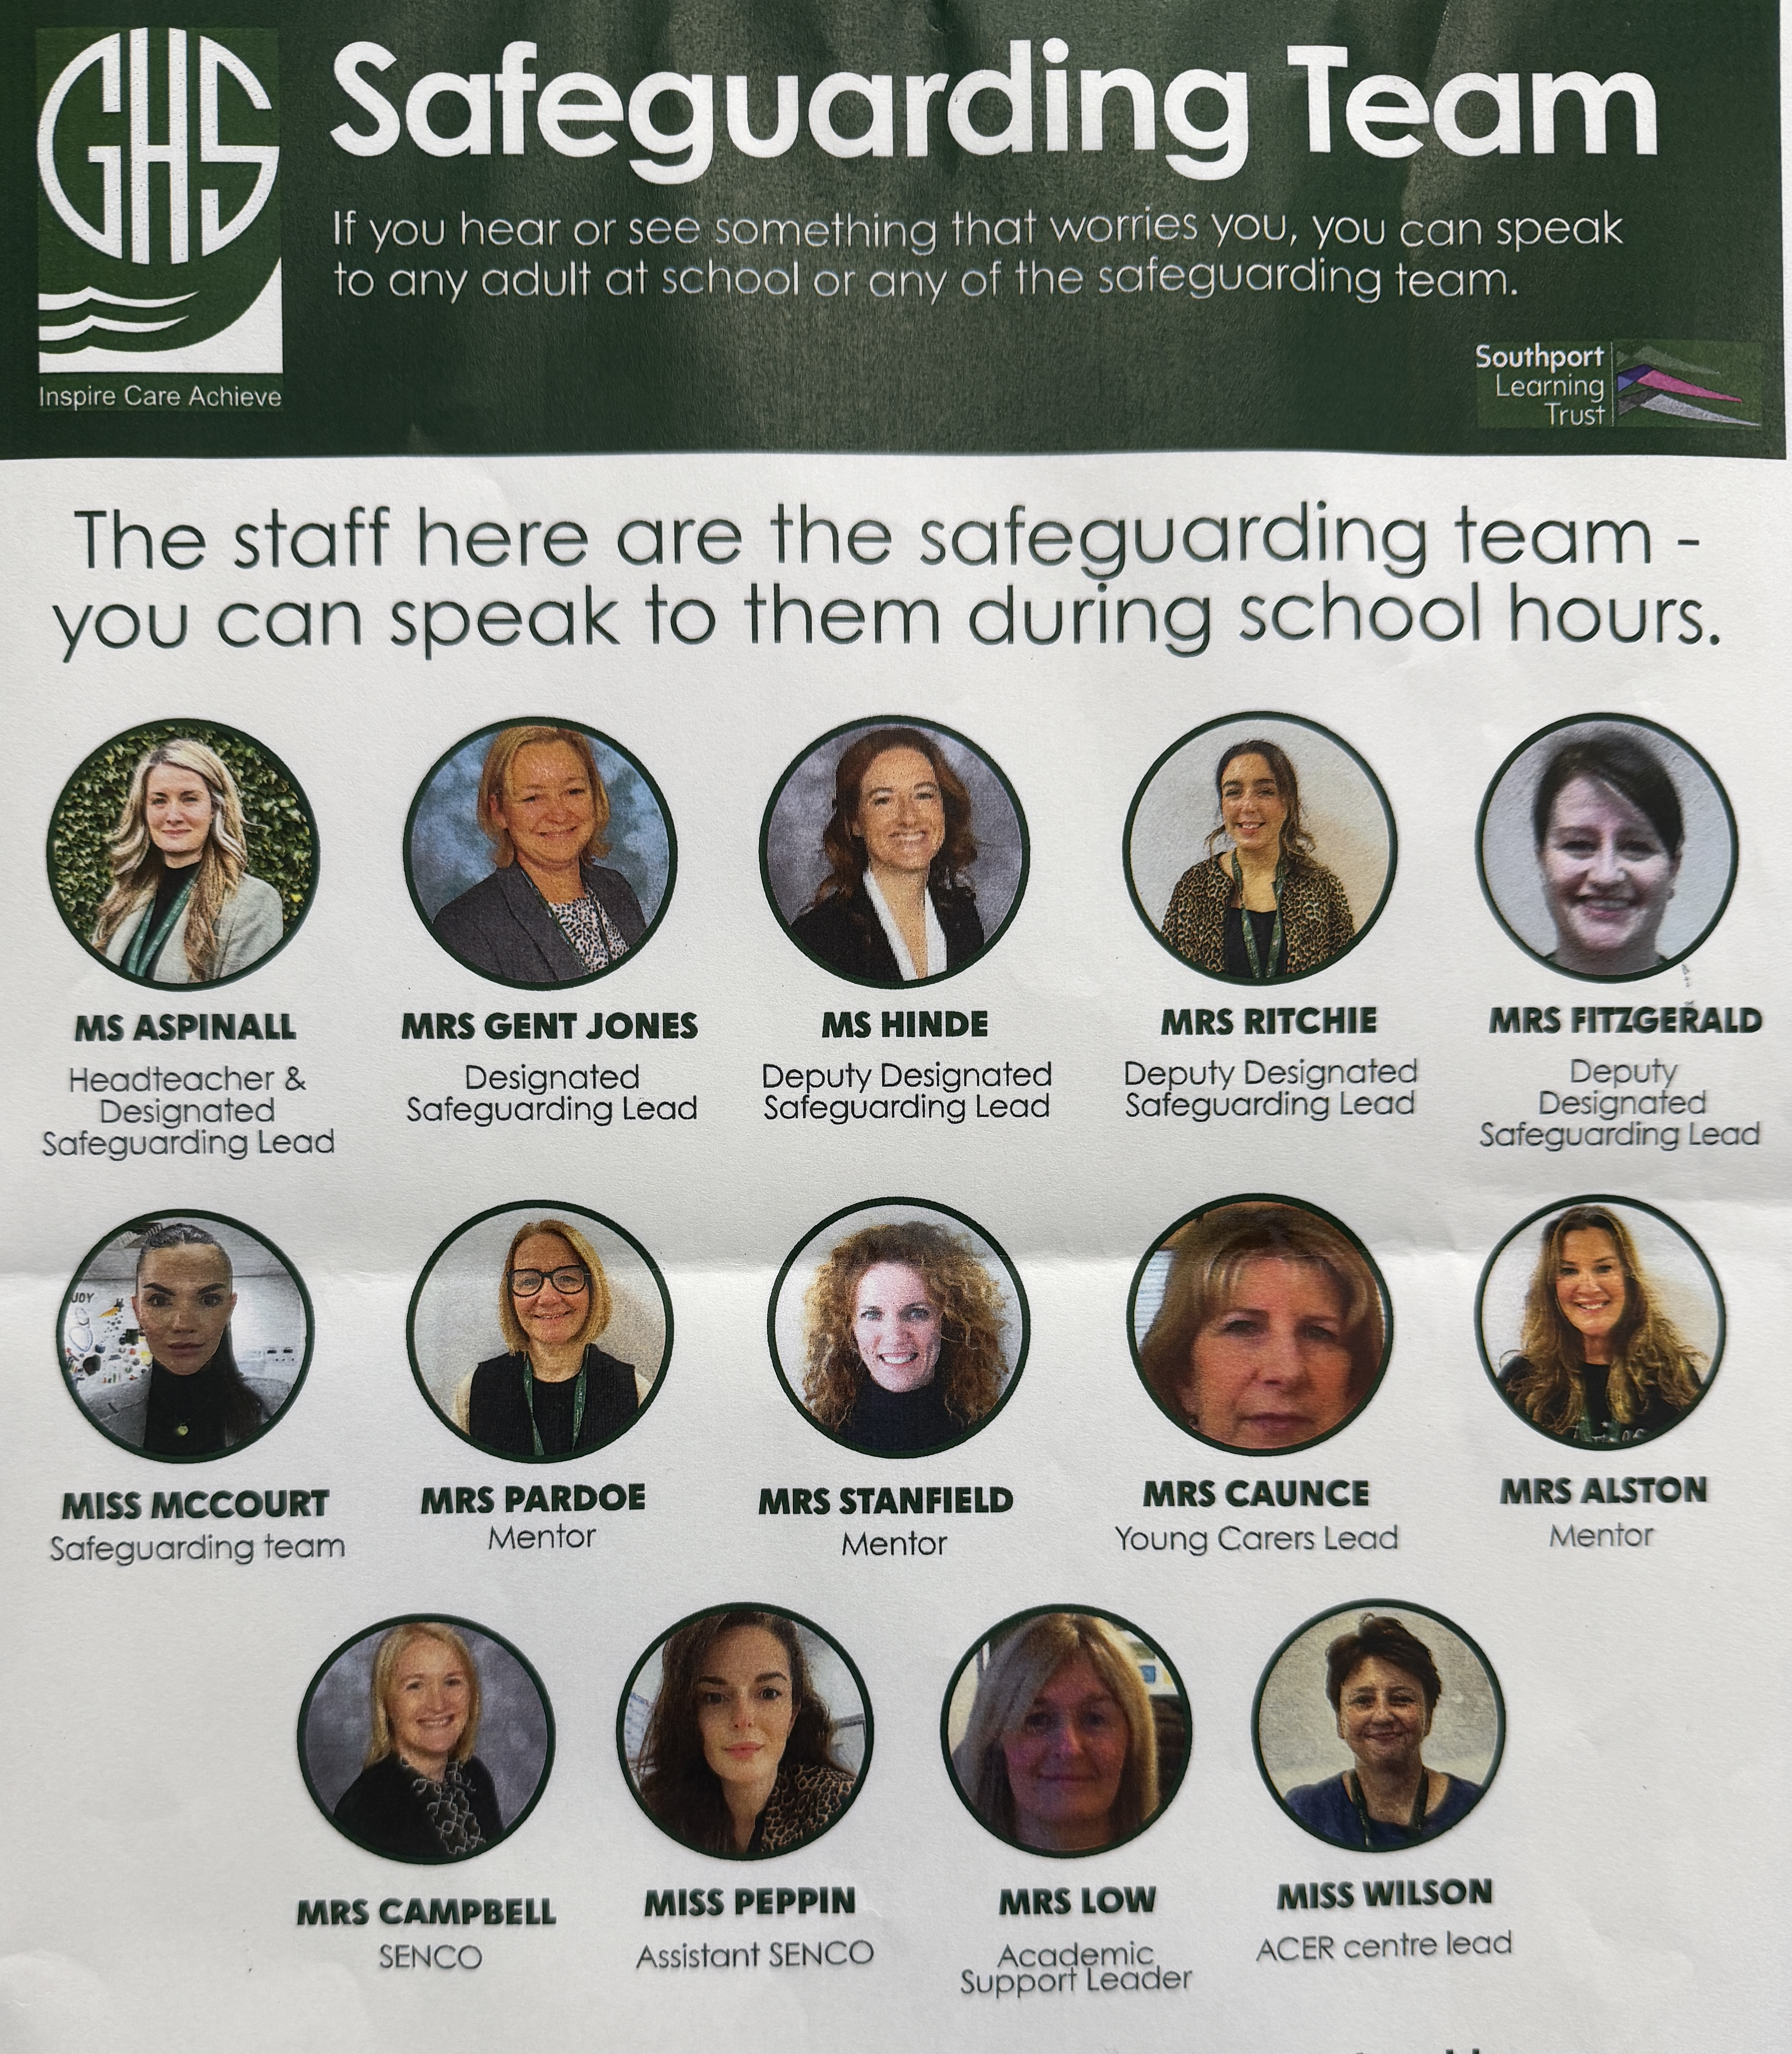
The Greenbank safeguarding team are here to help you if you are worried about anyone in school or are concerned about any of the issues raised in class.

Slide 3





Classroom Rights and Responsibilities
Only join in discussions if you feel comfortable
Rights: Principles that everyone is entitled to
Responsibilities: Actions that you are expected to carry out
Be listened to and listen to others
Be respected and not judged
Have my discussions kept confidential unless there is cause for concern
Use the correct vocabulary
Ask for help, support and advice

Slide 4

Title: How can social media affect our mental health?
Whiteboards, Do now:
What are some of the benefits of being online?
What are some negatives ?

Slide 5

What are we learning today?
Lesson Objective: Today we are learning about how social media can affect our mental health.
Learning Outcomes:
To analyse how much time we spend on social media.
To decide how to choose which accounts to follow.
To evaluate how we maintain healthy habits on social media.

Slide 6

Today's Key Terms
Screen time
Privacy
Inappropriate content
Start of the lesson
Can you explain these words ?

Slide 7
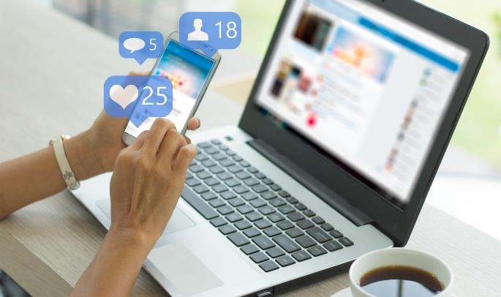

Whiteboards
Positives and negatives of social media
List 3 positive things about social media:
List 3 negative things about social media:
Notes:
TAKE 10 ACTIVITY 3
It can be easy to vilify social media when if fact there are both positives and negatives. Show PowerPoint Slide 9 and working in small groups task students with listing as many positives and negative as they can think of. They could do this on flipchart paper and move the papers around from group to group to share ideas. What are the main positives and negatives suggested? Take some feedback from groups before moving onto the next slide.

Slide 8


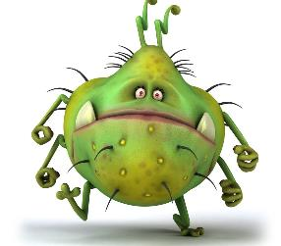
The good, the bad and the ugly
Social media - the good, the bad & the ugly
Good way to keep in touch, share information, photographs etc. Can keep up to date with issues you are interested in. Lots of free information, re-connect with people, global communication, instant, advertising/marketing self, cheap/free
Can become very reliant 'addicted' to social media, lose other types of communication skills e.g. conversation, writing, speaking on the telephone, listening, concentration. Increases fear of missing out FOMO, comparing self to others
Manipulation by large corporations, use of personal data, 'spying', fake news, unhealthy and/or harmful sites, can be used for criminal activity, bullying, hate crime, trolling etc
Notes:
PowerPoint Slide 10 gives a few examples of positive and negative aspects of social media. It also considers some of the potentially dangerous behaviours that can take place online. Take comments and additional examples if time allows.

Slide 9
Social media usage
How long is spent on average on social media every day by a person?
101 minutes
127 minutes
147 minutes
183 minutes
This amount is up from 90 minutes in 2012.
It is growing every year.

Slide 10
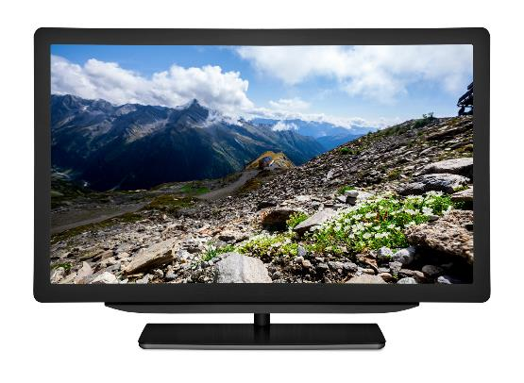
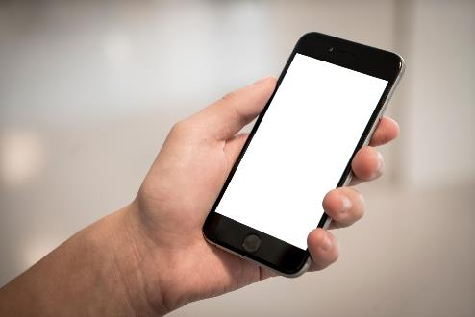

Social media usage
How much screen time do you spend every day?
Notes:
TAKE 10 ACTIVITY 1
This exercise is designed to help establish a baseline that will indicate how dependent (or not) students are on social media. Show PowerPoint Slide 2 and give students a few moments to estimate their screen time. Take some brief feedback.

Slide 11
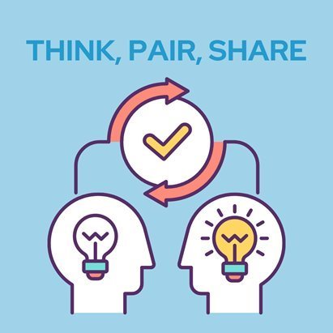
Is it healthy to spend so much time online ?
What are the potential issues in spending too much time on it?

Slide 12
Impact of social media
As you watch the video make notes on the following in your booklets:
What are some of the issues with social media?
Why do you think social media is being likened to a ‘drug’?

Slide 13
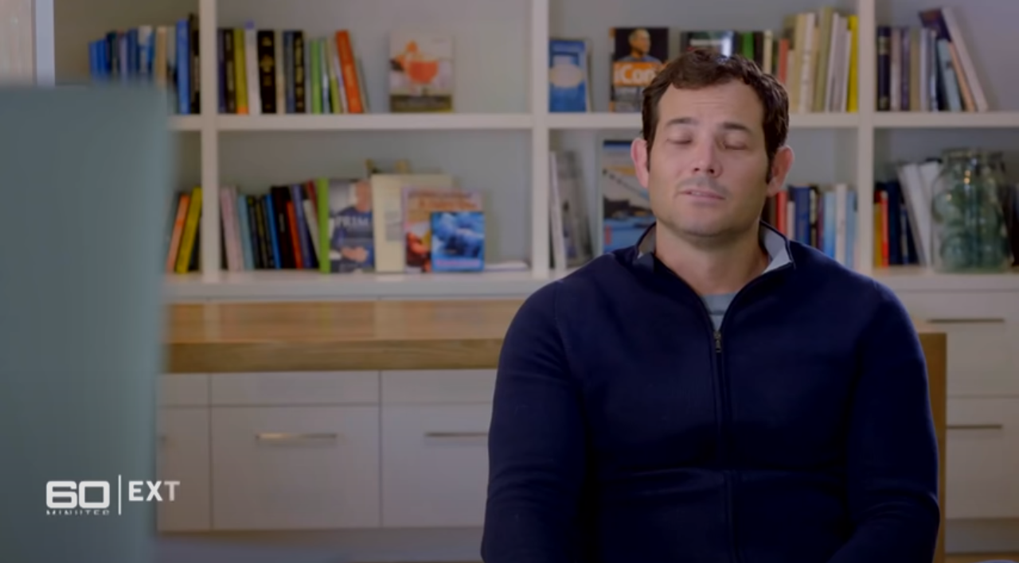
Impact of social media
https://www.yout-ube.com/watch?v=XmXRaG3nLhY

Slide 14
Teacher feedback
What are some of the issues with social media?
Becoming addicted to it, social media taking over your life, comparing your life to others, feeling of jealousy.
Why do you think social media is being likened to a ‘drug’?
It can take over your whole life, the way you live, you may start to feel you cannot live without it.

Slide 15
Impact of social media
Social media can be positive but it can also negatively impact your mental health. Some of these are:
  Increase in anxiety.
  Depression.
  Negative body images and low self-esteem.
  Sleep problems.
  Cyberbullying.
Notes:
https://www.nursingtimes.net/news/mental-health/how-use-of-social-media-and-social-comparison-affect-mental-health-24-02-2020/

Slide 16
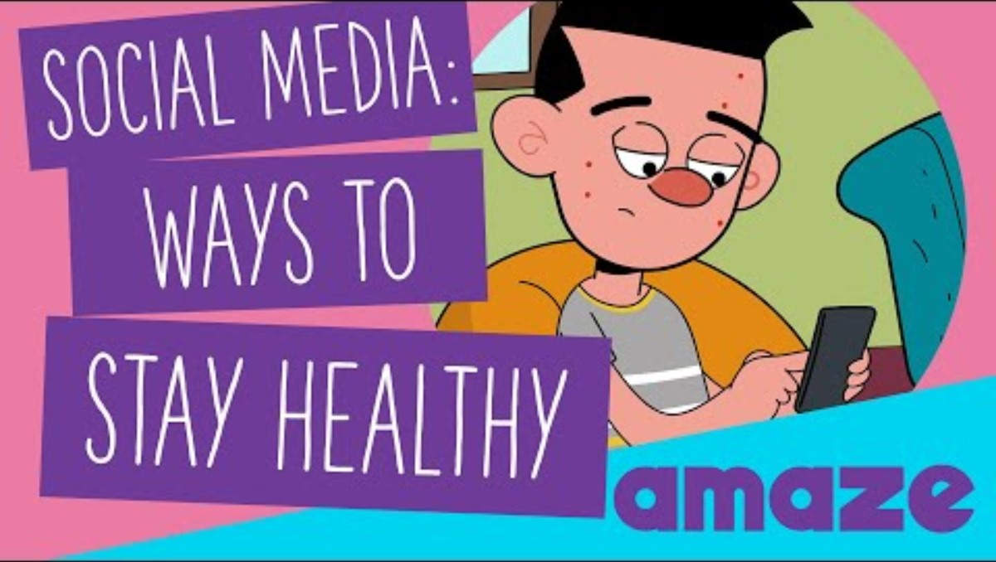
Staying healthy

Slide 17
Social media responsibility
Over half of teenagers have been exposed to inappropriate content on social media.
True
False
Unfortunately the majority of young people have been exposed to content which isn’t appropriate.

Slide 18
Social media responsibility
From everything we have discussed today you now need to come up with some personal rules that you could abide by on social media.
Think about: privacy, content, your mental health, is it true?

Slide 19
Feedback
What can you do?
Privacy - To stop people viewing content who you don’t know.
Inappropriate content - Anyone who posts anything inappropriate, block them.
Self-esteem - Is there any chance that this will make me feel worse about myself?
Are they genuine? - If they aren’t real or are portraying as a fake, you could remove them.
Is it offensive? - Could the account offend other people?

Slide 20
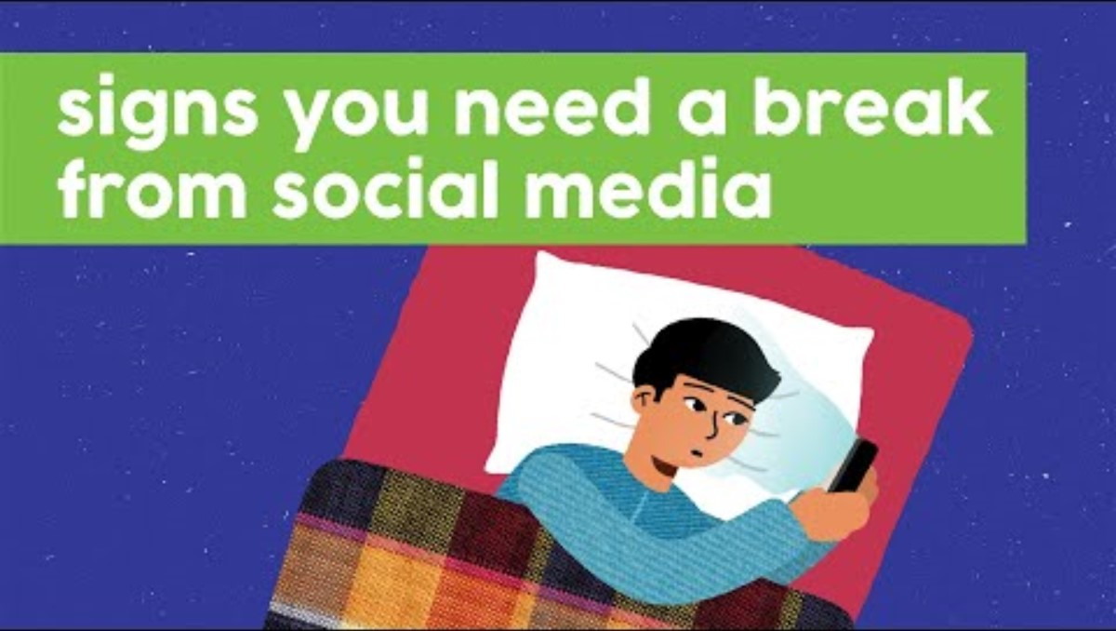
What can you do?

Slide 21

Today's Key Terms
End of the lesson
Can you explain these words ?
Fill in your booklet
Is there anything you
are not sure about ?
Screen time
Privacy
Inappropriate content

Slide 22

What can you do?
"You've just lost your place
on the leader board."
"Have you checked in?"
  Turn off notifications.
  Don't care about top spots, streaks etc.
  Remember it's only algorithms 'talking' to you - they don't really know (or care) about you as an individual.
  You are in charge and can choose what you see, read and switch off.
"Daisy B has just stolen
your top spot."
"Time to do your
daily exercise."
"200 day streak -
keep it up."
Notes:
Conclude the activity by going through the information on PowerPoint Slide 8. Stress that we are all in control of what we allow our mobile phones and social media to do, although it often doesn’t feel this way. Inform students about the role of algorithms and how manipulative they can be. Social media algorithms are a way of sorting posts in a users’ feed based on relevancy. Social networks prioritise which content a user sees in their feed first by the likelihood that they’ll actually want to see it. Algorithms collect our data usage and then push appropriate content our way. If anyone is particularly interested in this area they might want to read “Weapons of Math destruction” by Cathy O’Neil.

Slide 23
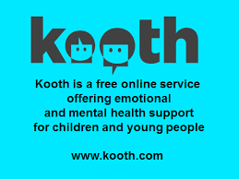

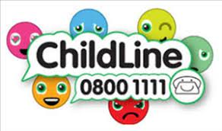




Where to go for help

