Slide 1

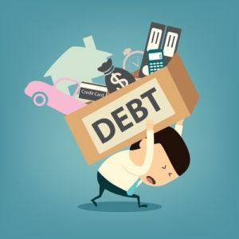


Being in Financial Debt
Year 9 Personal Development
Keeping Safe and Managing Risk
Future choices and Money
British Values:
Rule of Law

Slide 2

The Greenbank safeguarding team are here to help you if you are worried about anyone in school or are concerned about any of the issues raised in class.

Slide 3





Classroom Rights and Responsibilities
Only join in discussions if you feel comfortable
Rights: Principles that everyone is entitled to
Responsibilities: Actions that you are expected to carry out
Be listened to and listen to others
Be respected and not judged
Have my discussions kept confidential unless there is cause for concern
Use the correct vocabulary
Ask for help, support and advice

Slide 4

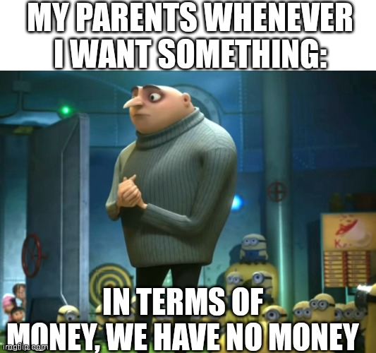
Title: What are loans?
Whiteboards -Do now:
What do you do if you run out of money?
Can you have a negative bank balance?
Notes:
What are loans? What do I need to know about loans? How do loans accrue interest?

Slide 5
Feedback
Wait until you have some more money coming in, get a loan or borrow money.
Yes – an overdraft/ loan/ mortgage will do this.

Slide 6
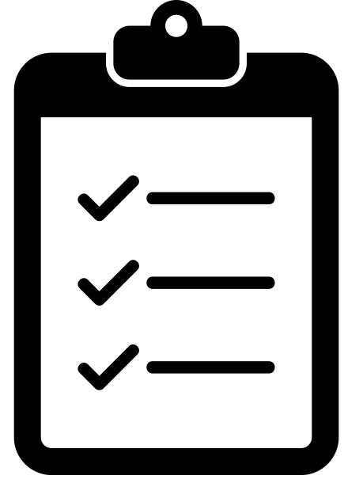
What are we learning today?
Lesson Objective: Today we are learning about the different types of loans.
Learning Outcomes:
To understand the different types of loans.
To understand how loans accrue interest.
Notes:
What are loans? What do I need to know about loans? How do loans accrue interest?

Slide 7

Today's Key Terms
Debt
Loan
Credit
Debit
Interest
APR
Overdraft
Loan sharks
Payday loans
Start of the lesson
Can you explain these words ?

Slide 8

Whiteboards
What is debt ?
What is credit ?

Slide 9

What is Debt and Credit ?
Debt is a sum of money that is owed or due. Credit is the ability to obtain goods or services based on the trust that payment will be made in the future e.g. 'buy now, pay later'.
Copy these definitions into your booklets

Slide 10
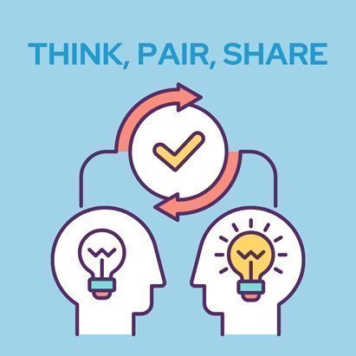
Why do people get into debt ?
Be ready to feedback your ideas

Slide 11
Why do people get into debt ?
Financial risks - causes of debt
Injury or health problems
Unexpected expenses
Family break up
Reduced income
or benefits
Unemployment or
redundancy
Poor budgeting

Slide 12
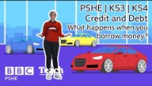
What is Debt and Credit ?
PSHE KS3 | KS4 | Credit and Debt - What happens when you borrow money? | BBC Teach - YouTube

Slide 13
What is Debt and Credit ?
PSHE KS3 | KS4 | Credit and Debt - What happens when you borrow money? | BBC Teach - YouTube
1.What is interest ?
2.What is APR ?

Slide 14
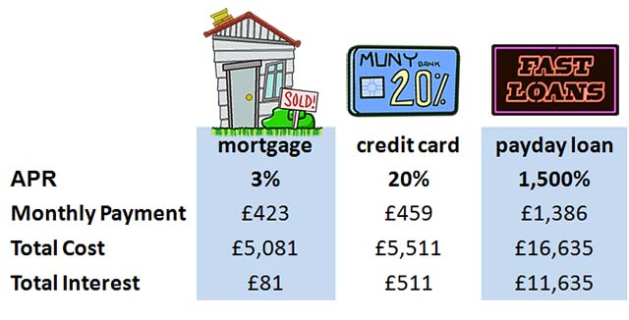
Interest rates
Interest rates can make a big difference to the cost of borrowing…
EXAMPLE 1: COST OF BORROWING £5,000 FOR ONE YEAR

Slide 15
Higher or lower?
How much APR is charged?
Which do you think are the highest to the lowest APR amount ?
Payday Loan | Bank Loan | Mortgage | Credit card | Overdraft

Slide 16
How much APR is charged?
Feedback
Mortgage | Bank Loan | Overdraft | Credit cards | Payday Loan
5.7% | 5.85% | 21.8% | 22.2% | 1250%
Typical % APR - APRs may vary from lender to lender

Slide 17

Why do people borrow money ?
Why do people borrow?
Create a mind map with your ideas
?
?
?
?
?
?
?

Slide 18
Feedback
Bike/Car
Holiday
House
Technology e.g. console
Christmas and Birthdays
Education - University Fees
Food Shopping
Broken Appliance e.g. Washing machine
Fashion e.g. latest trainers
Notes:
Start to think about the reasons why people borrow - are they sensible or not? Do you want to consider life changes here? Going to university, to pay for tutor fees, lost their jobs, change in thier lives etc?

Slide 19



Mainstream Debt – they all need paying back!
Debt
Student loans – used to pay tuition fees and living costs
Mortgages – help you buy a house
Credit Cards – used to pay for things when you don’t have money

Slide 20
Types of borrowing
There are different ways we can borrow. There are very few times you can borrow without having to pay for the service. It is always important to borrow responsibly and think about the extra cost of borrowing. Do you know what these types of borrowing are?
SHORT TERM LOANS
LONG TERM LOANS
OVERDRAFT
CREDIT CARD
CREDIT UNION

Slide 21
Feedback
What they are…
SHORT TERM LOANS
LONG TERM LOANS
OVERDRAFT
CREDIT CARD
CREDIT UNION
An amount lent for a short period of time (under a year) at a high interest rate.
An amount lent for a long period of time (over a year) at a low interest rate.
Spending above what is available in a debit account.
A card which has a limited amount which can be spent and paid back.
Non-profit organisation offering low interest borrowing.

Slide 22
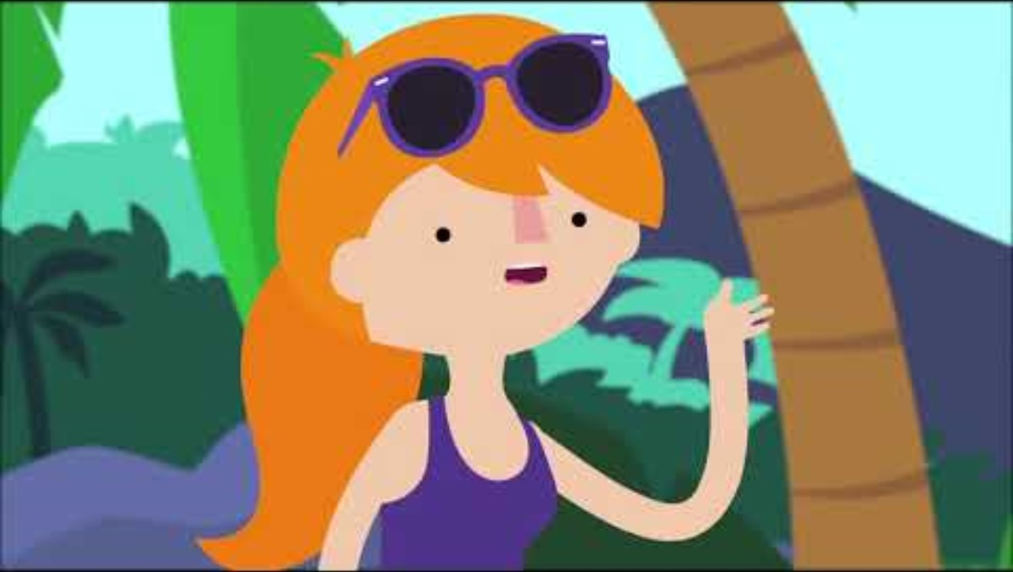
What is a loan ?
Watch the clip on the next slide and write down 3 facts about loans

Slide 23
What is a loan ?

Slide 24


Be aware!
Two types of loans you need to be careful of:
Loan Sharks
All lenders should be registered with the FCA (Financial Conduct Authority), who monitor the way financial companies conduct their business. Loan sharks are not registered and are illegally lending money at high interest rates.
Loan sharks might take illegal actions to reclaim their money.
Payday Loans
These are designed to be short term loans. They are referred to as payday loans as they are designed to help someone get through until payday, when they should then pay it off. They have high interest rates and are easy to access.
Notes:
Can you link this back to financial responsibility?

Slide 25

Payday loans scenario
Class Discussion
Sarah’s boiler has broken and she has no savings. She has a poor credit rating and has very little spare money available at the end of the month. But her boiler needs fixing so she decides to get a payday loan. This is what she borrows:
£1000 over 12 months: £166.00 per month: £992 interest: Total to repay £1,992.00.
What would your concerns be?

Slide 26

Payday loan trap
Class Discussion
If she has a problem repaying a payday loan, the payday lender might tempt her with an extension known as a deferral or rollover, or even a further loan.
However, they’re limited in how many times they can roll over a loan, and must give her an information sheet each time with details of free debt advice providers.
Rolling over her payday loan might seem like a great solution at the time but it can quickly lead to problems because she’ll have to pay back much more in interest and other fees.
This could leave her struggling to pay for the essentials she needs.

Slide 27
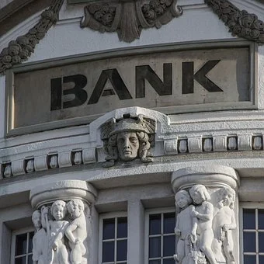
Safe lending online
Consider all alternatives when lending; shop around.
Work out how much you can afford.
Always look at the APR.
Never borrow money on the spur of the moment.
Be careful about borrowing money to pay off existing debt.

Slide 28
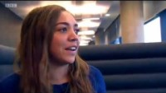
Ext: The dangers of payday loans
Young, British & Broke: The Truth About Payday Loans - Documentary - YouTube

Slide 29

Today's Key Terms
Debt
Loan
Credit
Debit
Interest
APR
Overdraft
Loan sharks
Payday loans
End of the lesson
Can you explain these words ?
Fill in your booklet
Is there anything you
are not sure about ?

Slide 30








Where to go for help

