Slide 1




Year 8 Personal Development
Values, Rights and Responsibilities
Respect, Tolerance and Inclusion
British Values:
Mutual Respect and Tolerance

Slide 2
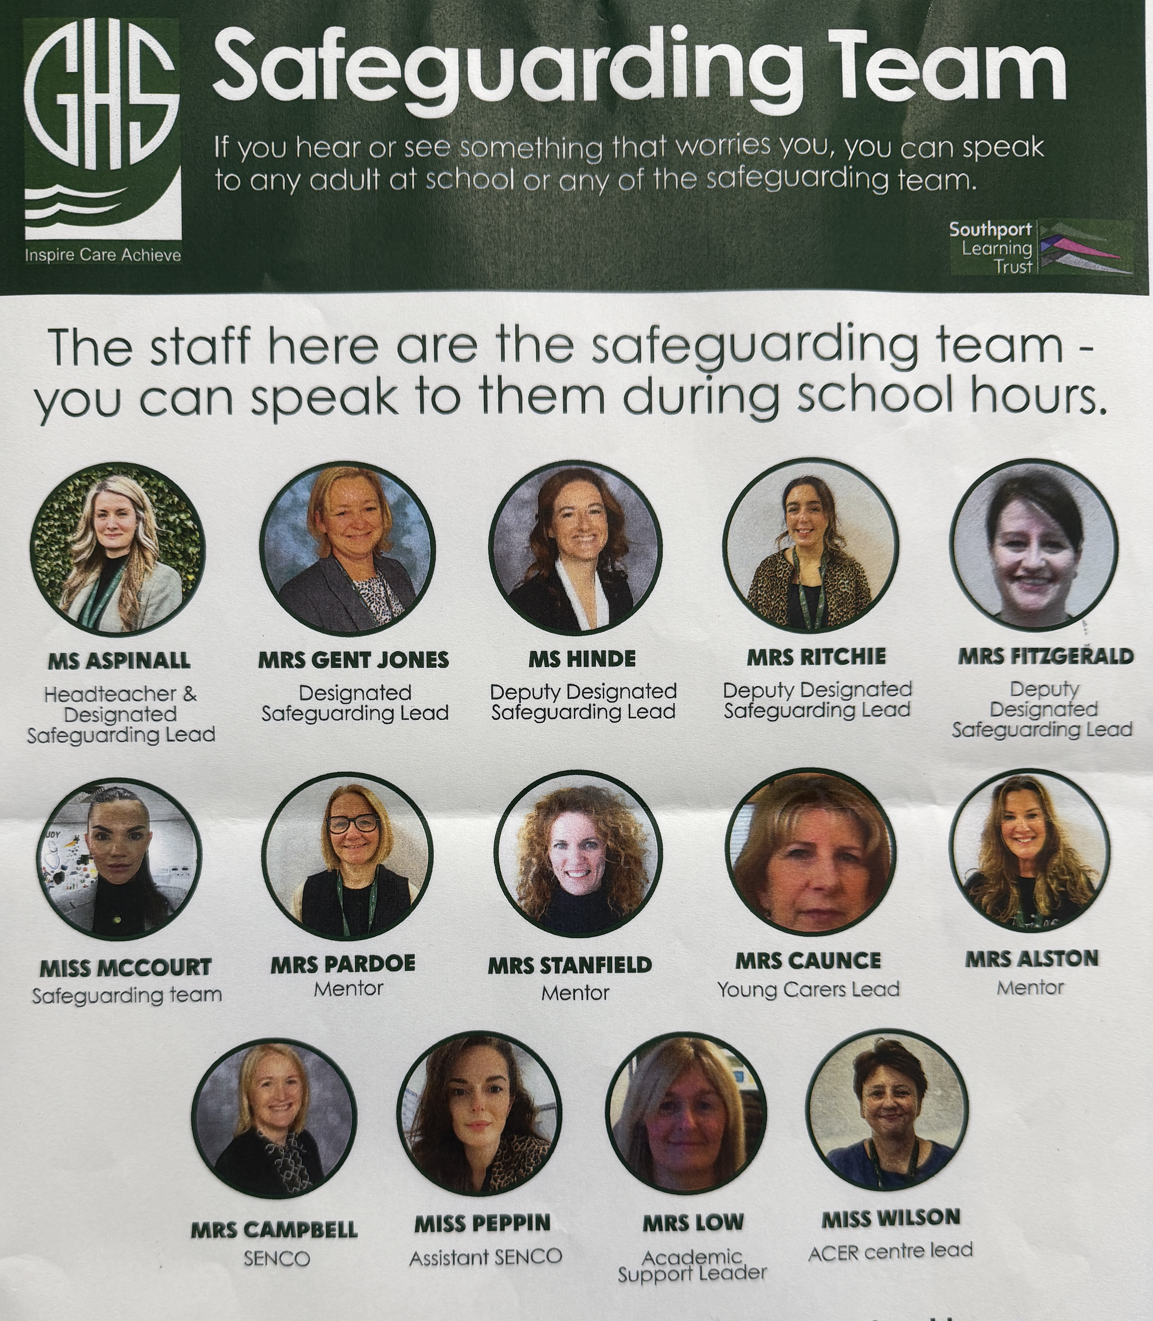
The Greenbank safeguarding team are here to help you if you are worried about anyone in school or are concerned about any of the issues raised in class.

Slide 3



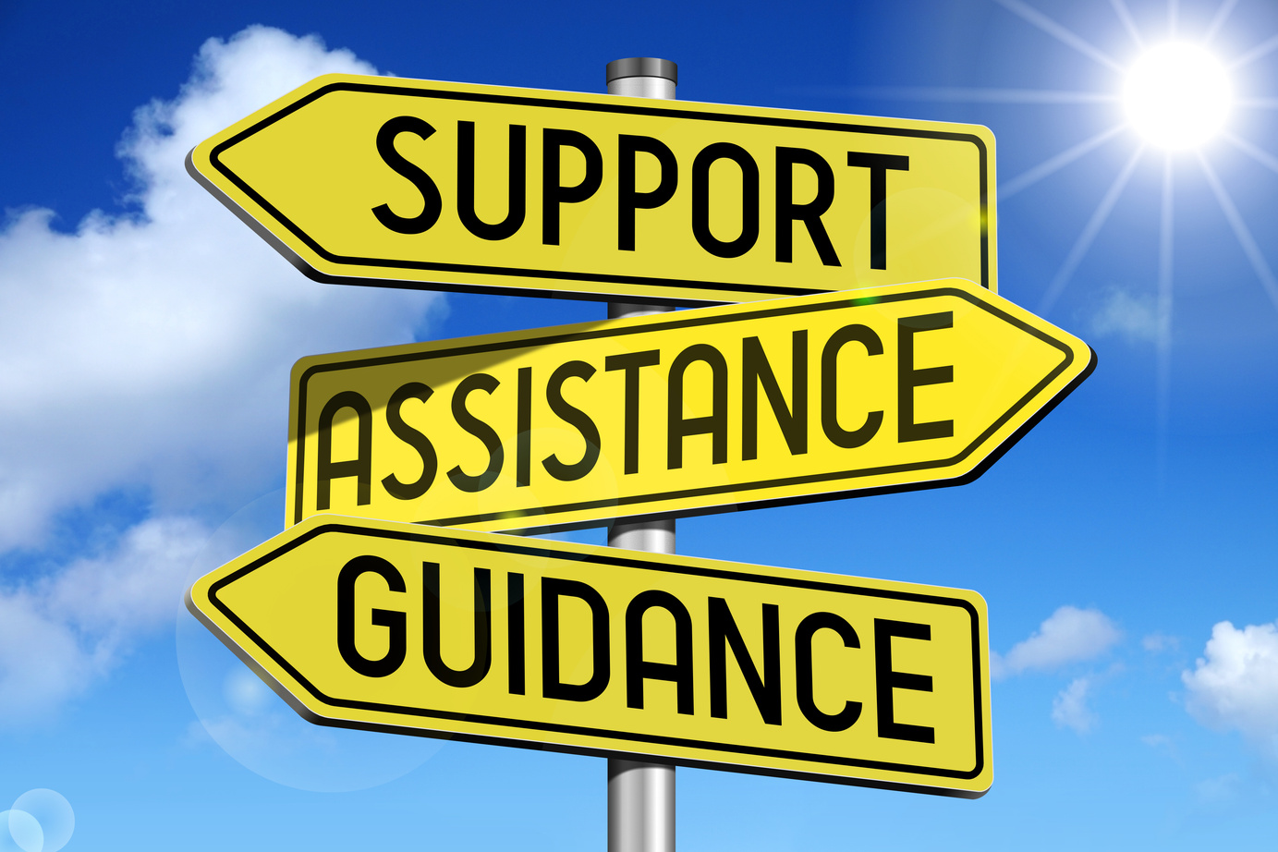

Classroom Rights and Responsibilities
Only join in discussions if you feel comfortable
Rights: Principles that everyone is entitled to
Responsibilities: Actions that you are expected to carry out
Be listened to and listen to others
Be respected and not judged
Have my discussions kept confidential unless there is cause for concern
Use the correct vocabulary
Ask for help, support and advice

Slide 4

Title: Respect, Tolerance and Inclusion
Do now: Whiteboards
What is a stereotype
What is meant by prejudice ?.

Slide 5
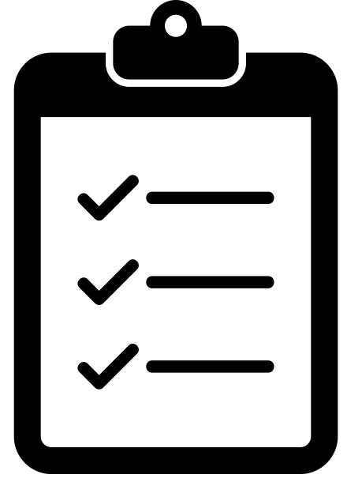
What are we learning today?
Lesson Objective: Today we are learning about British values, focusing on respect and tolerance.
Learning Outcomes:
To know what the 9 Protected Characteristics are
To understand why British values are important.
To explore what it means to be respectful and tolerant.

Slide 6

Today's Key Terms
Start of the lesson
Can you explain these words ?
Respect
Tolerance
Inclusion
Protected characteristics
British values

Slide 7
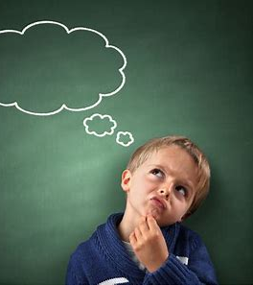
Watch the clip on the next slide and write down 3 word to describe how it makes you feel
Be ready to discuss your thoughts

Slide 8
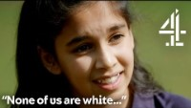
Heartbreaking Moment When Kids Learn About White Privilege | The School That Tried to End Racism - YouTube

Slide 9

Whiteboards
What do we mean when we say 'show some respect' ?

Slide 10

What is respect ?
Showing respect means treating others with consideration, acknowledging their value and importance as individuals.
Copy this definition into your booklets

Slide 11
Respect
“We should respect everyone.”
True
False
In society, everyone is worthy of respect and everyone is different in some way, therefore people need to understand and celebrate diversity.

Slide 12

What are British Values?
Why do you think it is important to teach British Values ?
Can you think of any examples where these values have been covered in lessons ?

Slide 13

What are British Values?

Slide 14
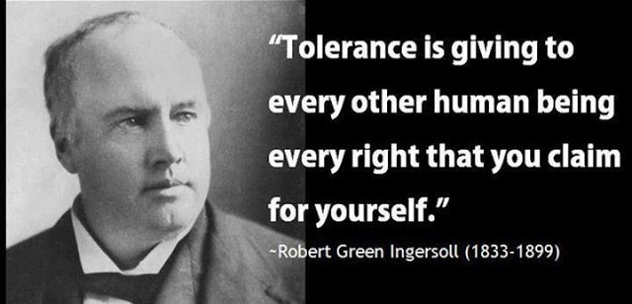
Tolerance
Tolerance: willingness to accept behaviour and beliefs that are different from your own, although you might not approve or agree with them.

Slide 15

Tolerance
Task: Respect and tolerance are linked. Explain how they are linked in your booklets.
Respect means having due regard for the feelings, wishes, or rights of others.
Tolerance: willingness to accept behaviour and beliefs that are different from your own, although you might not approve or agree with them.

Slide 16
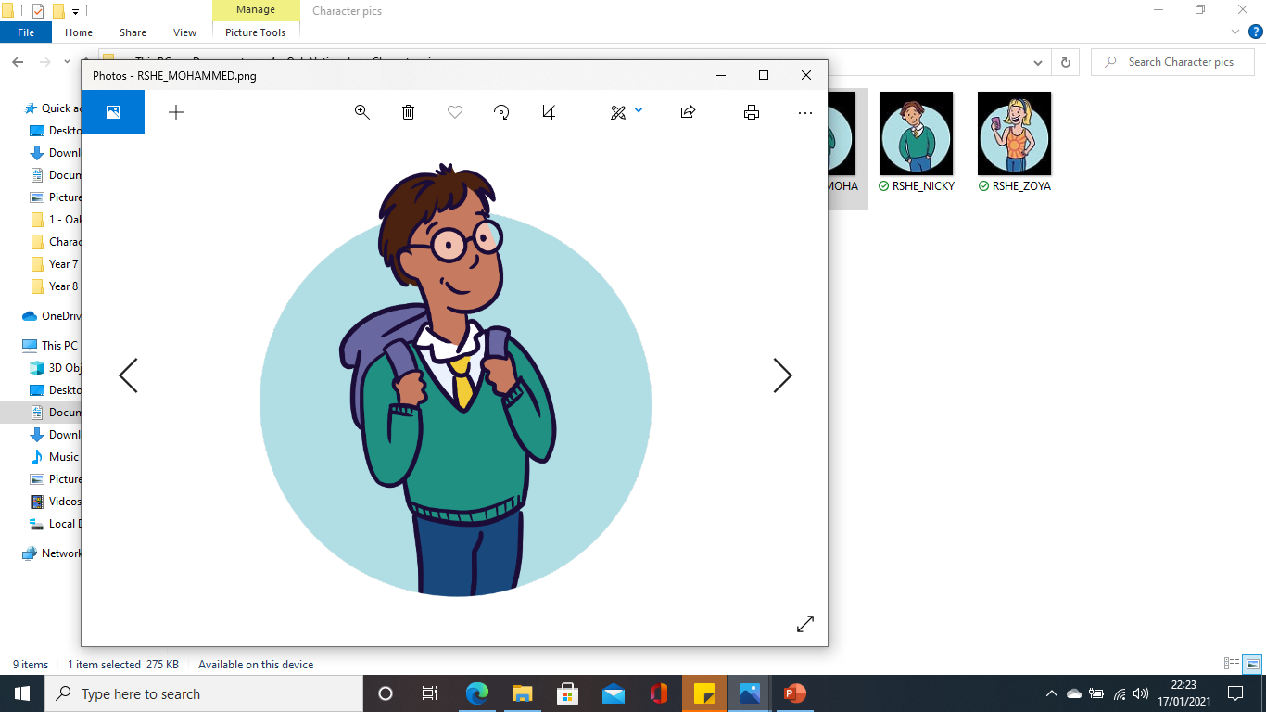
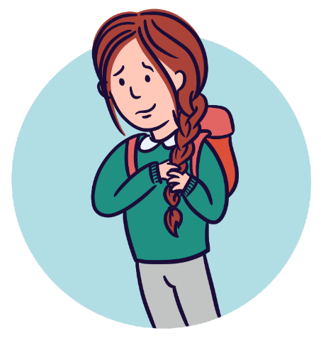
Tolerance: Read all about it!
Mohammed sits next to Chelsea in most lessons.
Chelsea is a Liverpool fan. Mohammed is a Manchester United fan.
Chelsea likes to go to church on a Sunday. Mohammed goes to mosque most days.
Chelsea does her homework after dinner. Mohammed does his in school before going home.

Slide 17

Tolerance: Read all about it!
Mohammed and Chelsea don’t fall out over their different opinions or lifestyles.
Chelsea asks Mohammed about what happens at the mosque. Mohammed asks about the church.
They both joke with each other about who is the best football team.

Slide 18
Tolerance: Read all about it!
Chelsea doesn’t understand why Mohammed spends his lunches doing his homework.
Instead of calling him names about it, she politely asks him why he does it then.
Mohammed explains that he goes to mosque straight from school for a couple of hours so he needs to do it in school.

Slide 19
Tolerance: Read all about it!
Chelsea begins to understand why Mohammed does his homework then.
She realises that she would like more time in the evenings too so asks Mohammed if she could join him at lunches to do homework too.
Discussion task: In what ways to these pupils show tolerance to each other?

Slide 20
What is Inclusion ?
Social inclusion is the act of making all groups of people within society feel valued and important.
Discussion: what do you think is meant by 'Protected Characteristics'
Notes:
Show PowerPoint Slide 13 and go through the points to conclude the activity.

Slide 21
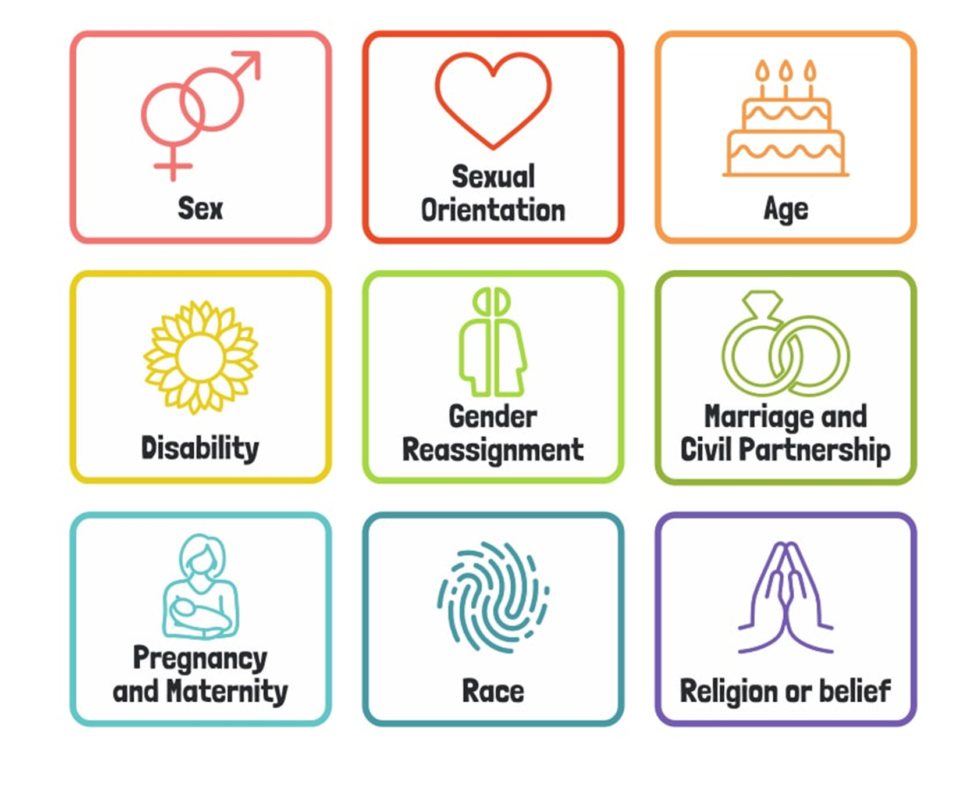
Protected Characteristics
Protected characteristics are specific attributes or traits that are legally safeguarded against discrimination and harassment under the Equality Act 2010.
In other words, you cannot be discriminated against for any of the 9 characteristics

Slide 22
Protected Characteristics
Do you think there should be any others included ?

Slide 23

Protected Characteristics

Slide 24
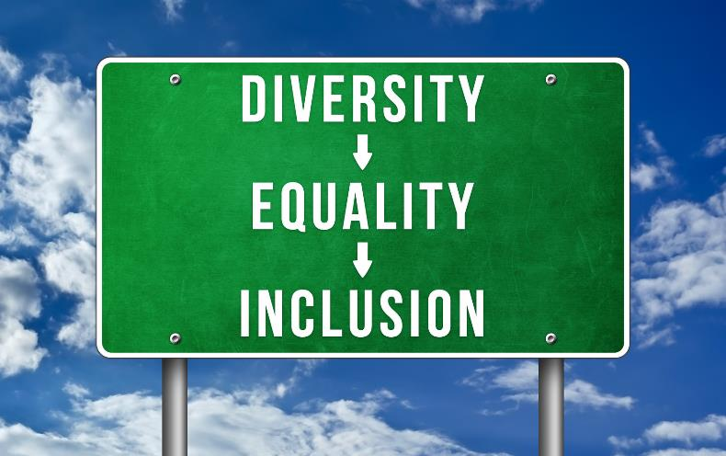
Respect, Inclusion and Tolerance
Read the short scenarios on the next slides and discuss in your groups some simple things you could do to make that person feel more valued and important in your local community.
Notes:
TAKE 20 ACTIVITY 1
This activity and Take 20 Activity 2 can run together if you have time available. They offer students the opportunity to make practical suggestions about promoting inclusion. This activity uses three short scenarios to look at three marginalised groups in a distanced way to promote a safe environment for discussing the issues these individuals can experience. Show PowerPoint Slide 9 which gives the task instructions. Move through the scenarios on PowerPoint Slides 10-12 and give time for discussion and feedback after each. Use the notes below each slide during the feedback and conclude with PowerPoint Slide 13.

Slide 25
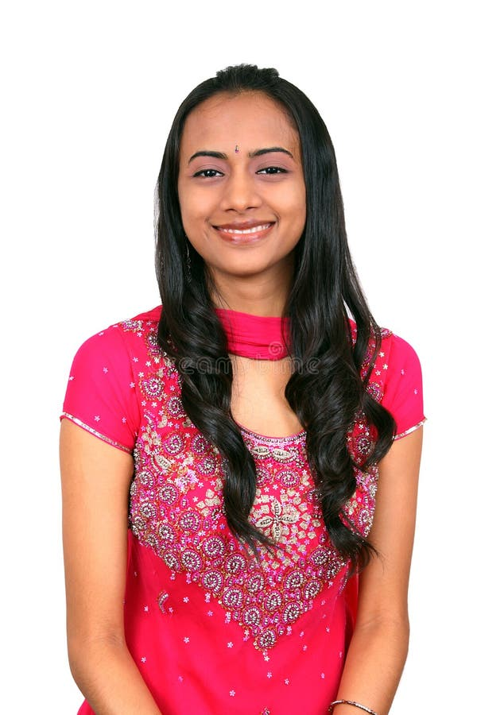
Respect, Inclusion and Tolerance
Sandeep was born in the UK but her family are originally from the north of India. She loves Indian traditional clothing and would wear it more often but is worried that she would be treated differently if she dressed differently from her friends. Her grandmother usually wears traditional clothing and sometimes people stare or make rude comments to her.
Notes:
Young British people with a different family heritage often report feeling trapped between two cultures and this can result in feelings of anxiety, guilt and confusion. Peer pressure to conform is strong and family pressure to uphold cultural values is often present. Sandeep’s friends and peers could be inclusive by finding out more about her family heritage, asking questions and listening, but not judging. They should treat her exactly the same way whatever she is wearing. This should also be the case with anyone – clothing and appearance should not be used to stereotype and lead to any type of prejudiced or biased behaviour.

Slide 26
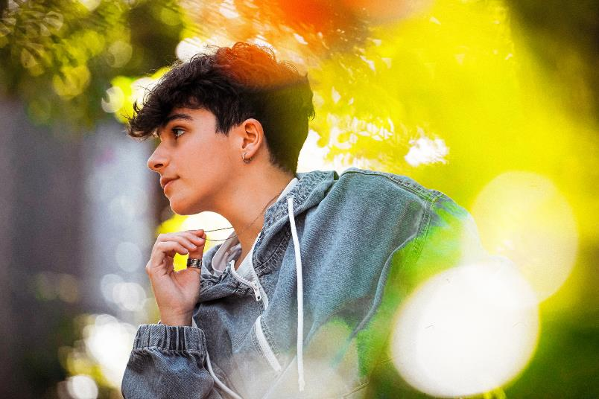
Respect, Inclusion and Tolerance
Joel's little sister has cerebral palsy and although she is quite independent and goes to the same school, Joel feels responsible for her. He always makes sure she gets on and off the bus safely and goes home with her as her balance and coordination isn't good and she sometimes falls over. Joel would like to join some after school clubs or spend time with friends but doesn't want to abandon his sister.
Notes:
This scenario considers two potentially marginalised groups – Joel who is a young carer and his sister who has a disability. Young carers can easily become isolated as a result of their caring role for a sibling or adult family member. Being a good, supportive and inclusive friend is important to these children and young people. Disabled people also need to be valued and included but usually want to be treated in the same way as their peers (although everyone’s needs will be unique). Sometimes a disabled sibling and their carer come as ‘a package’ and being welcoming and inclusive to a young person that wouldn’t necessarily be part of the peer group e.g. because they are younger can be a great way to build a supportive community and gain greater understanding of each other.

Slide 27
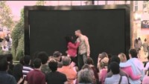
Respect, Inclusion and Tolerance
Love Has No Labels | Diversity & Inclusion | Ad Council - YouTube

Slide 28
Ext: Inclusivity in school
What could be done to make Greenbank more inclusive ?
Discuss in small groups and be ready to feed back
Notes:
After a few minutes, take some feedback. You can direct the discussion in a way that is most appropriate for your setting and also question whether students think social inclusion is likely to vary from one setting to the next. E.g. a small village compared to a large city suburb; an area with lots of mixed ages and cultures compared to an established homogenous area (e.g. almost all white).

Slide 29

Today's Key Terms
End of the lesson
Can you explain these words ?
Fill in your booklet
Is there anything you
are not sure about ?
Respect
Tolerance
Inclusion
Protected characteristics
British values

Slide 30









Where to go for help

