Slide 1



Year 7 Personal Development
Keeping Safe and managing risk
Online life and media
Online Groomingg
Grooming
British Values:
Rule of Law

Slide 2
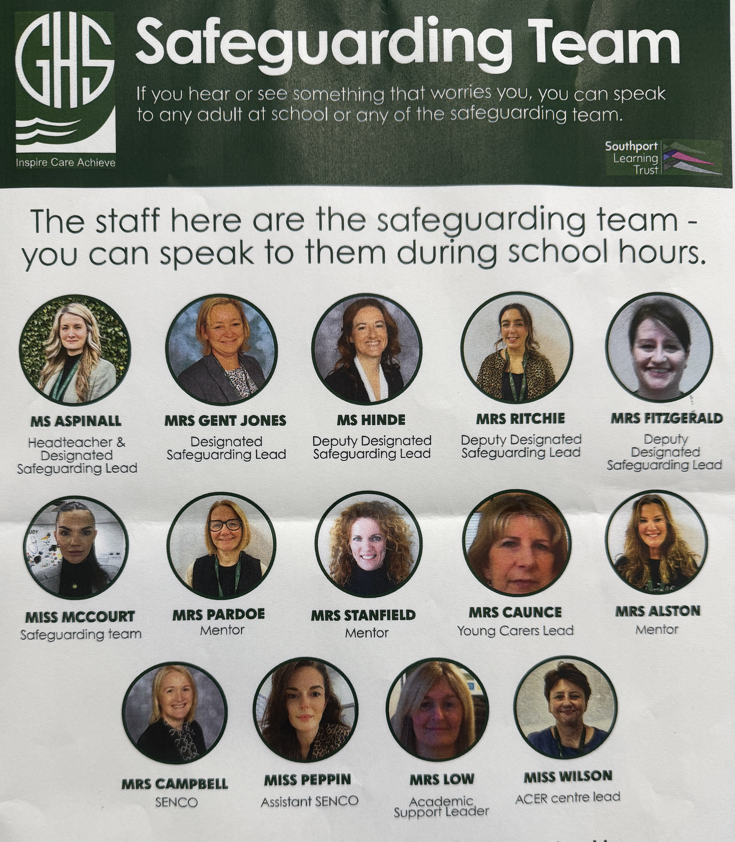
The Greenbank safeguarding team are here to help you if you are worried about anyone in school or are concerned about any of the issues raised in class.

Slide 3





Classroom Rights and Responsibilities
Only join in discussions if you feel comfortable
Rights: Principles that everyone is entitled to
Responsibilities: Actions that you are expected to carry out
Be listened to and listen to others
Be respected and not judged
Have my discussions kept confidential unless there is cause for concern
Use the correct vocabulary
Ask for help, support and advice

Slide 4

Today's Key Terms
Start of the lesson
Can you explain these words ?
Grooming
Catfishing
Consent

Slide 5

What are we learning today?
Lesson Objective: Today we are learning how to ensure the information we read online is true.
Learning Outcomes:
To understand what is meant by the term ‘grooming’.
To investigate the signs of fake profiles.
To identify ways to protect others from grooming and catfishing.

Slide 6

Title: How do we check online information?
Do now: Whiteboards
Why is social media sometimes likened to a ‘drug’?
How may following an influencer impact our mental health?

Slide 7
Why is social media sometimes likened to a ‘drug’?
It is addictive and can take over your whole life, the way you live, you may start to feel you cannot live without it.
How may following an influencer impact our mental health?
You may become addicted to following them, comparing your life to theirs, trying to live up to their expectations (reality), feelings of jealousy.

Slide 8

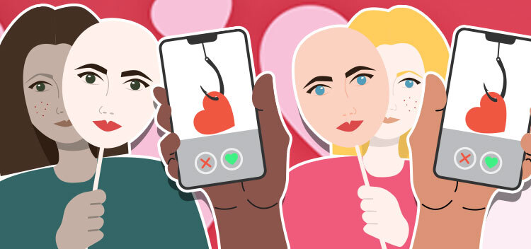
Think, pair, share
What do we mean by 'catfishing' ?

Slide 9
Fake profiles
Many websites and Apps have many fake profiles also known as Catfish Accounts:
“Not everyone online is who they say they are”
3% of Facebook Profiles, 15% of Twitter Profiles and 8% of Instagram profiles are fake. Estimated 142,000,000 fake accounts on the internet

Slide 10
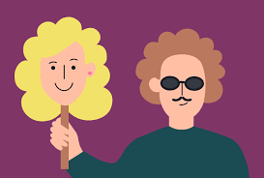
Whiteboards
Task: Why would someone choose to make a fake profile? Make a list of reasons

Slide 11
Fake profiles
Teacher feedback
  To trick or deceive someone
  Adults pose as child to get close to them
  Form of Revenge
  Blackmail them
  Bully them
  Exploit them for money

Slide 12
Catfishing
Watch this video and answer the questions below in your books:
What happens when someone steals your identity?
Should catfishing be made a crime?
There is no specific law making Catfishing illegal. However, they are laws around fraud or deception which can be applied to catfishers in certain situations

Slide 13

If a young person is being 'groomed'
what does that mean?
Clue: It's not the type of grooming like getting your hair cut or nails done.
Notes:
Note: It's important you use this activity as the introduction for the lesson.
Students may feel anxious or embarrassed to talk about grooming in the first instance as some may know that it can have a sexual element. Ask the students to work independently and explain they won't be asked to share their thoughts with other students unless they feel comfortable doing so. Show PowerPoint Slide 2 and then ask the students to write a response on mini-whiteboards or pieces of paper. Reassure them if they don't know what grooming is, it's OK to write this down.
Give 2- 3 minutes then ask the class to show you their ideas. You may want the class to hold up their ideas for you to see if they are all facing the front, or they can leave their ideas on their desks and you can move around the classroom. This will give you a good idea about the current level of knowledge of the class. Reveal the definition on PowerPoint Slide 3 and clarify the meaning with the pupils so they all have a clear understanding about what grooming is. If you feel confident doing so you could then ask the students to write down any questions they have about grooming to make sure they're addressed during the lesson activities.

Slide 14
Key Terms
Grooming is when someone builds a relationship with a young person and tricks them or pressures them into doing something abusive, criminal or both.
Grooming is still rare, but it does happen to some young people.
Watch the video on the next slide and discuss how 'Lost Princess' was groomed

Slide 15

Grooming
CBBC Newsround - Caught in the Web - YouTube

Slide 16
Grooming
21% of girls aged 11 to 18 said they had received a request for an inappropriate image or message – Source NSPCC
24% of young people have experienced an adult that they don't know trying to contact them - Source NSPCC

Slide 17

Consent
You don't have to do anything that you don't want to do.
If you're being pressured to do something you're not comfortable with, that's called coercion, even if it’s someone you trust.
Consent can change – people change their minds and this is ok.

Slide 18
Grooming
Watch this video and answer the questions below in your books:
Who is Andy and how did he know Sarah?
How did Andy gain the trust of Sarah?
Why does Andy want photos of Sarah?
What should Sarah have done in this situation?
What help is available to Sarah?
Notes:
https://www.youtube-nocookie.com/embed/v1QwOJN4Ff0?autoplay=1&iv_load_policy=3&loop=1&modestbranding=1&playlist=v1QwOJN4Ff0

Slide 19
What are the signs?
Do you know any of their friends?
Do they seem to good to be true?
Are their posts and stories really elaborate?
Are they asking for personal information?
Do they have any tagged profiles?
Is there face hidden in most pictures?
Fake accounts
Is it hard to work out who people are in the photos you see?
Does something seem not right or just a bit strange?
Do they have pictures with other people?
Catfishers and groomers will go the extra mile to and cover their tracks make their victims truly believe exactly who they say they are

Slide 20
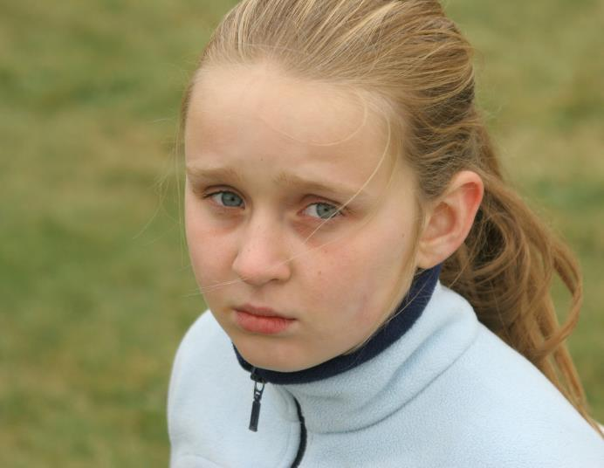
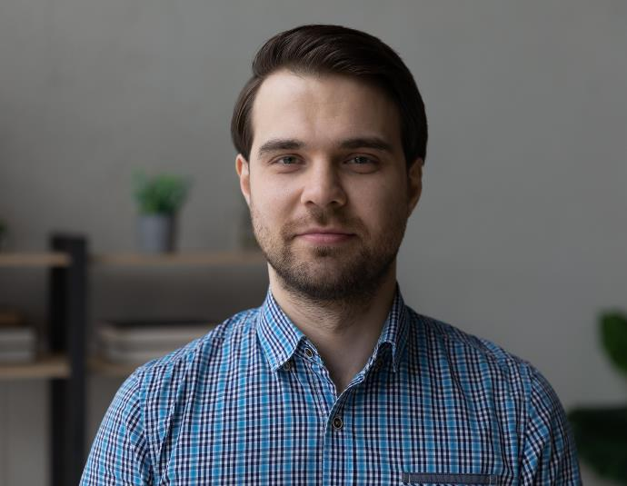
Mum' s best friend Dan has always told Callie that she's his favourite girl. Just lately he's been buying her lots of expensive presents and giving her cash. Sometimes he babysits when Mum has gone out to work. He's been saying things like Callie is his special girl and it makes her feel creeped out. Once he tried to kiss her on the lips. When she told him to stop he said he would tell Mum that it was all her fault.
Grooming/ Ages 11-12 years/Slide 15
Notes:
Callie: This is grooming and potentially the first stages of sexual abuse. It's important to inform students that some abusers are known to the young person, and this can make it more challenging to tell someone. Dan is using compliments and presents to groom Callie. He's also using threatening and coercive behaviour by twisting the situation so Callie feels guilty when she hasn't done anything wrong. Even though it's difficult, Callie should tell someone or speak with a Childline counsellor. She should trust her instincts as the relationship with her mum's friend doesn't feel right.

Slide 21
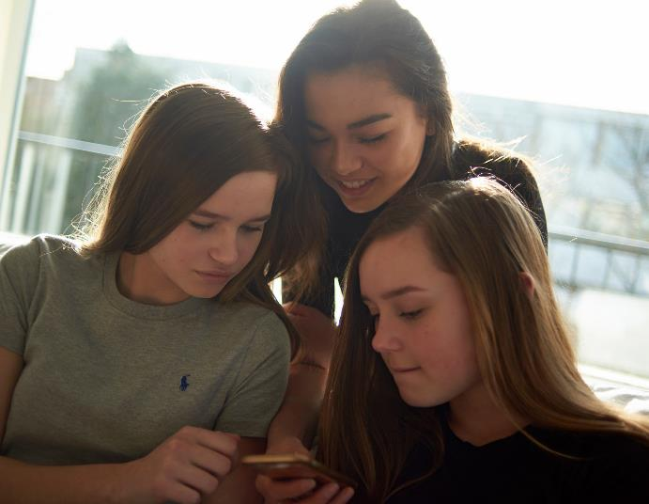

Clarissa and her two friends have found a new online chatroom where there are lots of fit boys to talk to. One boy in particular has told them they are sexy and the conversations have been getting pretty flirty. Clarissa has been chatting to him on her own and thinks she might be in love with him. He says she's beautiful, looks way older than 12, and he'd like to meet up. He's suggested that she doesn't tell the others or they might get jealous.
Grooming/ Ages 11-12 years/Slide 17
Notes:
Clarissa: It's difficult to tell if the person she is talking to is genuine or not. Online groomers tell lies and often have false profiles so it's important to be really careful and not trust people online if someone can't be sure who they are. Sometimes the person might pretend to be like the young person and have the same interests or problems as them. They could just be doing this to build trust. If Clarissa wants to check this person out she could ask for a videocall and it would be inadvisable to meet in real life until she knows the person is genuine and can be trusted. Even then it would not be sensible to go alone. Is she being manipulated by being asked not to tell the others?

Slide 22

Final Thoughts
Why is it important not to accept random friend requests?
When have you ever come across a fake profile? How could you tell?
What are the dangers of fake profiles?

Slide 23

Today's Key Terms
End of the lesson
Can you explain these words ?
Fill in your booklet
Is there anything you
are not sure about ?
Grooming
Catfishing
Consent

Slide 24
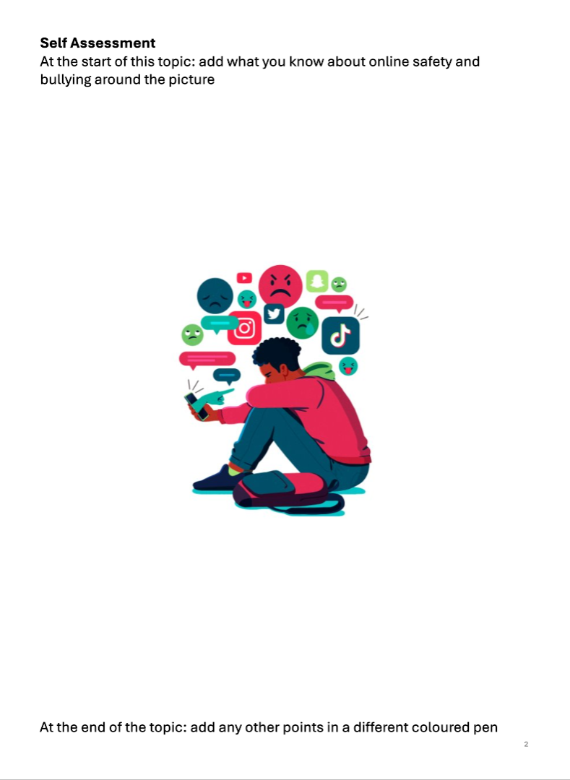
Self Assessment
Add any extra information to the self assessment sheet in your booklets in a different colour

Slide 25









Where to go for help

