Slide 1
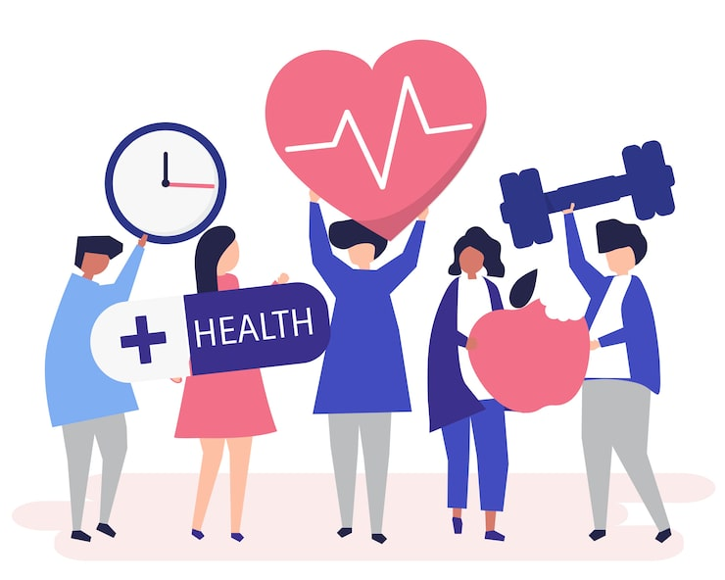

YEAR 11
PERSONAL DEVELOPMENT
3. KEEPING HEALTHY
NAME:
CLASS:
TEACHER:

Slide 2


PD PUPIL SELF ASSESSMENT YEAR 11 KEEPING HEALTHY
I CAN DO/UNDERSTAND THE FOLLOWING : | START | END
I understand the different healthcare providers available to me and when to use them
2. I know how to register with a healthcare professional
3. I know when it's appropriate to use a pharmacy
4. I understand what is meant by Gillick competence
5. I know what triggers stress in me and how to cope with it
6. I understand why prescription drugs can be dangerous
7. I understand what is meant by spiking and how to keep myself safe
8. I know the difference between cosmetic and aesthetic procedures, and the risks involved
9. I know where to go for help if affected by anything in this topic
Use the faces below to assess what you know now, and again at the end of this unit.
– you understand all about this or agree with this statement
– you know something about this or are not sure about it
– you do not understand this or do not agree
Notes:
2

Slide 3
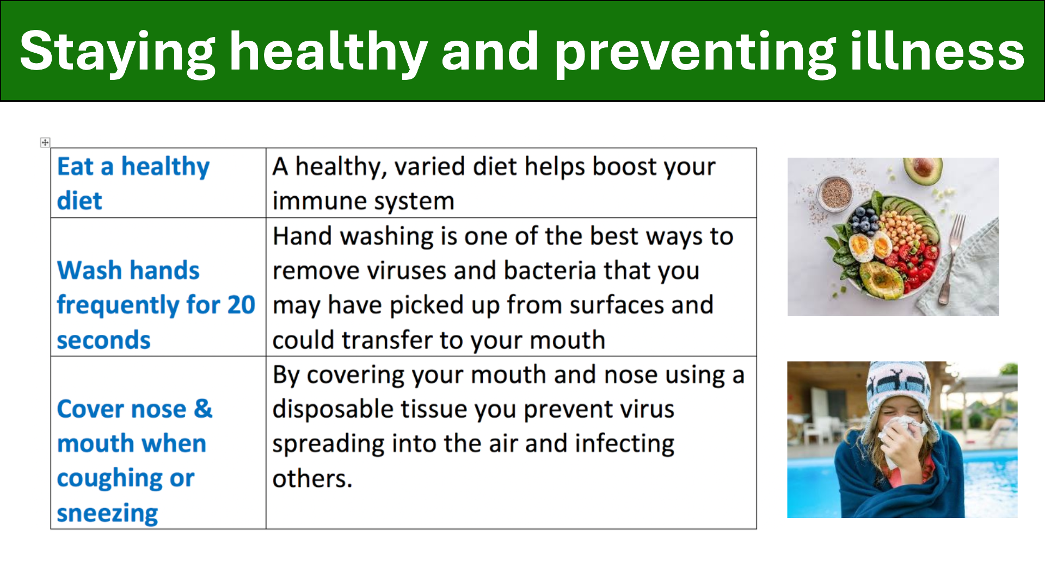
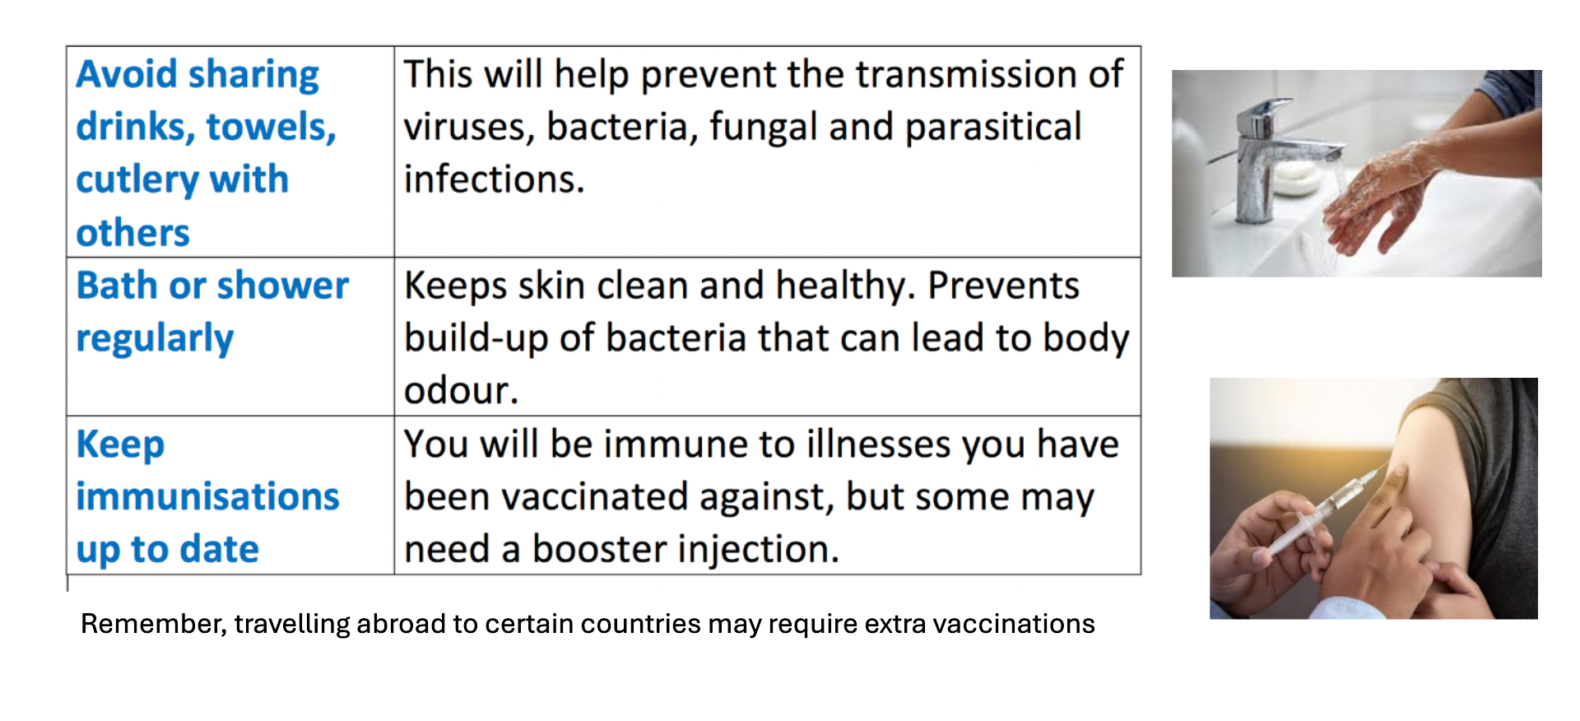
Staying Healthy
Why exercise ?
________________________________________________________________________________________________________________________________________________________________________________________________________________________________________________________________________________________________________________________________________________________________________________________________________________________________________________________________________________________________________________________________________________________________________________________

Slide 4
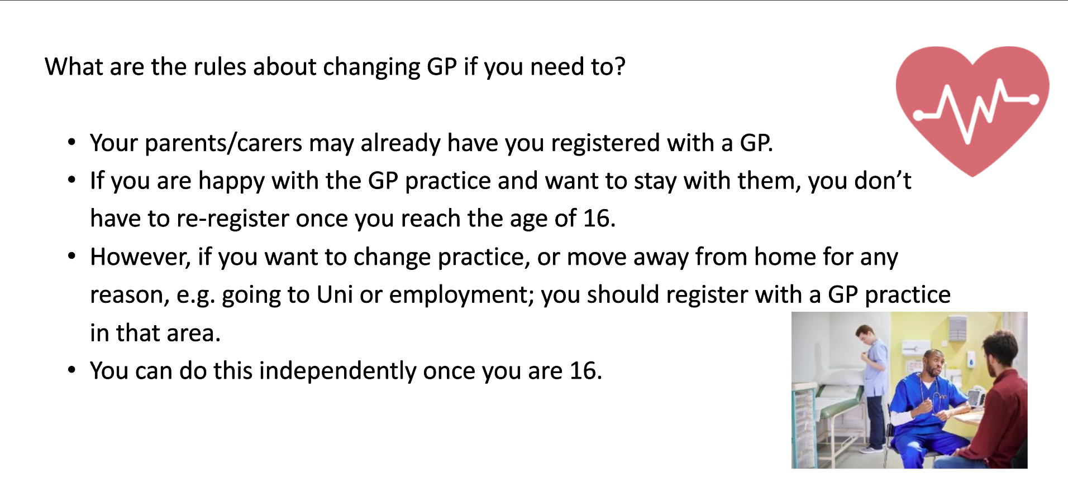
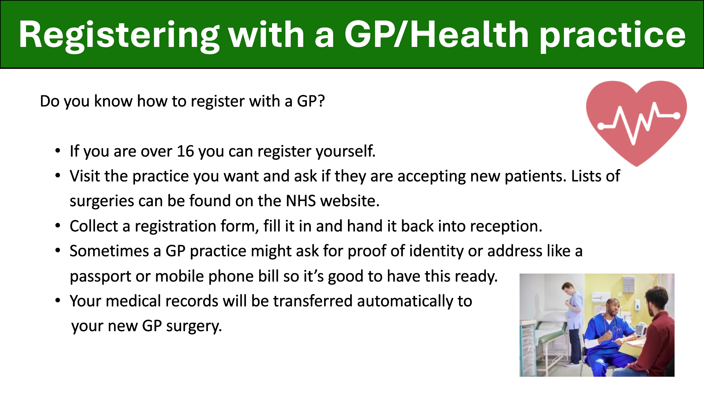
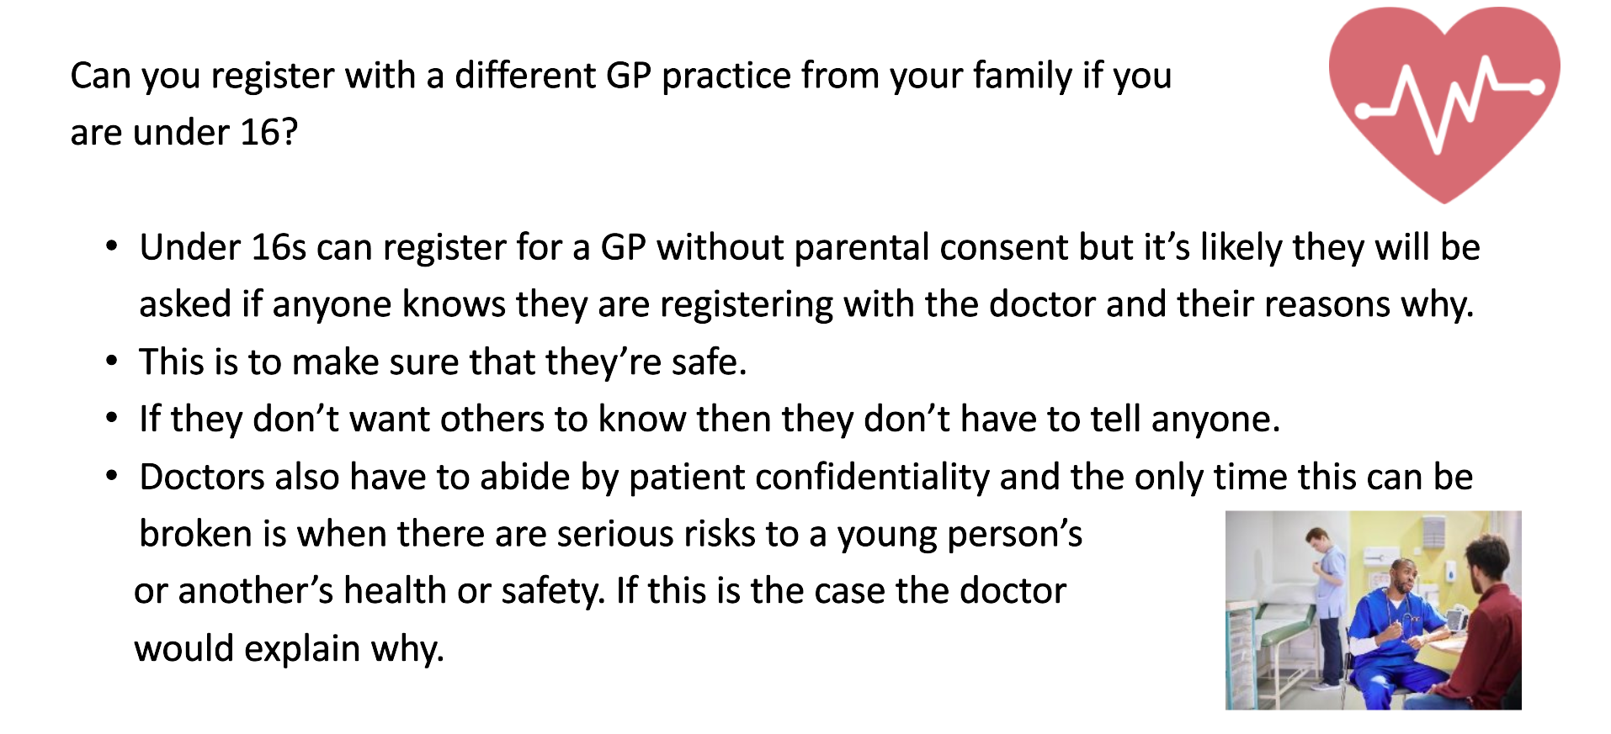
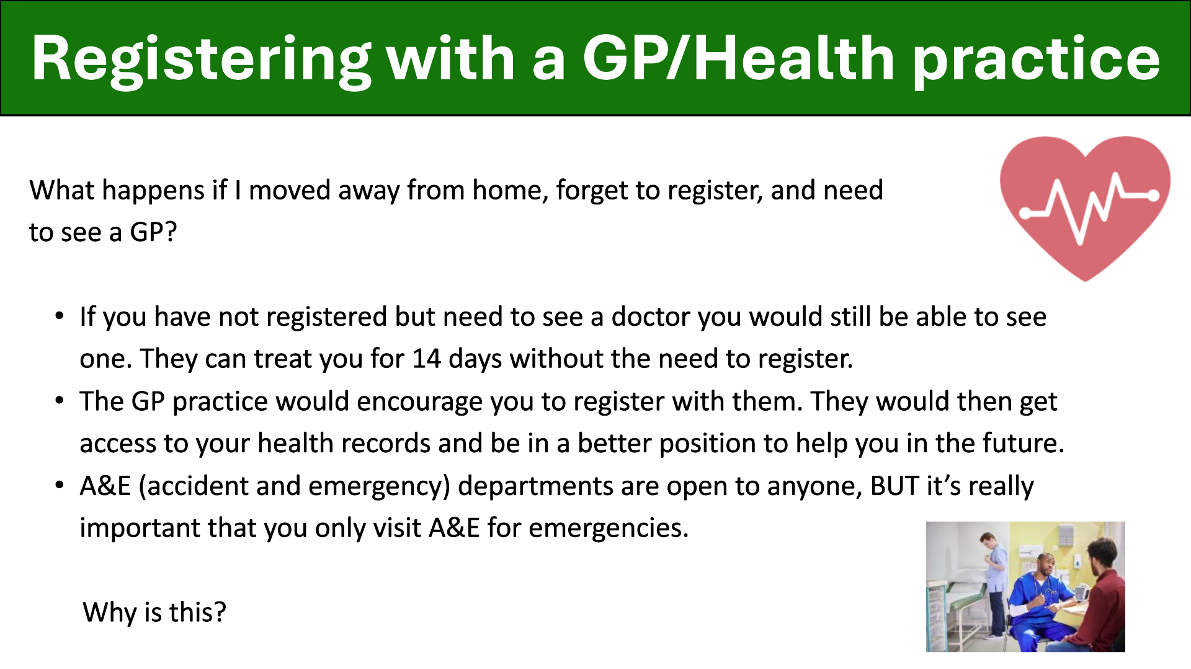
How to register with a GP / health practice
Notes

Slide 5
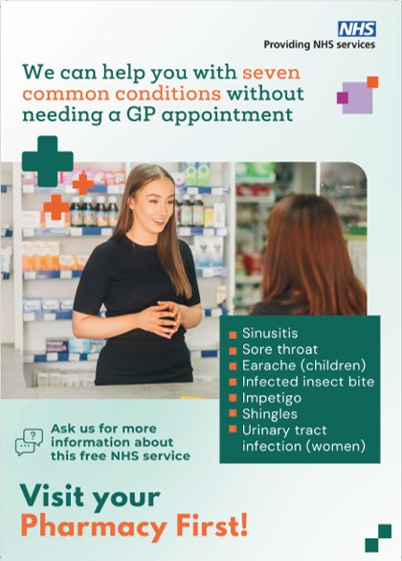


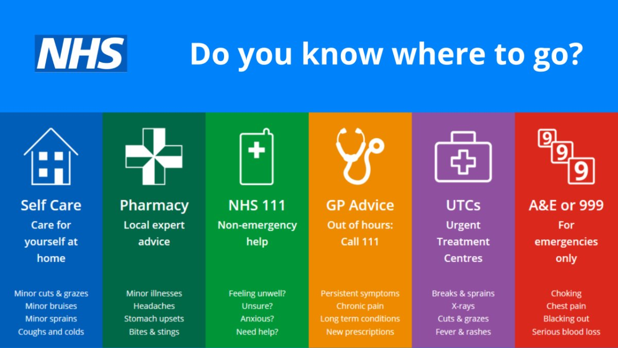
When to use your local pharmacy
Local pharmacies offer a range of services, meaning you do not have to wait for a GP appointment:​
They can dispense medication and provide advice ​
They can offer help and treatment on many common conditions and refer you to a specialist if needed​
24 hour services​
Online ordering of prescriptions, some also deliver ​
Emergency contraception​
Vaccinations, blood pressure checks and health screening.
​
Do not use google, AI or social media to diagnose yourself !​

Slide 6
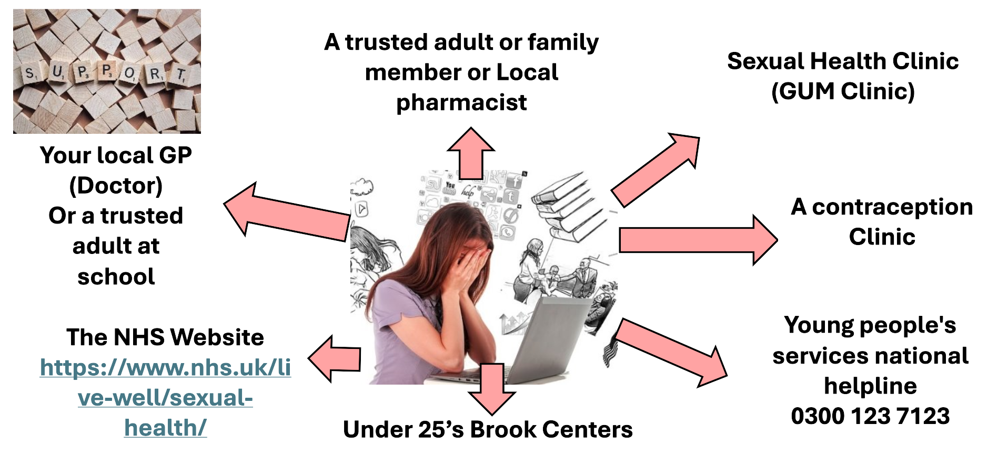
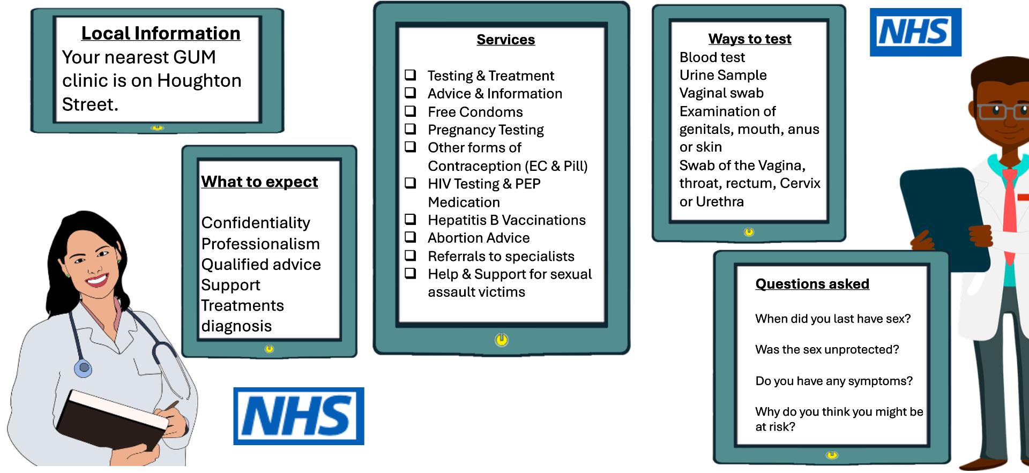
Sexual health: advice and help
What is Gillick competence ?
________________________________________________________________________________________________________________________________________________________________________________________________________________________________________________________________________________________________________________________________________________________________________________________________________________________________________________________________________________________________________________________________________________________________________________________

Slide 7
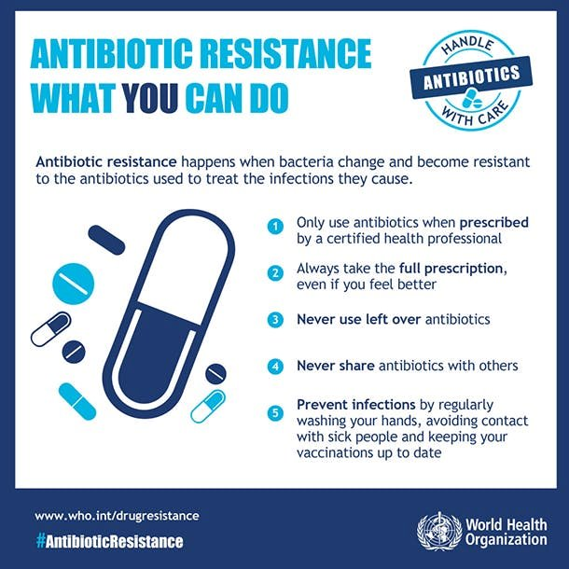
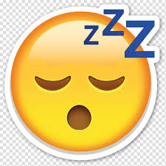
Antimicrobial resistance (AMR) is a natural phenomenon that occurs when microorganisms like bacteria and viruses, evolve to survive the medicines designed to kill them. When these "germs" become resistant, the drugs—collectively called antimicrobials—become ineffective, making infections harder to treat and increasing the risk of disease spread, severe illness, and death.​ ​Overuse of antibiotics is one cause, with some bacteria becoming known as 'superbugs'.​ ​Medical Procedures: Modern medicine relies on effective antimicrobials for surgeries (like caesarean sections and hip replacements), organ transplants, and cancer chemotherapy. Without them, these routine procedures become much more dangerous.​
​
​
​
Video notes
Tips for getting enough sleep

Slide 8

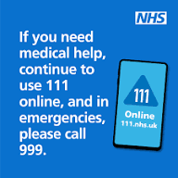
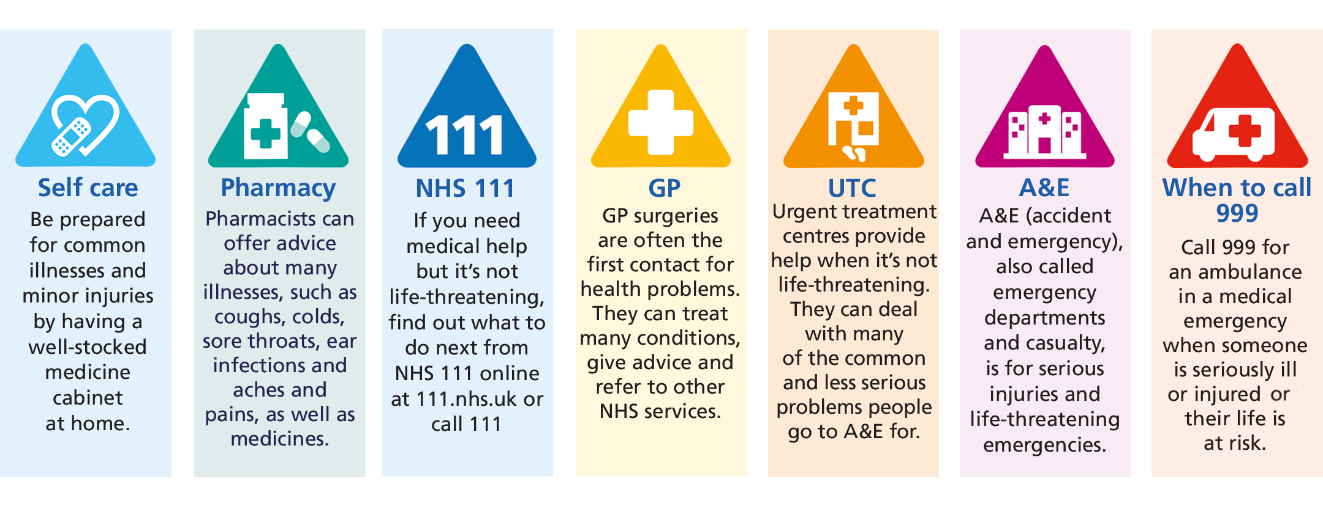
Keeping healthy summary
Get enough sleep​
Exercise regularly​
Eat healthily​
Practice good hygiene​
Attend health checks ​
Ensure you are registered with a GP​
Use pharmacies for minor issues​
Only call 999 and use A&E in emergencies​
Call 111 for non-emergency help
Ensure you always order repeat medication on time​
Use reliable contraception​
Use sexual health clinics when needed
Keep vaccinations up to date and always check before travelling abroad
Attend screening such as cervical smears and mammograms when asked
Always finish a course of antibiotics
NEVER be embarrassed about asking for help or attending appointments
NEVER use google, AI or social media to diagnose yourself

Slide 9
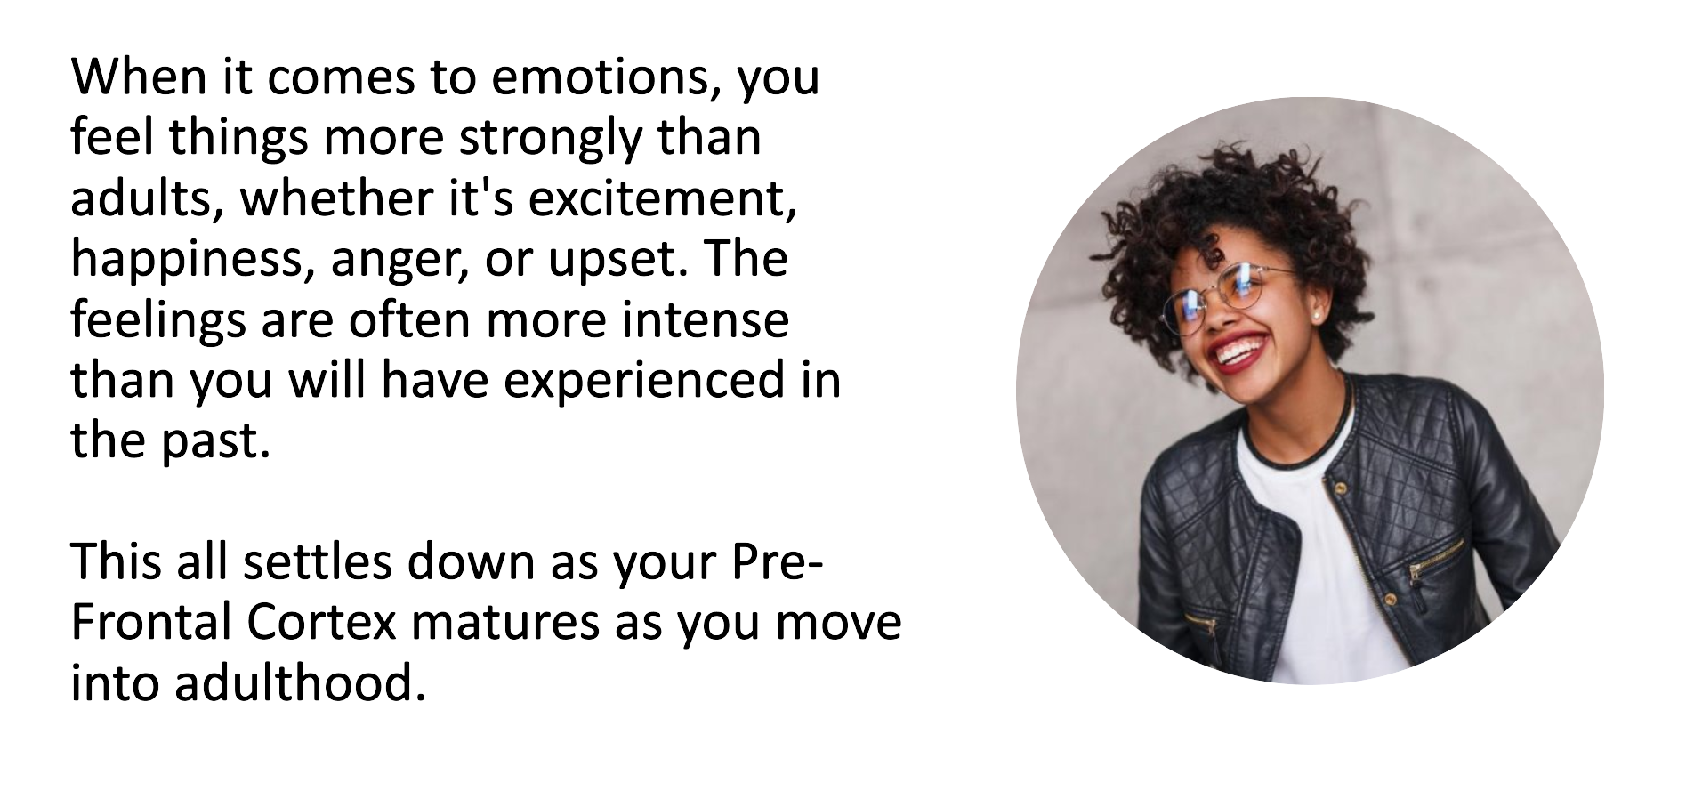
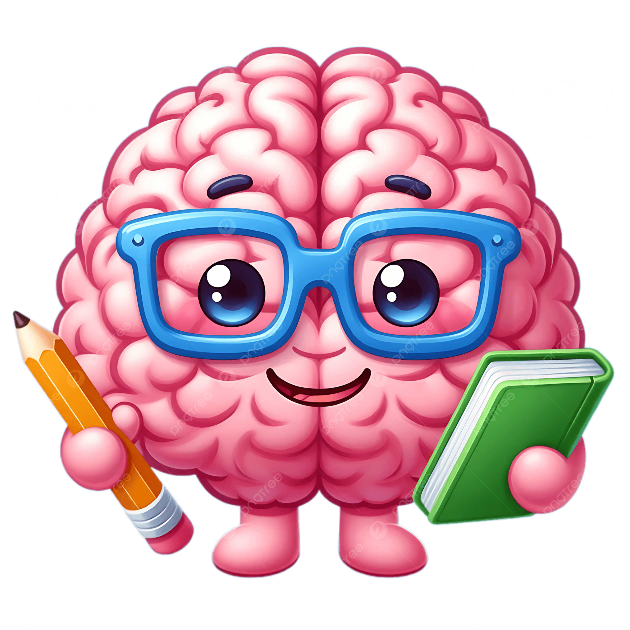
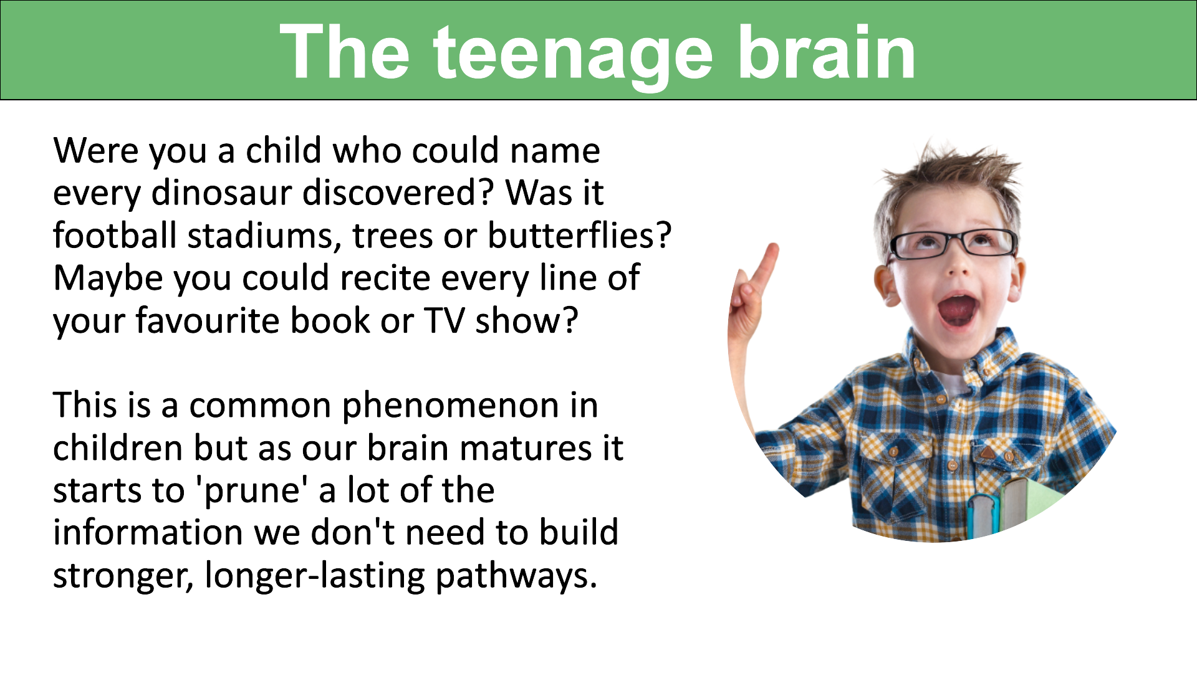
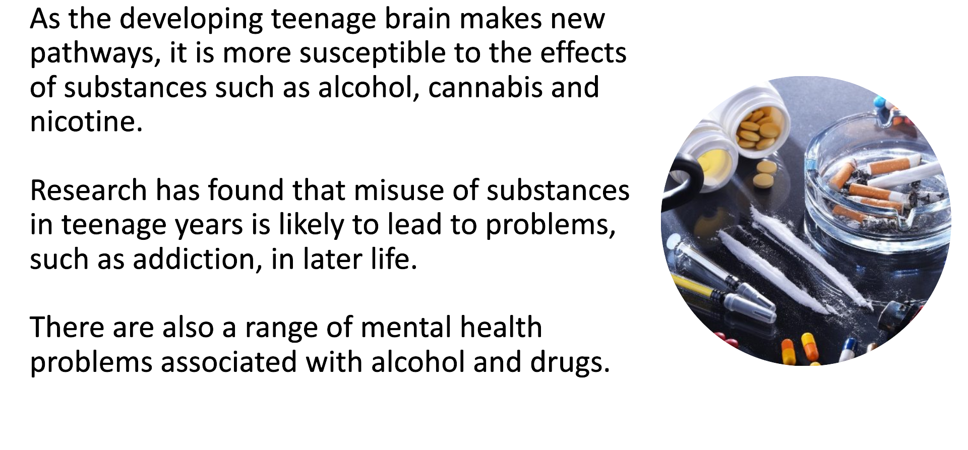
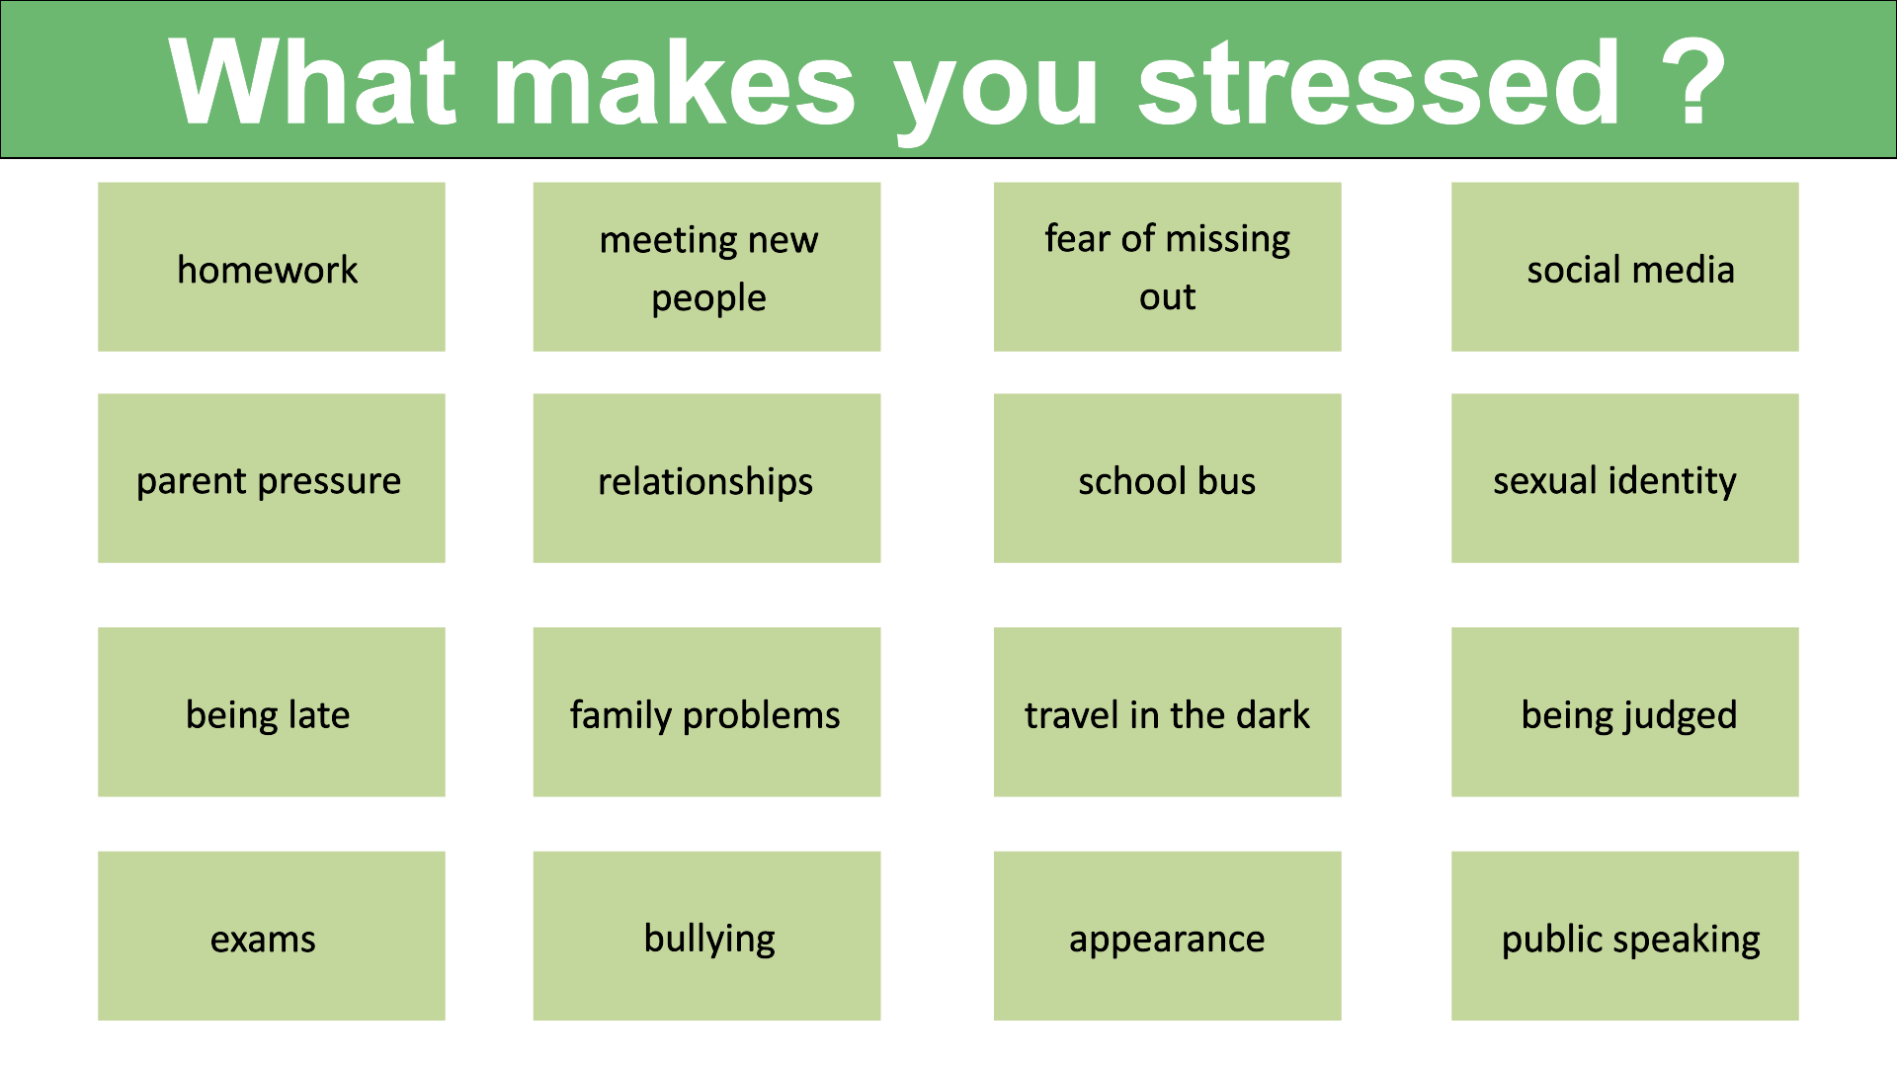
Positive mental health
Write down 3 facts about the teenage brain
______________________________________________________________________________________________________________________________________________________________________________________________________________________________
The teenage brain

Slide 10
Dealing with stress
Good ways | Bad ways
What is self-harm ?
________________________________________________________________________________________________________________________________________________________________________________________________________________________________________________________________________________________________
Why do people self harm ?

Slide 11

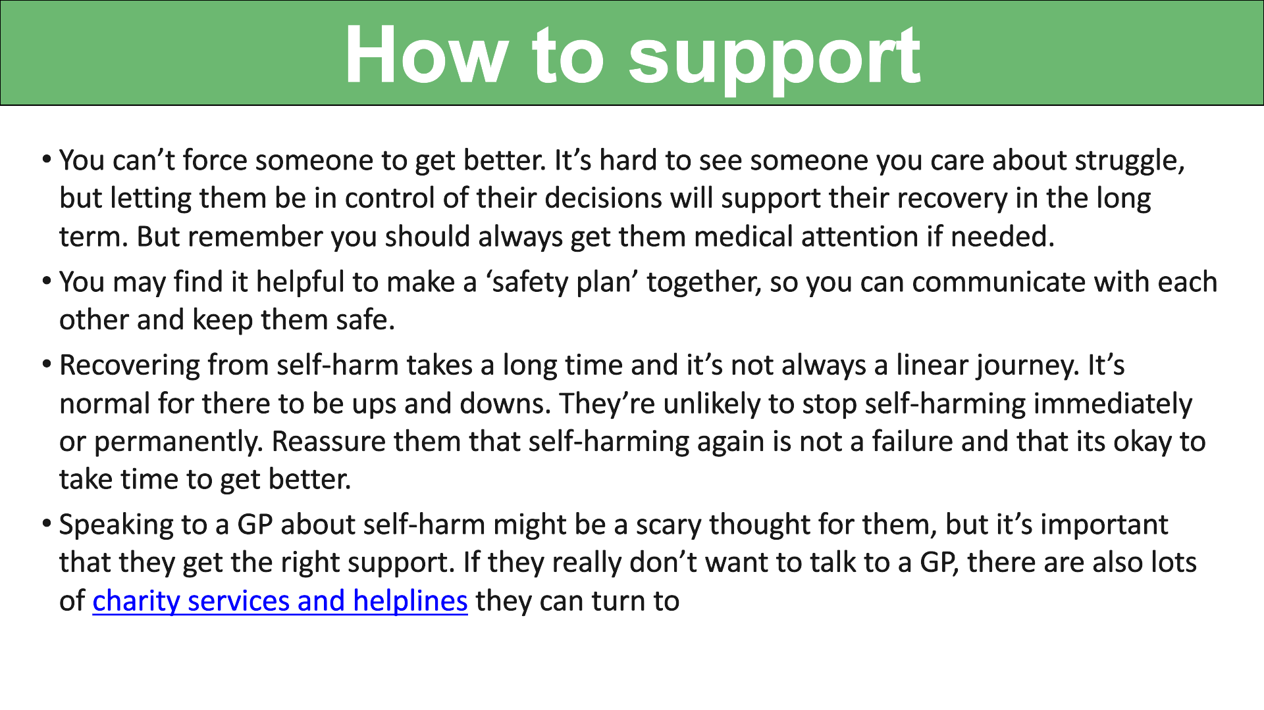
Happiness is closely linked to our sense of connection
with others, as relationships provide support, belonging,
and shared meaning in our lives. For teenagers in
particular, it is important that you are encouraged and
supported to explore what makes you feel happy and
what contributes to feelings of unhappiness, helping to
build emotional awareness and resilience. At the same
time, you should understand that experiences of loneliness are common and can affect almost everyone at certain points in life; such feelings are not a sign of failure or weakness but a natural part of being human. By normalising these experiences and fostering open conversations, young people can learn to navigate their emotions with confidence and without shame.​
​
Get plenty of sleep.​
Eat well.​
Spend time with friends.​
Talk about your feelings regularly.​
Reduce alcohol consumption.​
Keep active and eat well.​
Develop new skills.​
Relax and enjoy your hobbies.
Set realistic goals
​
What else works for you ?

Slide 12
Drugs and Addiction
Drugs are defined as “a medicine or other substance which has a physiological effect when ingested or otherwise introduced into the body”
Substance misuse refers to any substance used for purposes other than those intended, can be dangerous and could even cause death.
What is a prescription drug ? | Why do some people need prescription drugs?
How can prescription drugs be misused? | What are some of the consequences of misusing prescription drugs?

Slide 13
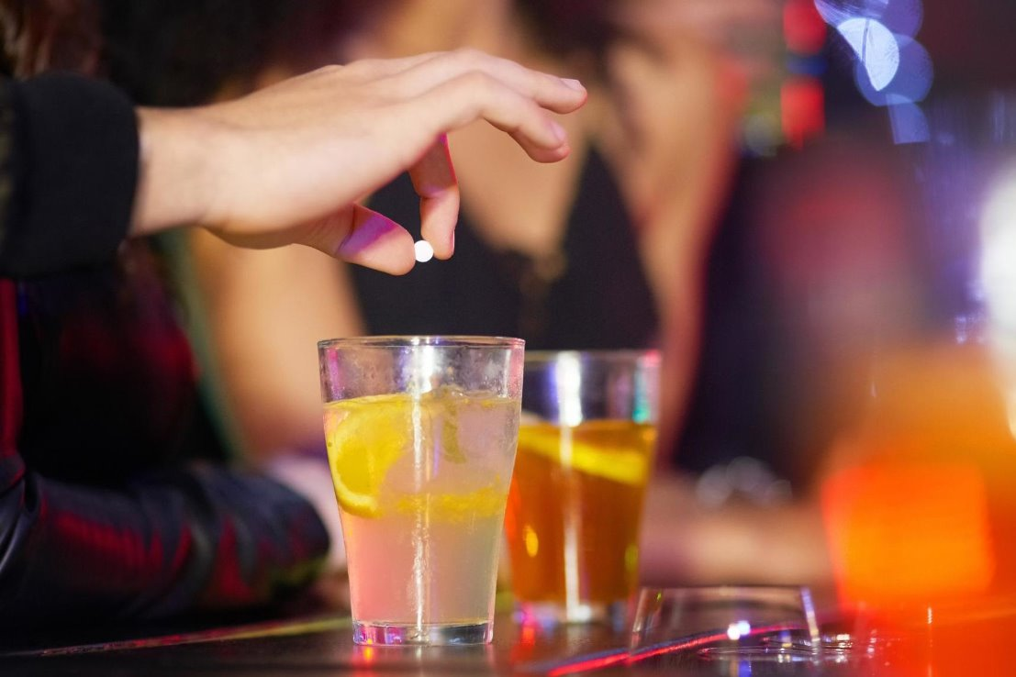
Should doctors give out fewer prescription drugs ?
________________________________________________________________________________________________________________________________________________________________________________________________________________________________________________________________________________________________________________________________________________________________________________________________________________________________________________
What are sedatives ?
________________________________________________________________________________________________________________________________________________
What is anaesthetic ?
________________________________________________________________________________________________________________________________________________
Spiking
In October 2021, police reported over 200 cases of young people's drinks being 'spiked' with illegal drugs in nightclubs and pubs. ​
​
Rates of 'needle' spiking have also increased where young people have been injected with a drug without them knowing. This has​ resulted in hospitalisation for some.​
​
GHB (gammahydroxybutrate) and GBL (gammabutyrolactone) are closely related drugs with similar sedative and anaesthetic effects.​
When consumed, GBL is converted to GHB in the body. ​
GHB and GBL look identical. They are sold as:​
colourless oily liquids​
capsules, but this is rare​
as powder or paste, but this is also rare​
GHB has a medical use in the treatment of narcolepsy, and GBL is used in stain remover, rust remover, superglue remover, as an alloy cleaner and as a paint stripper.​

Slide 14
Dangers of GHB
Orally - Drinking GHB or GBL on its own would lead to chemical burns in your mouth and throat. Because of this, people take GHB and GBL orally by using a pipette, syringe or pre-measured vial to measure the dose and then mix it into a soft drink.​
Injecting - You can’t inject GBL, but some people inject GHB – although this is rare and particularly dangerous.​
Snorting - You can’t snort GBL (as it’s a liquid), but some people snort GHB powder, but this is also very rare.​
It's very easy to overdose on GHB and GBL.
This is because there's only a very small difference between the dose causing the desired effects and the dose leading to severe overdose.
Experienced users measure the drug out very carefully using a pipette or a syringe, or by filling pre-measured vials (small bottles) to avoid taking too much. If you don’t measure the dosage, you’re likely to overdose and fall unconscious.
How does it make people behave?
GHB and GBL can reduce people’s inhibitions, and some people take the drugs to have more intense sex.
How to avoid drink spiking:
Always buy your own drink and watch it being poured.
Don't accept drinks from strangers.
Never leave your drink unattended while you dance or go to the toilet.
Don't drink or taste anyone else's drink.
Throw your drink away if you think it tastes odd.

Slide 15
Body Enhancements:
Tattoo
Filler
Liposuction
Piercings
Veneers
Rhinoplasty
Tanning bed
Cosmetic | Aesthetic

Slide 16
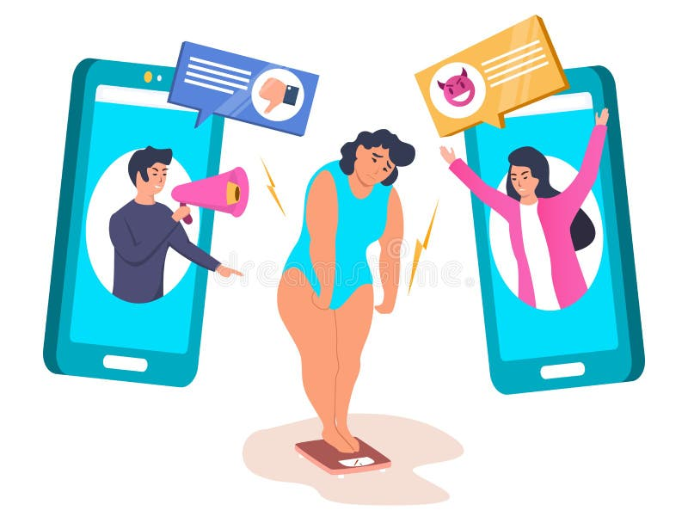
Enhancement | Risks
Tattoos
Piercings
Fillers and botox
Tanning beds
Plastic surgery
How does the internet affect body image ?

Slide 17
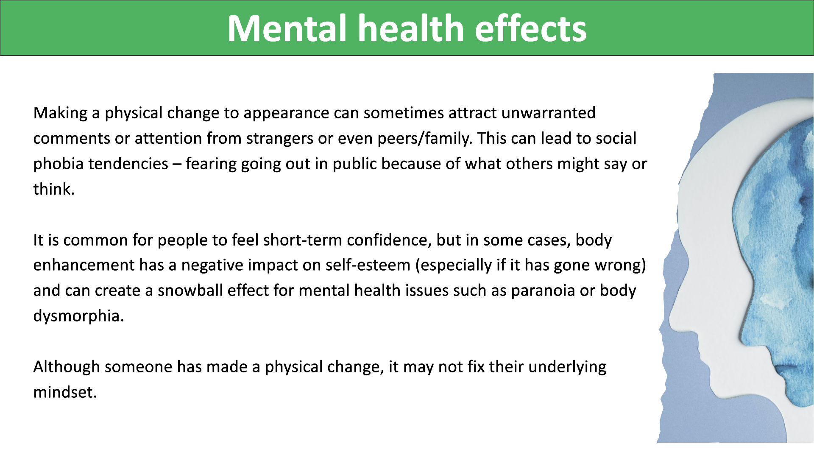
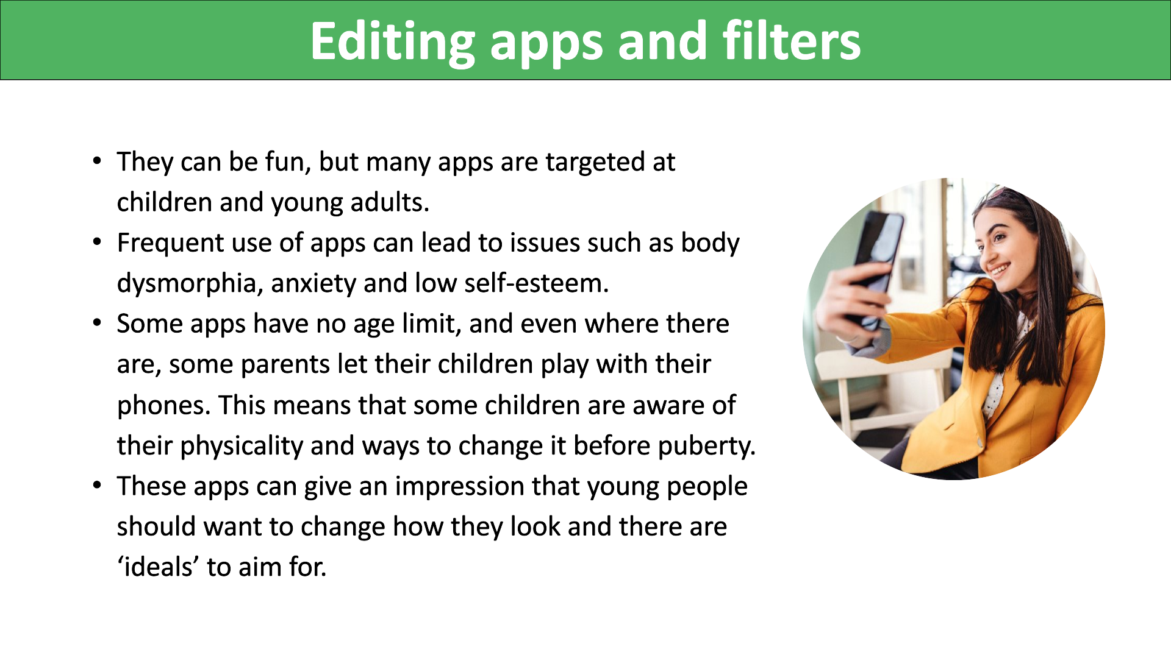
The internet and body image

Slide 18
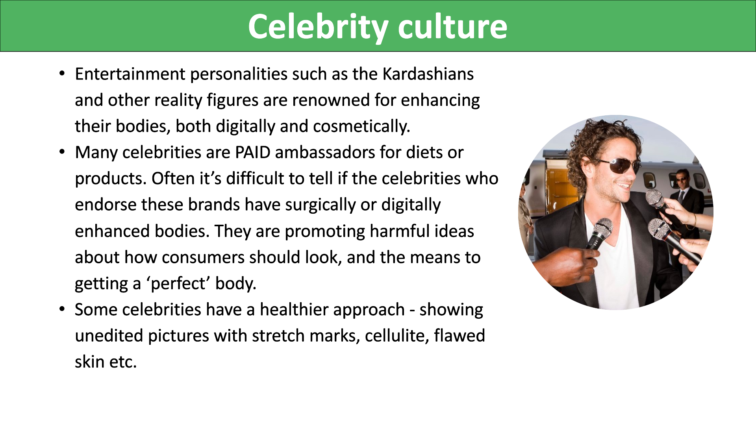
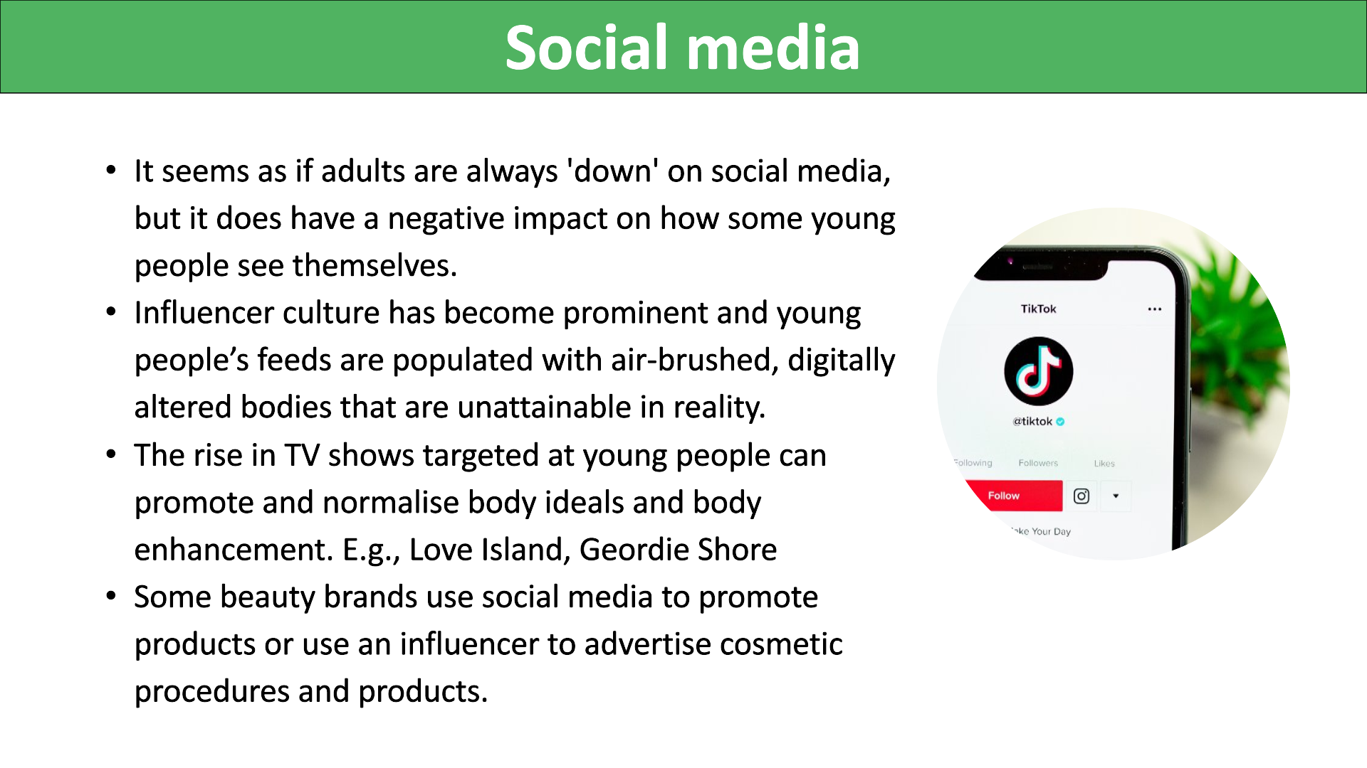
The internet and body image

Slide 19
Getting factual information about any type of body enhancement is vital. Unfortunately, there are unscrupulous practitioners about.​
​The internet is also not a brilliant place to get information about body enhancement procedures. Truths are often mixed in with fake news, myths and others' opinions.​
​It's best to shop around, visit several places that offer the procedure and get all the information in advance. If something doesn't feel right then it's probably not.​
​Never be tempted with a do-it-yourself option, these are risky and can be life-threatening.
Gemma
Dale
Sarah
Jackson

Slide 20








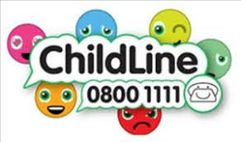




Support and advice on this topic

Slide 21
Spare pages:
____________________________________________________________________________________________________________________________________________________________________________________________________________________________________________________________________________________________________________________________________________________________________________________________________________________________________________________________________________________________________________________________________________________________________________________________________________________________________________________________________________________________________________________________________________________________________________________________________________________________________________________________________________________________________________________________________________________________________________________________________________________________________________________________________________________________________________________________________________________________________________________________________________________________________________________________________________________________________________________________________________________________________________________________________________________________________________________________________________________________________________________________________________________________________________________________________________________________________________________________________________________________________________________________________________________________________________________________________________________________________________________________________________________________________________________________________________________________________________________________________________________________________________________________________________________________________________________________________________________________________________________________________________________________________________________________________________________________________________________________________________________________________________________________________________________________________________________________________________________________________________________________________________________________________________________________________________________________________________________________________________________________________________________________________________________________________________________________________________________________________________________________________________________________________________________________

Slide 22
Spare pages:
____________________________________________________________________________________________________________________________________________________________________________________________________________________________________________________________________________________________________________________________________________________________________________________________________________________________________________________________________________________________________________________________________________________________________________________________________________________________________________________________________________________________________________________________________________________________________________________________________________________________________________________________________________________________________________________________________________________________________________________________________________________________________________________________________________________________________________________________________________________________________________________________________________________________________________________________________________________________________________________________________________________________________________________________________________________________________________________________________________________________________________________________________________________________________________________________________________________________________________________________________________________________________________________________________________________________________________________________________________________________________________________________________________________________________________________________________________________________________________________________________________________________________________________________________________________________________________________________________________________________________________________________________________________________________________________________________________________________________________________________________________________________________________________________________________________________________________________________________________________________________________________________________________________________________________________________________________________________________________________________________________________________________________________________________________________________________________________________________________________________________________________________________________________________________________________________

