Slide 1
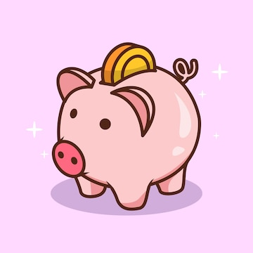

YEAR 10
PERSONAL DEVELOPMENT
5. FINANCIAL EDUCATION
NAME:
CLASS:
TEACHER:

Slide 2




PD PUPIL SELF ASSESSMENT YEAR 10: FINANCE
I CAN DO/UNDERSTAND THE FOLLOWING SKILLS/CONCEPTS: | START | END
I CAN NAME AND EXPLAIN DIFFERENT TYPES OF DEBT
2. I KNOW HOW APPS LIKE KLARNA AND PAYPAL WORK
3. I CAN EXPLAIN WHAT A PENSION IS
4. I UNDERSTAND WHAT DEBT IS AND CAN GIVE EXAMPLES
5. I UNDERSTAND HOW WAGES AND TAX WORKS
6. I KNOW WHAT MY CONSUMER RIGHTS ARE
7. I UNDERSTAND HOW TO BE AN ETHICAL CONSUMER
8. I KNOW WHERE TO GO FOR HELP ABOUT ANY OF THESE ISSUES
Use the symbols below to assess what you know now, and again at the end of this unit.
– you understand all about this and can explain this to other people.
– you know something about this, but not everything.
– you do not understand this or have never heard of this.

Slide 3
Dangers of debt
Current account
Credit card
Overdraft
Payday loan
Loan shark
Student loan

Slide 4


Other types of debt
Klarna and PayPal offer you to pay in three instalments for big items interest free. Which is tempting if you know you can pay the money back in full over three months!​
​
However, the interest is high if you forget to pay your loan back. These fees stack up quickly and Klarna and PayPal will pass your debt onto a debt collection agency if you don’t pay them back.​
The risks of gambling

Slide 5
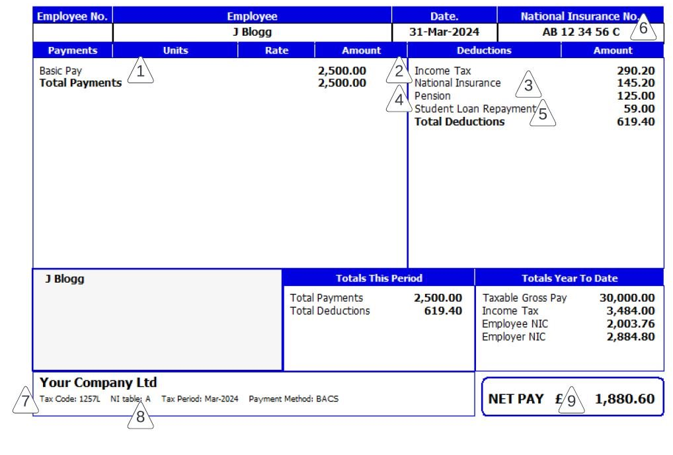
A budget is a financial plan for a defined period. It includes income (money coming in) and expenditure (money going out)​.
Budgets should be:
Comprehensive and honest – they should include all the ways they might receive or spend money, however small
Accurate – they need to make sure nothing is forgotten and identify their spending priorities
Cover a set period – usually a week or a month to allow comparison
Wages and tax
For most of us, the majority of our income will come from our work. We might own a business and receive income from it, or we could be employed by someone else.
When we are employed we might get paid a wage, where we earn an amount of money depending on how much we work or we could be paid a salary, where you are paid an annual amount for your work, which is usually divided into equal monthly amounts. Our gross pay is our total pay but our final take home figure is known as net pay. It is important to know what to expect for both figures.
A payslip is a useful means of checking we are being paid the correct amount and understanding what money is being deducted from our earnings. Nearly all employees have the legal right to receive a payslip, this can either be a printed or digital copy.

Slide 6
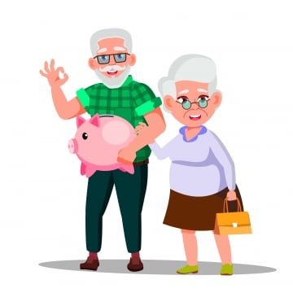
It is advisable to check your payslip to ensure you have earnt the correct amount. Even if you earn a salary you may find this amount differs, for example if you had missed work due to sickness or purchased extra days of holiday, there may be reductions or you may get extra income due to overtime, commission, claiming expenses or receiving a bonus. If you receive a wage where your income will depend on the amount of hours work it is important to check you agree with the number of hours.​
It is a good idea to keep payslips to prove payments made if needed in the future. One way to do this is to create a real or virtual folder to store them.​
What is a pension ?
________________________________________________________________________________________________________________________________________________________________________________________________________________________________________________________________________________________________
Many people now have an employer pension which both they (directly from their wages) and their employer contribute to. You usually have to ‘opt out’ of being in a pension scheme so this would be a potential deduction on a first payslip. When people retire they may get a cash sum and an annual amount but this will depend on how much money they have paid in and how long for. The sooner you start paying in to a pension, the bigger the amount you will get at retirement.
If you have paid national insurance (a kind of tax) you will likely also be entitled to a state pension from the government when you reach state retirement age (for most of us this will currently be 68).
2026 state pension: £241.30 per week (£12,547.60 per year).

Slide 7
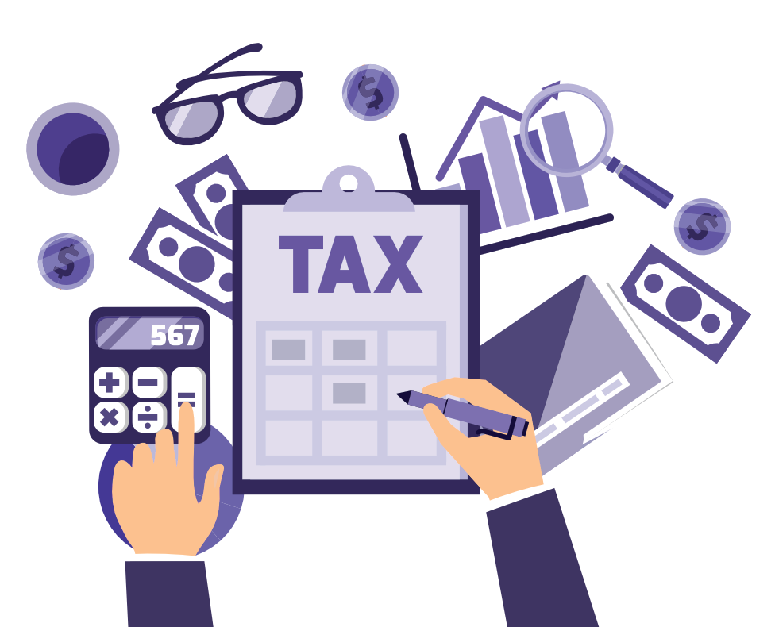
Managing money
___________________________________________________________________________________________________________________________________________________________________________________________________________________________
In the same way that we should all budget for things (rent, car, clothes, food etc.) the government must also have a yearly financial plan on what it is going to spend money on.​
The government collects money through tax.
How is tax money spent ?

Slide 8
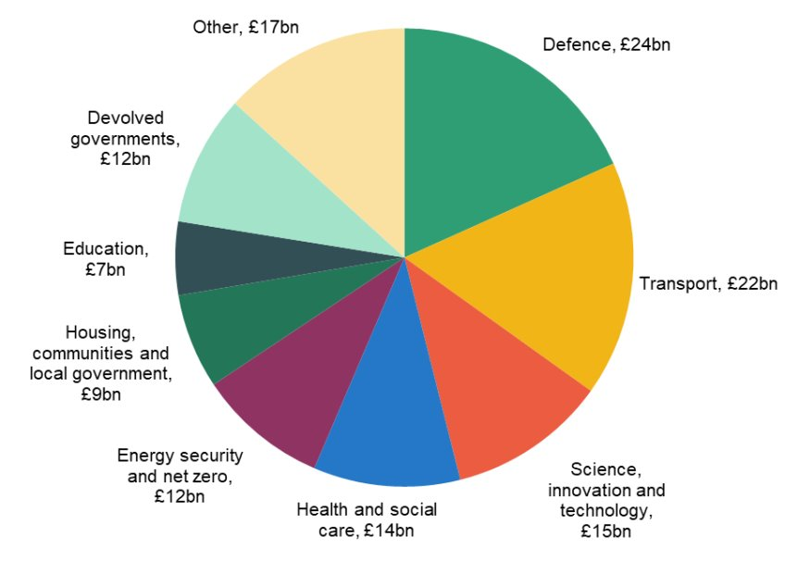
Government spending 2025
Should we spend more or less on each category ?

Slide 9
Types of tax
Income Tax – It’s the money you pay based on how much you earn, usually from a job.​
VAT (Value Added Tax) – Added to most goods and services you buy.​
National Insurance – Helps fund state pensions and benefits.​
Council Tax – Paid to local councils to fund local services.​
Corporation Tax – Paid by businesses on their profits.​
Excise Duty – Taxes on specific goods such as alcohol, tobacco and fuel.​
Capital Gains Tax – A tax on profits made when selling assets such as property (excluding main home) or shares.​
Road Tax – A tax you must pay on your vehicle before you are allowed to drive it on the road. ​
Air Passenger Duty – A tax added to the price of a plane ticket for flights departing from the UK.​
Dividend Tax – A tax on income earned from shares.​
Insurance Premium Tax – A tax added to insurance policies like home, car and travel insurance.​
Landfill Tax – A tax on waste sent to landfill designed to encourage recycling. ​
Plastic Packaging Tax – A tax on plastic packaging that contains at least 30% recycles material aimed at reducing plastic waste.​
Stamp Duty Land Tax – Tax on property purchases in the Uk.
Income tax is taken from people’s earnings. If you have a job, it automatically gets deducted from your wage and if you are self-employed you have to complete a self-assessment tax return (you say how much money you have made that year).​ In the UK, the more someone earns the more tax they pay.​ This system is known as progressive taxation. Those with higher incomes contribute more to public services. ​Some people with lower incomes may pay little or no income tax. For example, someone earning £12,570 per year would pay £0 whilst someone earning £30,000 per year would pay around £3,486.​
2026/27 Income Tax Thresholds (England, Wales, NI)
Personal Allowance: £0 – £12,570 (0% tax)
Basic Rate: £12,571 – £50,270 (20% tax)
Higher Rate: £50,271 – £125,140 (40% tax)
Additional Rate: Over £125,140 (45% tax)

Slide 10
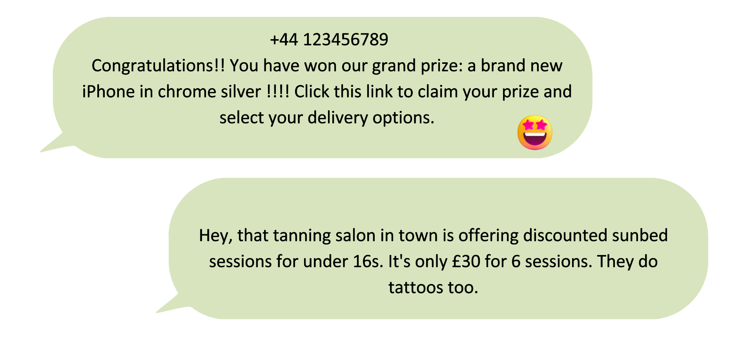
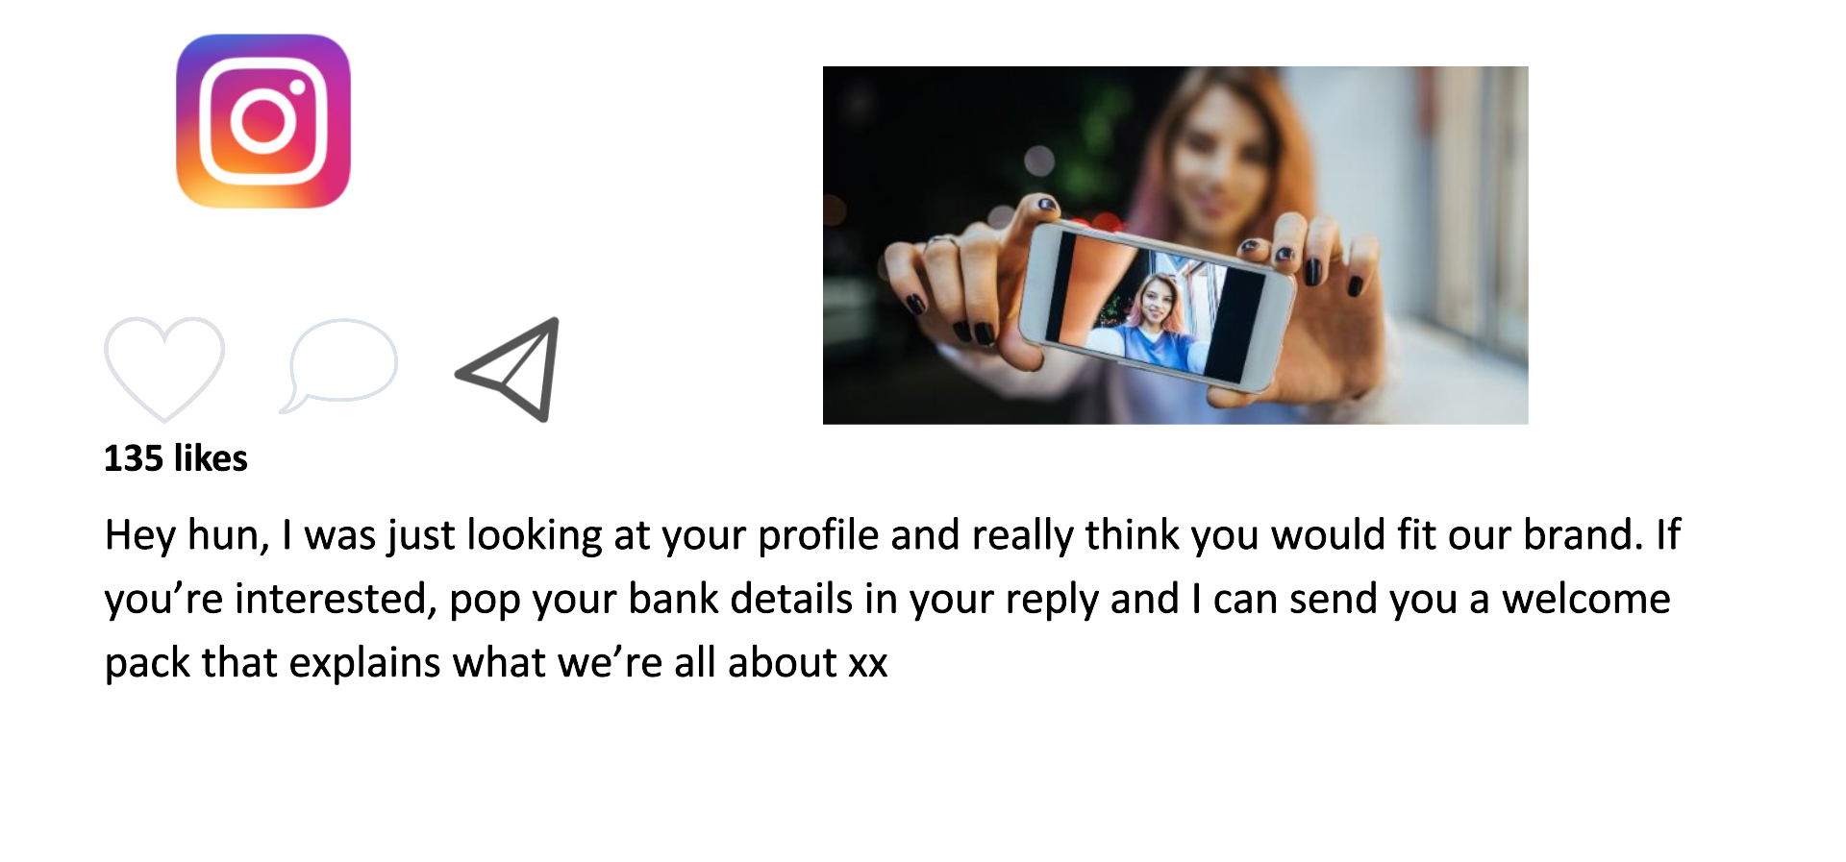
Consumer rights
What is a consumer ?
___________________________________________________________________________________________________________________________________________________________________________________________________________________________
____________________________________________________________________________________________________________________________________________________________________________________________________________________________________________________________________________________________

Slide 11
How to spot a scam
Notes on The Consumer Rights Act
________________________________________________________________________________________________________________________________________________________________________________________________________________________________________________________________________________________________________________________________________________________________________________________________________________________________________________________________________________________________________________________________________________________________________________________________________________________________________________________________________________________________________________________________________________________________________________________________________________________________________________________________________________________________________________________________________________________________________________________________________________________________________________________________________________________________________________________

Slide 12

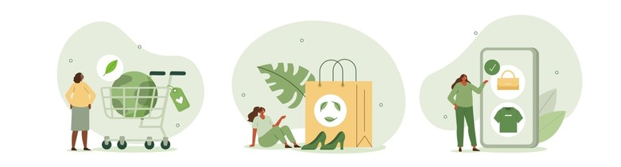
What are ethical purchases ?
_______________________________________________________________________________________________________________________________________________________________________________________________________________________________________________________________________________________________________________________________________________________________
Pros and cons of ethical shopping
Pros | Cons

Slide 13








Support and advice on this topic

Slide 14
Spare pages:
____________________________________________________________________________________________________________________________________________________________________________________________________________________________________________________________________________________________________________________________________________________________________________________________________________________________________________________________________________________________________________________________________________________________________________________________________________________________________________________________________________________________________________________________________________________________________________________________________________________________________________________________________________________________________________________________________________________________________________________________________________________________________________________________________________________________________________________________________________________________________________________________________________________________________________________________________________________________________________________________________________________________________________________________________________________________________________________________________________________________________________________________________________________________________________________________________________________________________________________________________________________________________________________________________________________________________________________________________________________________________________________________________________________________________________________________________________________________________________________________________________________________________________________________________________________________________________________________________________________________________________________________________________________________________________________________________________________________________________________________________________________________________________________________________________________________________________________________________________________________________________________________________________________________________________________________________________________________________________________________________________________________________________________________________________________________________________________________________________________________________________________________________________________________________________________________

Slide 15
Spare pages:
____________________________________________________________________________________________________________________________________________________________________________________________________________________________________________________________________________________________________________________________________________________________________________________________________________________________________________________________________________________________________________________________________________________________________________________________________________________________________________________________________________________________________________________________________________________________________________________________________________________________________________________________________________________________________________________________________________________________________________________________________________________________________________________________________________________________________________________________________________________________________________________________________________________________________________________________________________________________________________________________________________________________________________________________________________________________________________________________________________________________________________________________________________________________________________________________________________________________________________________________________________________________________________________________________________________________________________________________________________________________________________________________________________________________________________________________________________________________________________________________________________________________________________________________________________________________________________________________________________________________________________________________________________________________________________________________________________________________________________________________________________________________________________________________________________________________________________________________________________________________________________________________________________________________________________________________________________________________________________________________________________________________________________________________________________________________________________________________________________________________________________________________________________________________________________________________

