Slide 1


YEAR 9
PERSONAL DEVELOPMENT
8. CITIZENSHIP
NAME:
CLASS:
TEACHER:

Slide 2
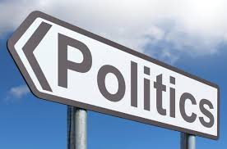
Self Assessment
At the start of this topic: mind map what the word POLITICS means to you
At the end of the topic: add any other points in a different coloured pen

Slide 3
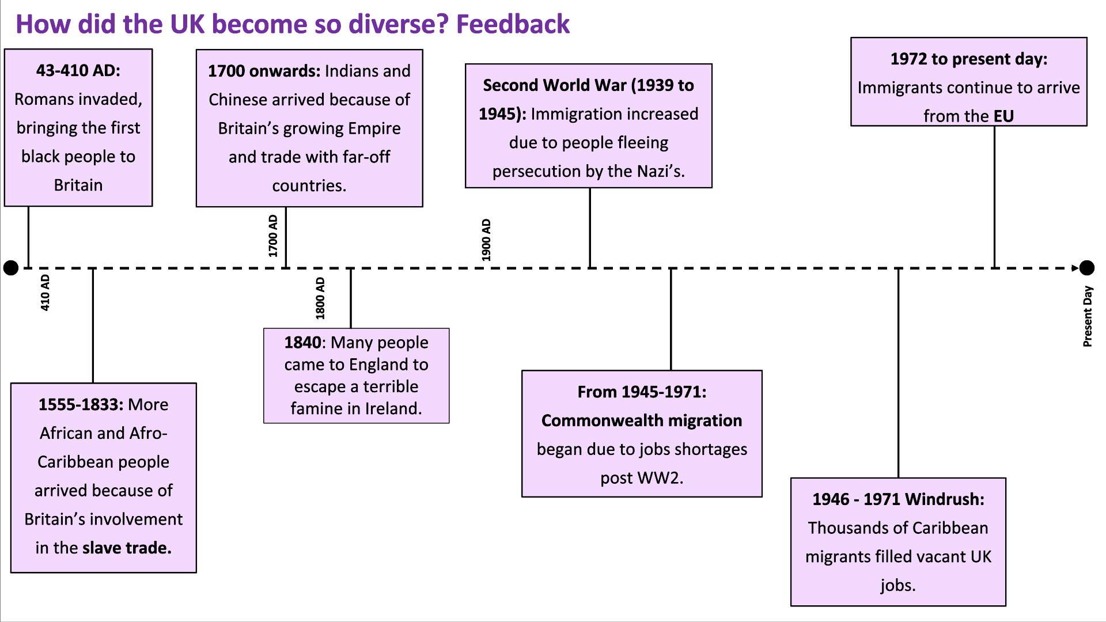
Diversity in the UK
What is Diversity ?
____________________________________________________________________________________________________________________________________________________________________________________________________________________________________________________________________________________________________
Benefits | Challenges

Slide 4
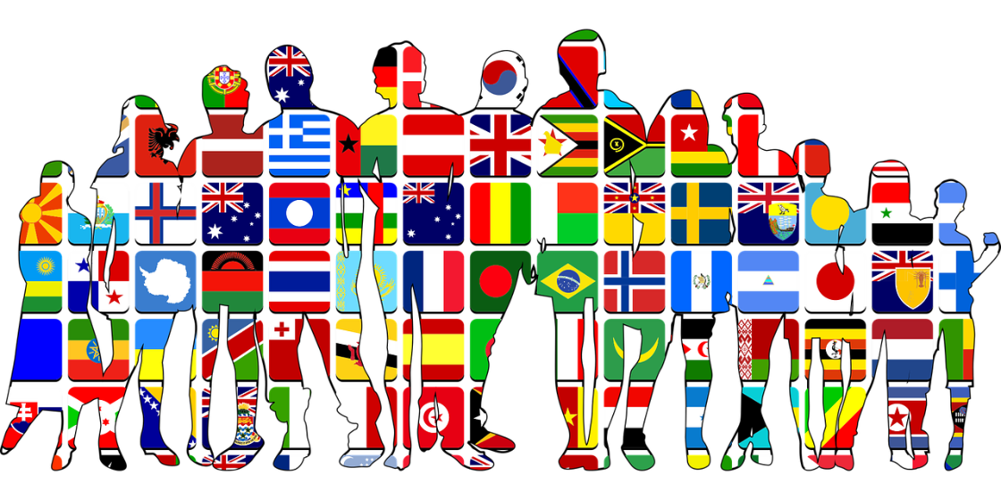
Some benefits are..
Diversity can foster new ideas and innovation. It can open our minds to new and exciting experiences and to new ways of thinking.
Having a diverse society can enrich the culture of a nation through, food, music, art.
It can build mutual understanding and respect.
Economic migrants help the economy grow through work, tax and shopping.
Migrants bring specialist skills.
Diversity, tolerance and respect enhanced through sharing cultures and integration.
Some challenges are...
Lack of integration (mixing) can lead to some communities being and feeling isolated.
Racism and discrimination may lead to some communities not feeling safe or part of the wider society.
Population growth can lead to demands on public services.
Rates of pay may reduce if economic migrants work for lower wages.
May cause tensions and rise in discrimination.
A multicultural society is a society with a multitude of different communities.
This will include ethnic and cultural diversity.

Slide 5
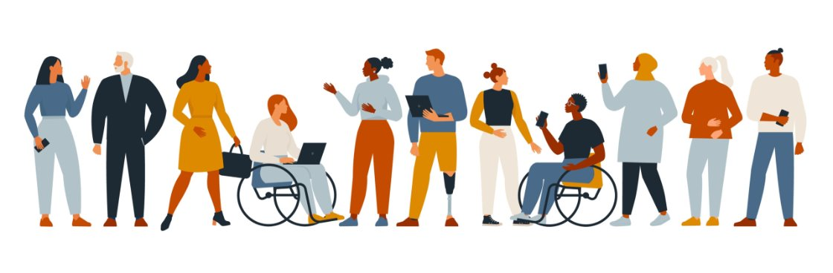
The Equality and Human Rights Commission states that equality is about ensuring that every individual has an equal opportunity to make the most of their lives and talents. ​
It is also the belief that no one should have poorer life chances, because of the way they were born, where they come from, what they believe, or whether they have a disability.
​
1.Prejudice and Discrimination: Some people face barriers to equality because others hold prejudiced beliefs and discriminate against them.
2. Economic Disadvantages: People from low-income backgrounds may struggle to access quality healthcare, education, and other essential services.
3. Stereotyping: Stereotypes can lead to unfair treatment. For example, assuming that all girls are not good at math or that all boys are not emotional are stereotypes that can prevent people from being treated equally.
4. Lack of Representation: Representation refers to seeing people who look like you or come from similar backgrounds in positions of power or influence. When certain groups are underrepresented in leadership roles, media, or other areas, it can make it harder for them to be treated equally.
5. Systemic Injustice: Systemic injustice refers to unfair practices and policies that are deeply ingrained in society. It can include things like racial profiling by law enforcement or unequal access to housing and job opportunities. These systemic barriers prevent some people from being treated equally.
Notes on the Equality Act

Slide 6
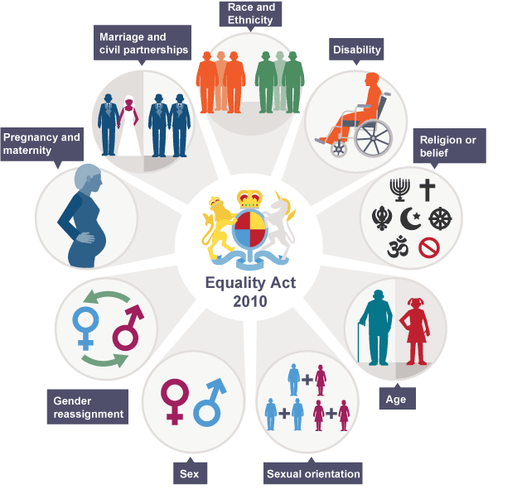
The Equality Act 2010 makes it law that every private, public and voluntary organisation must not discriminate against employees and people that use their services because of particular characteristics. ​
The Act brings together all previous equality laws, making them simpler, more effective and easier to understand.
Video: Protected Characteristics

Slide 7
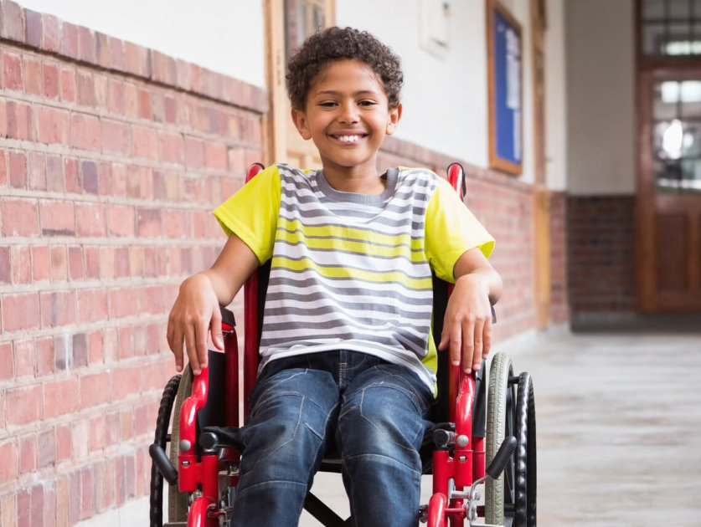
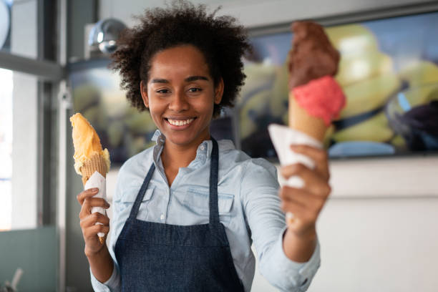
Tom
Kate
Why is Politics important ?
What is Politics ?
___________________________________________________________________________________________________________________________________________________________________________________________________________________________________________________________________________________________________________________________________________________________________
Notes on video

Slide 8
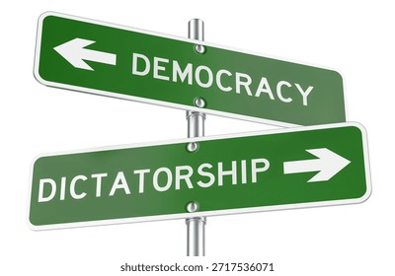
Democracy | Totalitarianism/Dictatorship
Definition: A system of government by the whole population or all the eligible members of a state, typically through elected representatives. | Definition: Totalitarianism is a political concept that defines a mode of government where they stop opposition parties and have a high degree of control over public and private life.
Characteristics: Debates, speaking, opposition. | Characteristics: Control, no opposition, authority.
Synonyms: Equality, justice, free, autonomous. | Synonyms: Oppressive, authoritarian.
Arguments For Democracy | Arguments For Dictatorship

Slide 9
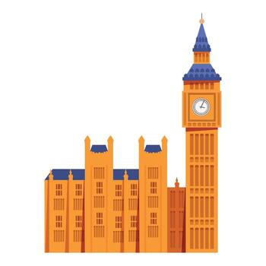
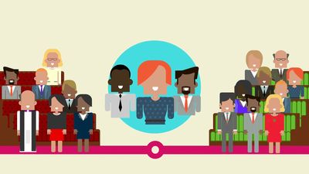
The UK parliament is made up of three parts:​
The House of Commons – elected MP’s, representing every constituency across the UK.​
The House of Lords – appointed for their experience and expertise in a range of professions.​
The Monarch – the King or Queen.​
The work of the UK Parliament falls into three areas:​
To represent people’s interests, making sure the government considers the public’s views.​
To make laws, the government can’t make new laws or raise new taxes without UK Parliament’s agreement.​
To check and challenge the work of government and to hold them to account.
________________________________________________________________________________________________________________________________________________________________________________________________________________________________________________________________________________________________________________________________________________________________________________________________________________________________________________________________________________________________________________________________________________________________________________________________________________________________________________________________________________________________________________________________________________________________________________________________________________________________________________________________________

Slide 10
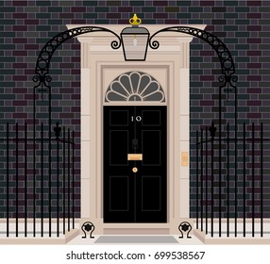
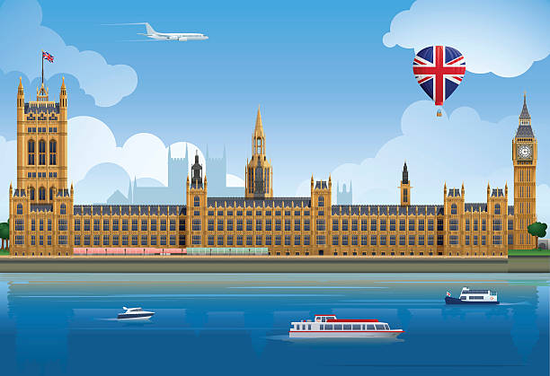
The government is:​
The Prime Minster​
The Cabinet and junior ministers.​
​
After a general election, the political party with the most MP’s elected forms the government. The leader of this party becomes the Prime Minster. They choose members of both Houses to become minsters, in charge of managing the UK.​
________________________________________________________________________________________________________________________________________________________________________________________________________________________________________________________________________________________________________________________________________________________________________________________________________________________________________________________________________________________________________________________________________________________________________________________________________________________________________________________________________________________________________________________________________________________________________________________________________________________________________________________________________​____________________________________
How does our government work ?
Voting is a method for a group, such as a meeting, in order to make a collective decision or express an opinion usually following discussions, debates or election campaigns.
Elections are formal group decision-making process by which a population chooses an individual or multiple individuals to hold public office.
Political campaigns are organized efforts which seeks to influence the decision making progress within a specific group.

Slide 11
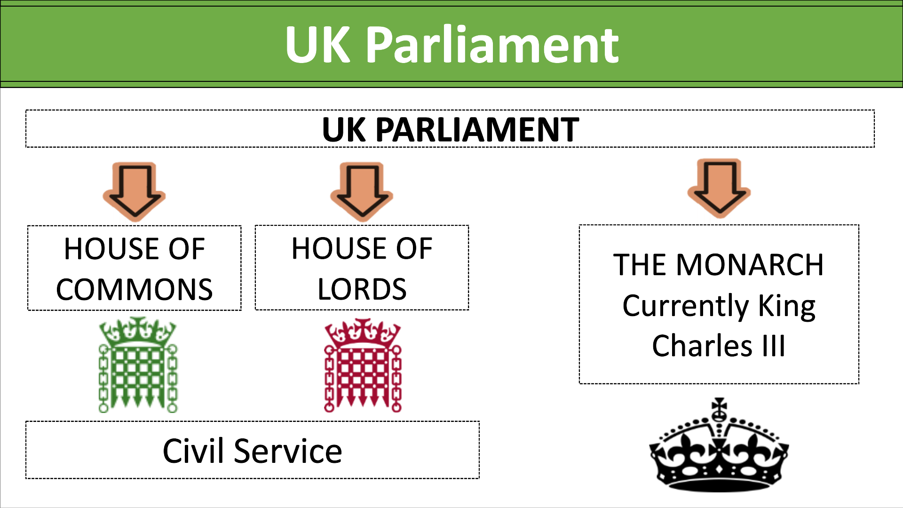
What is a constituency ?
________________________________________________________________________________________________________________________________________________________________________________________________________________________________________________________________________________________________
What is a manifesto ?
________________________________________________________________________________________________________________________________________________________________________________________________________________________________________________________________________________________________
Parliament has many functions, but five of the most important are:​
Examine and check government policy.​
Debate the major issues of the day.​
Give approval to the government's plans for raising and spending money.​
Examine amendments and proposals for new laws and existing laws.​
Represent the will of the people and by the custodians of democracy.​

Slide 12
House of Commons | House of Lords
The public elects Members of Parliament (MPs) to represent their interests and concerns in the House of Commons.​
MPs consider and propose new laws.​
MPs raise issues that matter to their constituents.​
MPs split their time between Parliament and working in the constituency.​
Some MPs may become government ministers, such as health or defence.​
MPs will hold regular surgeries to help their constituents.​
How does an election work ?
________________________________________________________________________________________________________________________________________________________________________________________________________________________________________________________________________________________________________________________________________________________________________________________________________________________________________________________________________________________________________________________________________________________________________________________________________

Slide 13
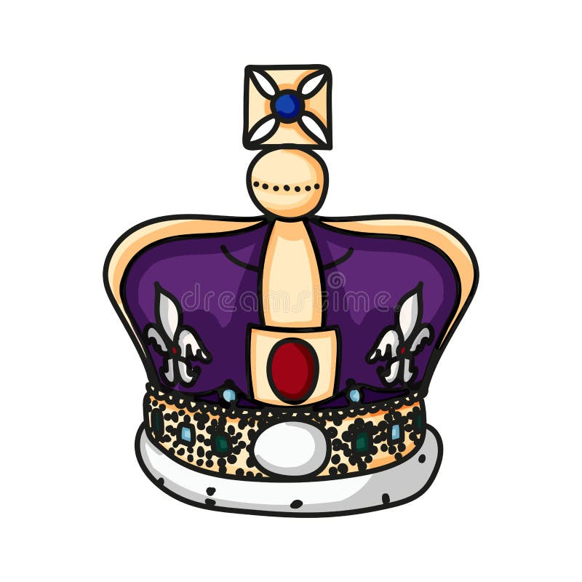
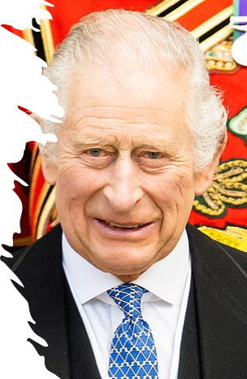
The role of the monarchy
What is a monarch?
The Monarch is the name for the King or Queen
Our current Monarch is King Charles III
Britain is a Constitutional Monarchy. We have a government and a monarch.
Video notes
What is the role of the King ?
____________________________________________________________________________________________________________________________________________________________________________________________________________________________________________________________________________________________________________________________________________________________________________________________________________________________________________________________________________________________________________________________________________________________________________________________________________________________________________________________________

Slide 14
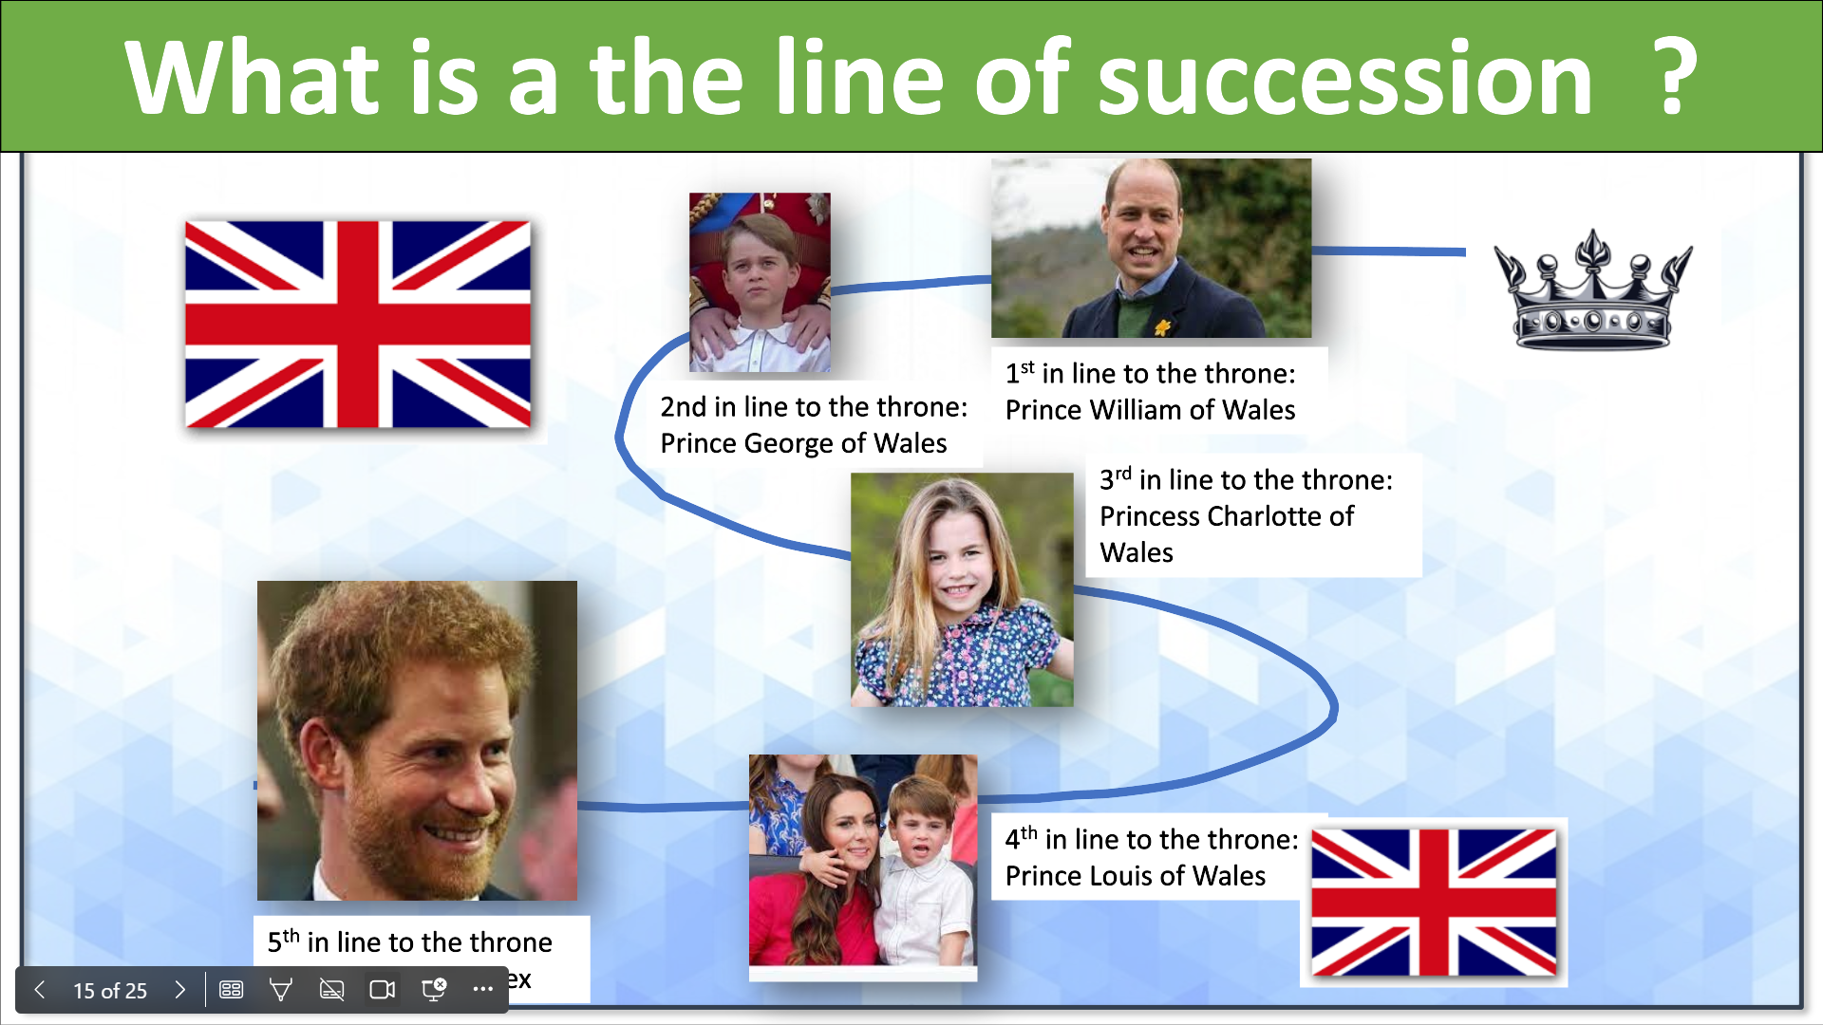
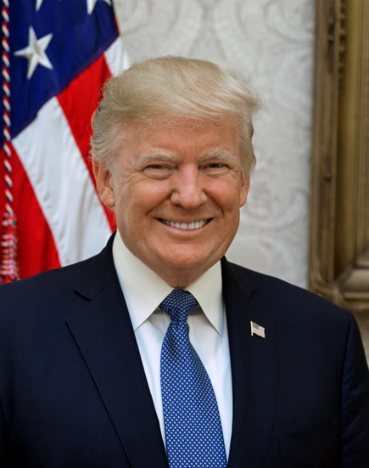
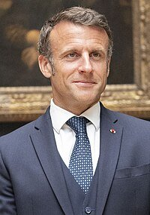
Most important roles of the King
______________________________________________________________________________________________________________________________________________________________________________________________________________________________________________________________________________________________________________________________________________________________________________________________________________________________________________________
A country without a monarchy is called a Republic​
France and America are both republics​
They have a President instead of a monarchy
Is a republic better than a monarchy ?

Slide 15
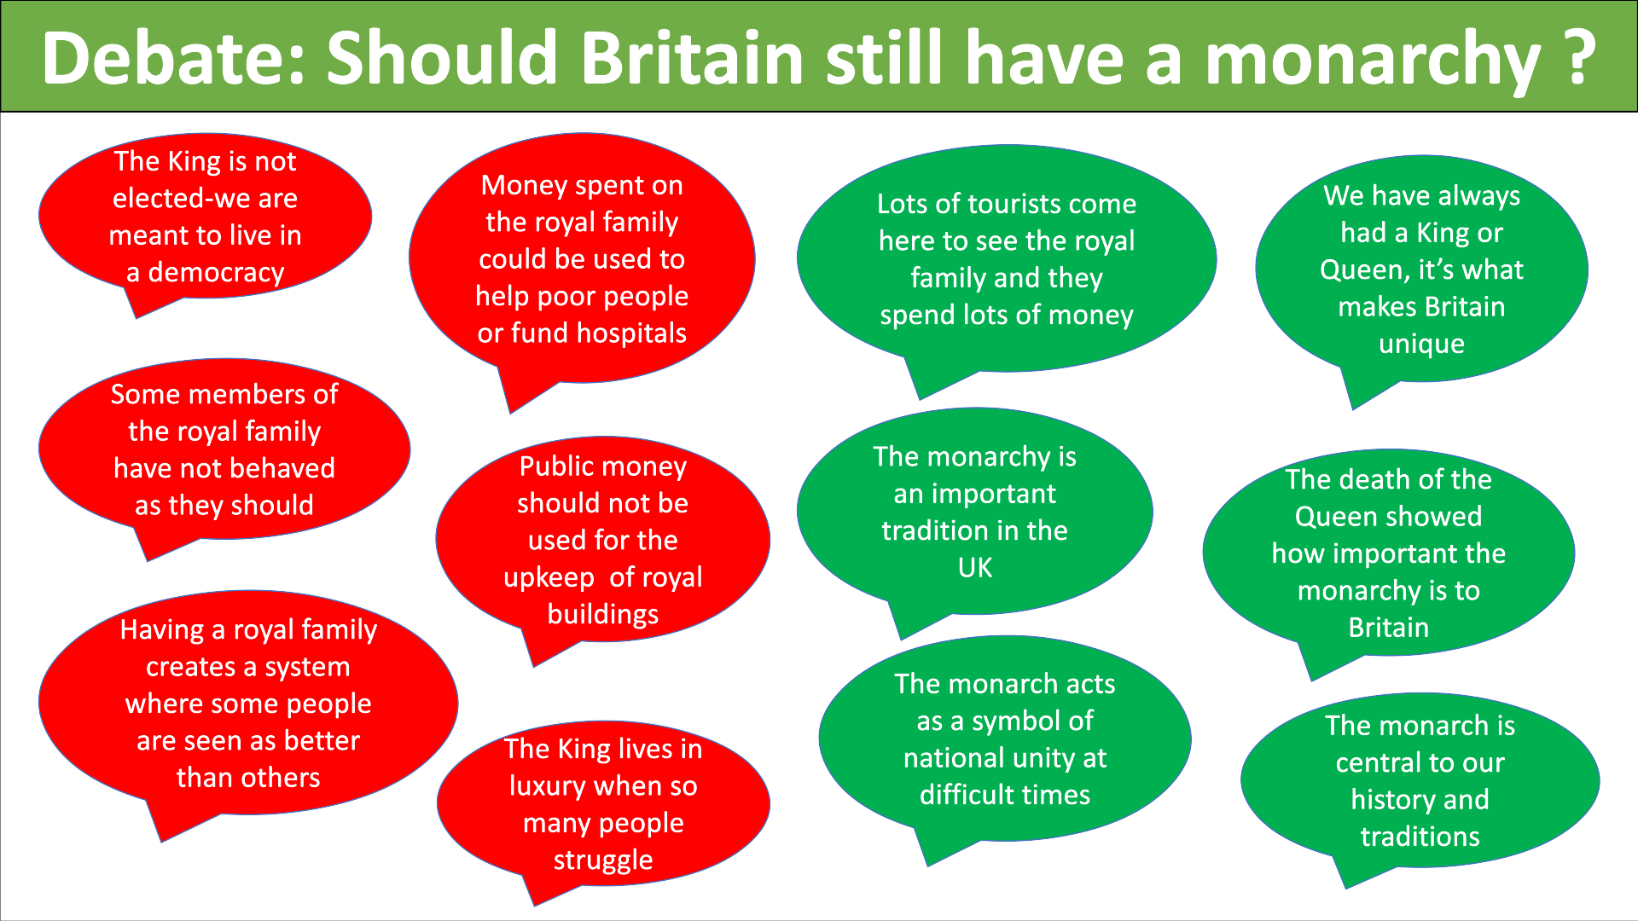

Should Britain still have a monarchy ?
________________________________________________________________________________________________________________________________________________________________________________________________________________________________________________________________________________________________________________________________________________________________________________________________________________________________________________________________________________________________________________________________________________________________________________________________________________________
_______________________________________________________________________________________________________________________________________________________________________________________________________________________________________________________________________________________________________________________________________________________________________________________________________________________________________________________________________________________________________________________________________________________________________________________________________________________________________________________________________________________________________________________________________________________________________________________________________________________________________________________________________________________________________________________________________________________________________________________________________________
​

Slide 16
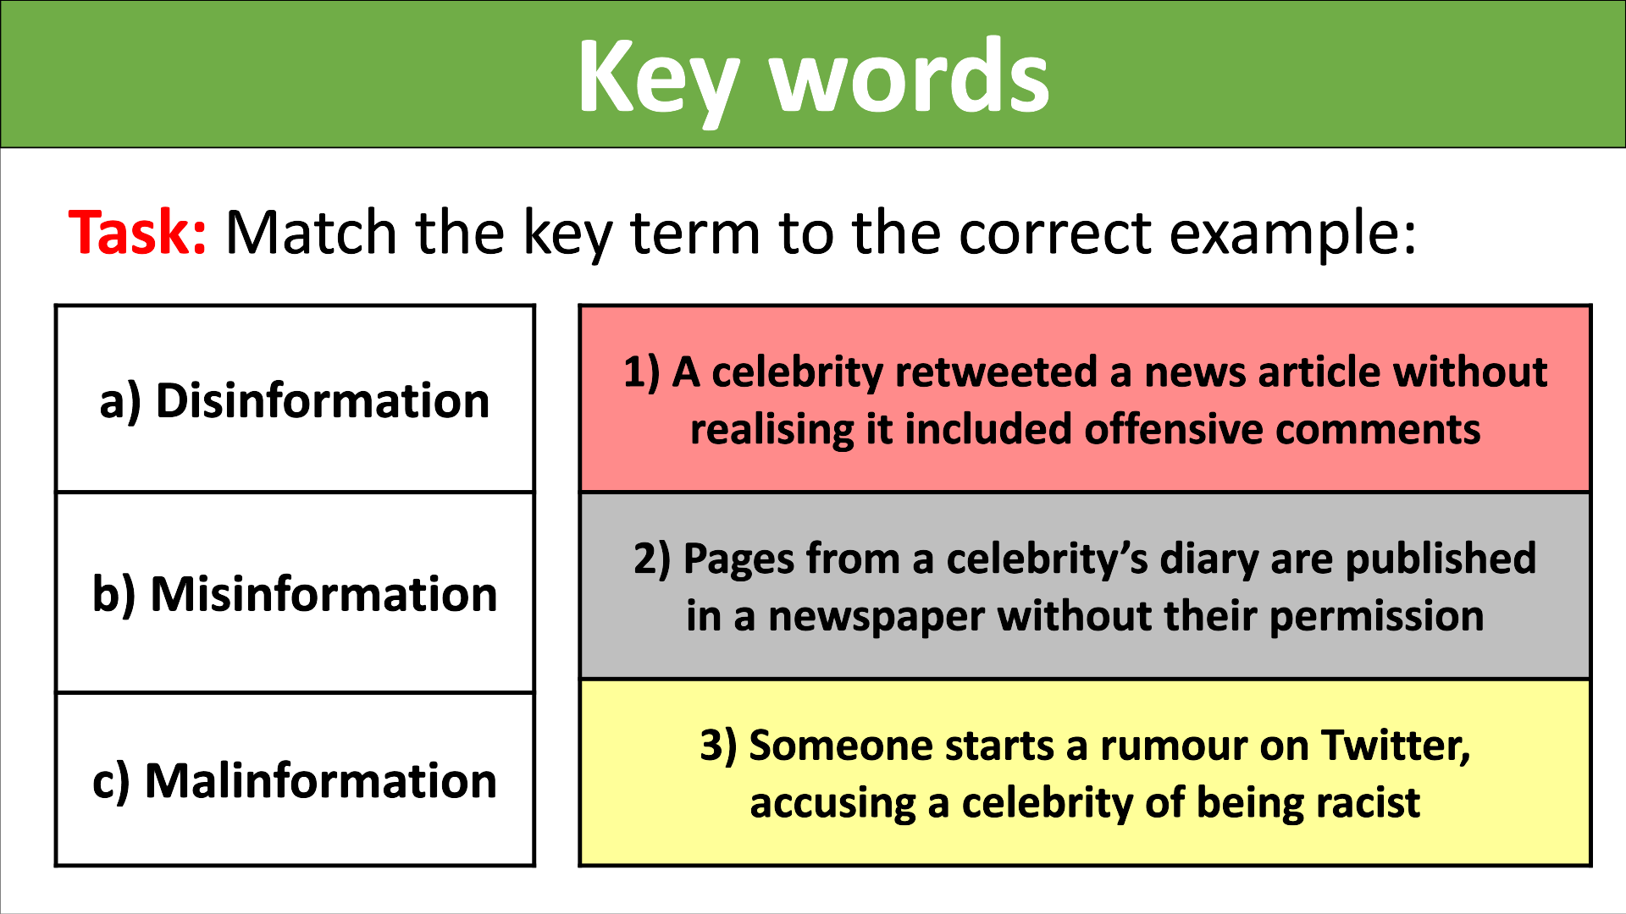
The Media and Misinformation
Who do you trust ? Your order
What is fake news ?
________________________________________________________________________________________________________________________________________________________________________________________________________________________________________________________________________________________________________________________________________________________________________________
Newspapers
Family members
News on social media
Wikipedia
Google or Google News
Government
BBC
Friends
Teachers

Slide 17
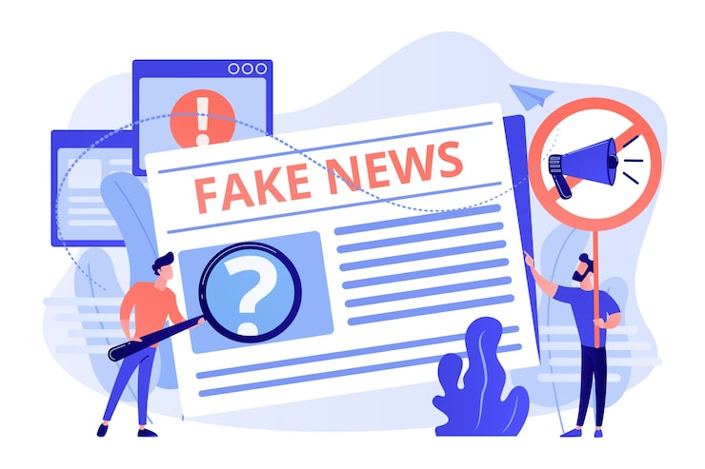
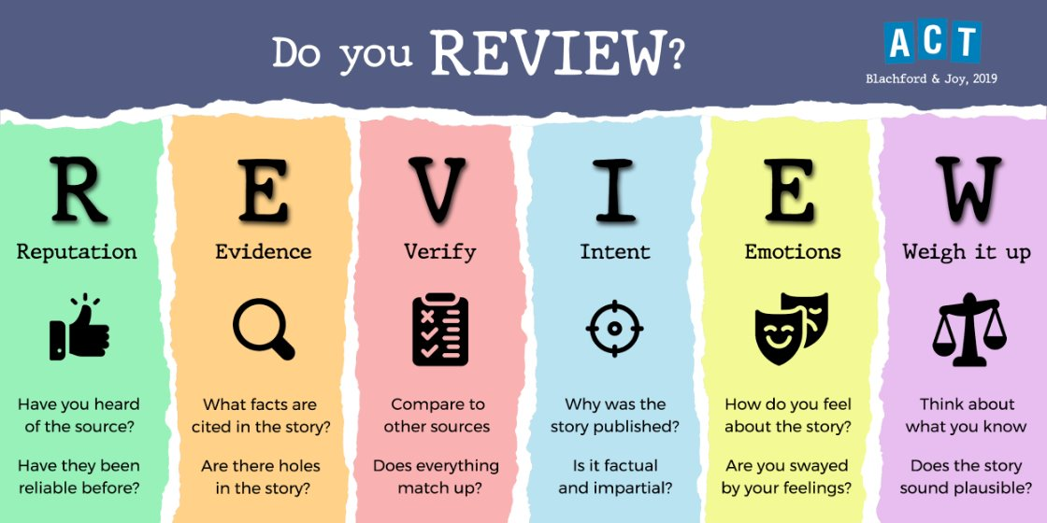
Why would someone create fake news ?
Video: How to spot fake news

Slide 18


Why does misinformation matter in a democracy?
Threatens the key values in a democracy
Genuine and fake information is difficult to distinguish
Can alter political debate
Can influence voter decisions
Lower people’s trust in the media, government, politicians and institutions
Can aggravate existing tensions in a country and generate violence
Can generate support for groups who are anti-democratic
Conspiracy Theories
​
What is confirmation bias ?​
________________________________________________________________________________________________________________________________________________________________________________________________________________________
How does it affect people's views ?​
________________________________________________________________________________________________________________________________________________________________________________________________________________________
We can ensure we are using reliable sources for our information.​
We can check the facts in stories or information ourselves using other sources.​
We can make sure we don’t share misinformation ourselves.​
Why is critical thinking important ?
_____________________________________________________________________________________________________________________________________________________________________________________________________________________

Slide 19
What is a deepfake ?
____________________________________________________________________________________________________________________________________________________________________________________________________________________________________________________________________________________________________________
The law and criminal responsibility
Definition: Law is usually made by a government, that is used to order the way in which a society behaves. | Characteristics: Laws usually inform people what they can or cannot do.
Examples: Human Rights Act, illegal buy tobacco or alcohol under the age of 18, Hate Crimes. | Synonyms: Rules, regulations, orders.
Why do we need laws ?

Slide 20
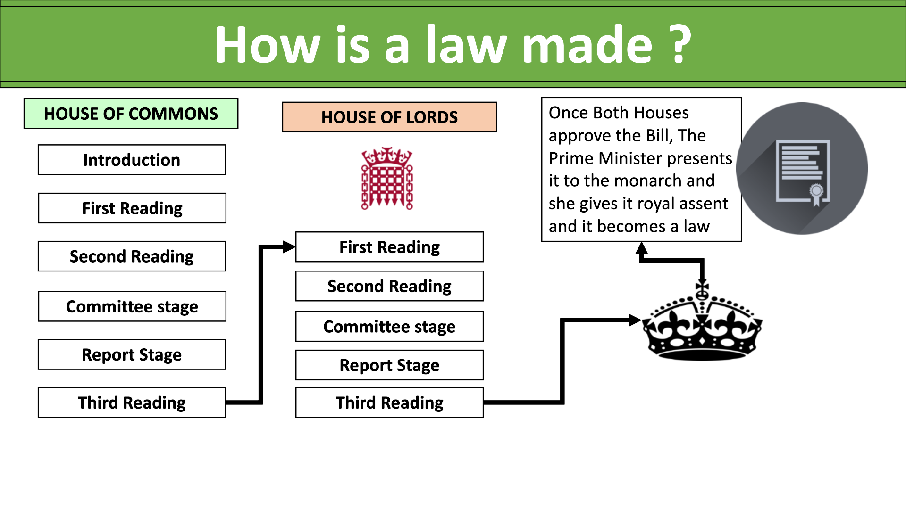
A Bill is a proposal for a new law, or a proposal to change an existing law that is presented for debate before Parliament.​
A Bill can start in the Commons or the Lords and must be approved in the same form by both Houses before becoming an Act (law).​
When both Houses have agreed on the content of a Bill it is then presented to the reigning monarch for approval (known as Royal Assent).​
What is a crime ?
_____________________________________________________________________________________________________________________________________________________________________________________________________________________
No one of any age is allowed to break the law. But in England, Wales and Northern Ireland, the age of criminal responsibility is 10 years old. (12 in Scotland)​
It is thought that children younger than this probably do not understand that what they have done is wrong. If they commit a serious crime, social services will deal with the case. ​
Everyone over the age of 10 is held responsible for their crimes and can be arrested, tried and, if found guilty, punished. ​

Slide 21
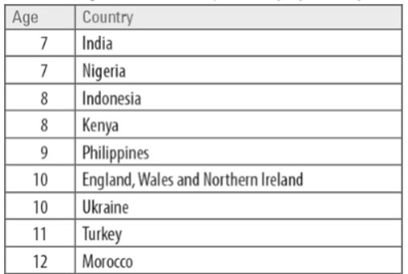
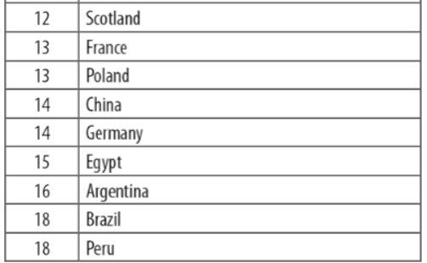

Do you think ten year olds know the long term consequences of their actions?
____________________________________________________________________________________________________________________________________________________________________________________________________________________________________________________________________________________________
​
Would they know what is right or wrong?
________________________________________________________________________________________________________________________________________​____________________________________________________________________________________________________________________________________________________
Should they be classified as old enough to be held criminally responsibility?
____________________________________________________________________________________________________________________________________________________________________________________________________________________________________________________________________________________________
​What do you think the age of criminal responsibility should be?
___________________________________________________________________________________________________________________________________________________________________________________________________________________________________________________________________________________________________________________________________________________________________________________________________________________________________________________________________________________________________________________________________________________________________________________________________________________________________________________________________________________________________________________________________________________________________________________________________________________________________________________________________________________________________________________________________________________________

Slide 22
The criminal justice system
Criminal _____ seeks to ________ the public from harm by inflicting ______________ on those who have done harm and by ___________ punishment on those who are tempted to do ________.
The harm it seeks to ____________ can vary. It can include; physical harm, bodily injury or even _______ . It can include loss or damage to ____________ or disturbance of public order. Or it could be something that threatens society or government like a _____________ attack.
What is the role of the police?
The police are generally considered to be responsible for: enforcing the law of a country; maintaining public safety and order; investigating criminal activity as well as detecting and even actively preventing crime in some cases (for example, terrorist plots, drugs rings or human trafficking operations). The definition in the police service’s Statement of Common Purpose states that “The purpose of the police service is to uphold the law fairly and firmly; to prevent crime; to pursue and bring to justice those who break the law; to keep the Queen’s peace; to protect, help and reassure the community; and to be seen to do this with integrity, common sense and sound judgement
Police officers investigate crimes and gather (as well as protect) evidence which may be used later in the trial. They are the ones who arrest offenders, and they may give testimony in court during the trial process.
The police have certain powers in specific situations. Following the Police Reform Act 2002, the police are allowed to ask for a person's name and address if the police suspect that person of acting anti-socially. It is an offense to refuse this request.
Police may also stop a person in the street and search them, but only if they have reasonable grounds to suspect a person of carrying drugs, weapons or stolen goods. In special cases, the police can be authorised to do a general 'stop and search' on members of the public if there is a heightened level of threat in the area, but this power is only temporary, and doesn't last beyond a 48-hour period. The Terrorism Act 2000 has also given police more powers to stop and search people in an area specified by police, and to seize any property which they suspect to be linked to terrorist activity. However, the Terrorism Act 2000 has been ruled illegal by the European Court of Human Rights as it is deemed to give the police too much power.

Slide 23
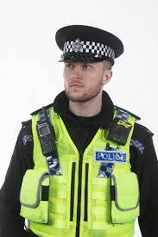
The police can arrest a person either with or without an arrest warrant. They can only arrest someone without a warrant if they believe that the person is about to cause injury or other serious harm, or if they cannot find the name and address of the suspect. Arrest warrants are issued by magistrates, and these warrants allow the police to enter a person's premises to make an arrest. Police can also issue cautions and penalty notices, as alternatives to arrest if the crime is less serious.
What is the role of the police ?
Add template sheet

Slide 24
Local Politics
What does a council do ?
__________________________________________________________________________________________________________________________________________________________________________________________________________________________________________________________________________________________________________________________________________________________________________________
My priorities as a councillor
__________________________________________________________________________________________________________________________________________________________________________________________________________________________________________________________________________________________________________________________________________________________________________________
Council Tax is an annual fee your local council charges you for the services it provides, like rubbish collection and libraries. Normally you pay it in 10 monthly instalments, followed by two months of not making any payments.​
​
How much Council Tax you pay depends on:​
your personal circumstances​
which valuation band your property is in​
how much the council needs to fund its services.​
Increase charges at Dunes Leisure Centre
Collect bins every three weeks (instead of two).
Close down day centres for old people.
Only open libraries two days a week.
Charge for youth centres.
Charge more for parking.
Cut spending on fire service/police.
Cut spending on schools.
How would I spend/save money ?

Slide 25
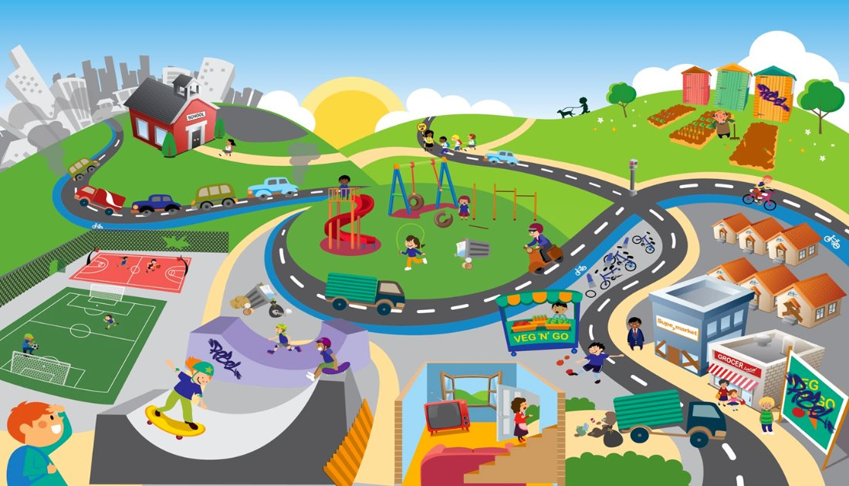
Issues

Slide 26
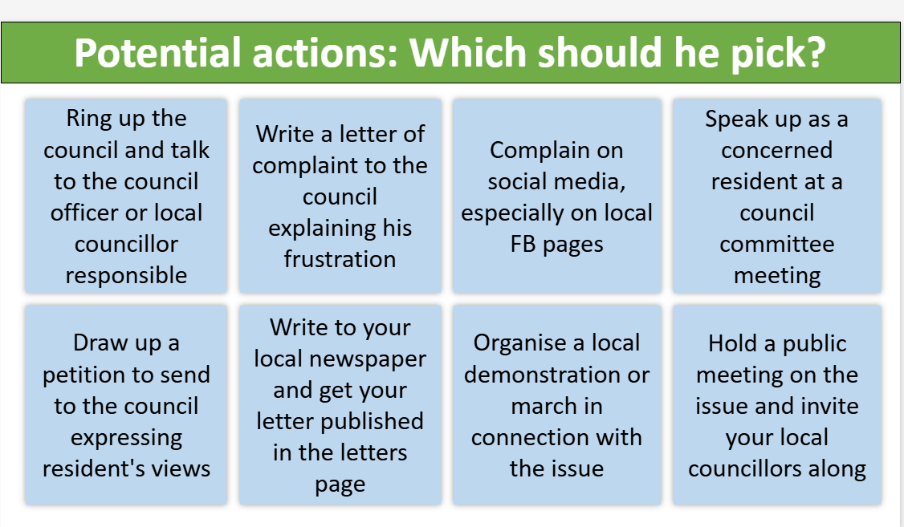
Notes

Slide 27





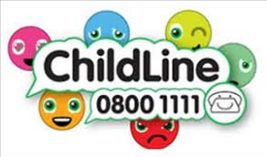





Support and advice on this topic

Slide 28
Spare pages:
____________________________________________________________________________________________________________________________________________________________________________________________________________________________________________________________________________________________________________________________________________________________________________________________________________________________________________________________________________________________________________________________________________________________________________________________________________________________________________________________________________________________________________________________________________________________________________________________________________________________________________________________________________________________________________________________________________________________________________________________________________________________________________________________________________________________________________________________________________________________________________________________________________________________________________________________________________________________________________________________________________________________________________________________________________________________________________________________________________________________________________________________________________________________________________________________________________________________________________________________________________________________________________________________________________________________________________________________________________________________________________________________________________________________________________________________________________________________________________________________________________________________________________________________________________________________________________________________________________________________________________________________________________________________________________________________________________________________________________________________________________________________________________________________________________________________________________________________________________________________________________________________________________________________________________________________________________________________________________________________________________________________________________________________________________________________________________________________________________________________________________________________________________________________________________________________

Slide 29
Spare pages:
____________________________________________________________________________________________________________________________________________________________________________________________________________________________________________________________________________________________________________________________________________________________________________________________________________________________________________________________________________________________________________________________________________________________________________________________________________________________________________________________________________________________________________________________________________________________________________________________________________________________________________________________________________________________________________________________________________________________________________________________________________________________________________________________________________________________________________________________________________________________________________________________________________________________________________________________________________________________________________________________________________________________________________________________________________________________________________________________________________________________________________________________________________________________________________________________________________________________________________________________________________________________________________________________________________________________________________________________________________________________________________________________________________________________________________________________________________________________________________________________________________________________________________________________________________________________________________________________________________________________________________________________________________________________________________________________________________________________________________________________________________________________________________________________________________________________________________________________________________________________________________________________________________________________________________________________________________________________________________________________________________________________________________________________________________________________________________________________________________________________________________________________________________________________________________________________

